Slide 1
Jail Diversion Treatment & Resource Center
711 G Street

Slide 2
How Did We Get Here?
Senate Bill 843
California Health Facilities Financing Authority (CHFFA)
Community Service Infrastructure Grant (CSI)
Sacramento County was 1 of 10 counties to be awarded monies from the CSI Grant

Slide 3
Human resources slide 3
California
Health
Financing
Fitness
Authority
Community Service Infrastructure
COUNTY COSTS ARE SPLIT BETWEEN PROBATION AND BEHAVIORAL HEALTH
SERVICES
PROJECT BUDGET:
Renovation Costs
$1,451,258
OTHER ADDITIONAL COUNTY SERVICES ARE PROVIDED IN-KIND
Furnishing & Security Costs
$239,285
TARGET POPULATION
Misdemeanor Mental Health Diversion Clients
COVERED COSTS INCLUDE:
Property Acquisition & Renovation
Furniture & Equipment
Some Start-up Costs
Applied for grant: 12/2019
Awarded granted: 3/2020
Deadline Date: 5/3/2021
Operational Date: 1/31/22

Slide 4
VISION Creation of an easily accessible community diversion and mental health treatment hub for the target population. A center for co-location of partnering agencies to provide expedited delivery of treatment and services in a warm and welcoming environment.
Partnership
Probation
Behavioral Health
Public Defender
Superior Court
Substance Use Prevention Treatment
Human Assistance
Correctional Health
Sacramento Sheriffs

Slide 5
Human resources slide 3
Welcoming Environment
Comfortable Lobby
Charging Stations
TV
Lounge Chairs
Snacks
Secure Temp Use Lockers

Slide 6
“ONE STOP SHOP”
Mental Health Assessments
MediCal
& CalFresh
JDTRC
SUDs
Assessments
Food & Drink
Legal Help
Clothing

Slide 7
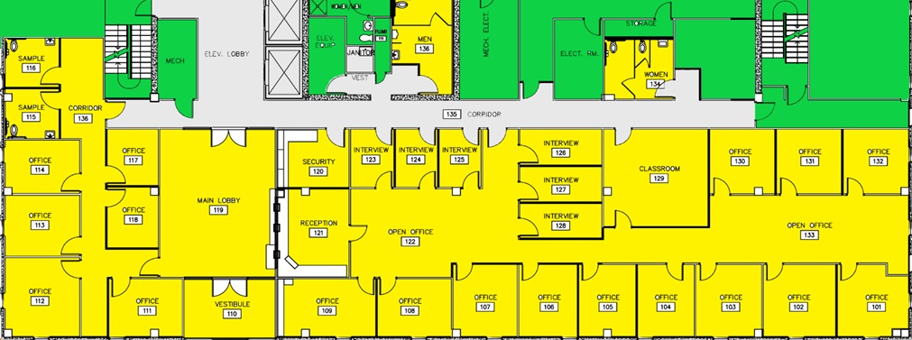
Large Photo Slide
JDTRC
 | Common Area
 | JDTRC
 | Secure Corridor
Floor Plan

Slide 8
KEY TIMELINE GOAL
 | Jan 2021 | Feb 2021 | Mar 2021 | Apr 2021 | May 2021 | Jun 2021 | Jul 2021 | Aug 2021 | Sep 2021 | Oct 2021 | Nov 2021 | Dec 2021
Permits Issued
JOC Contractor Pricing
Notice to Proceed
Construction Begins
Construction Completion
Employee Move In
Open for Services

Slide 9
Human resources slide 3
What is Misd. Mental Health Diversion?
Defendants Who
1:
Charged with a Misdemeanor
2:
Meets Requirements of PC 1001.36 and
Court Grants Mental Health Diversion Pursuant to PC 1001.36
3:

Slide 10
Pre-Granting of MHD
1
Client walks over to JDTRC with Public Defender Staff
2
5
Client is offered mental health and substance use disorder classes pending outcome of MHD
4
3
Client meets with Public Defender Pretrial Support Project for a need assessment including; mental health, substance use, housing, trauma, employment, veterans status, education, and financial stability
Client meets with Department of Behavioral Health and Substance Use Prevention Treatment Team for assessment and linkage to county services.
Public Defender gathers all assessments and creates a supportive plan to help connect client to new services and obtain treatment plan for court
Client is also offered record clearing services, support to linkage of Medi-Cal Services, and Cal Works, Cal Fresh, and GA
Assess
Link to Services
Develop Supportive Plan

Slide 11
Pre-Diversion Supports
Staff can walk client to JDTRC
Social worker to perform PTSP Assessment to determine needs
Mental Health?
Substance Abuse?
Housing?
Medical & Cal-Fresh?
Employment/Vocational?
VA?
CBT?

Slide 12
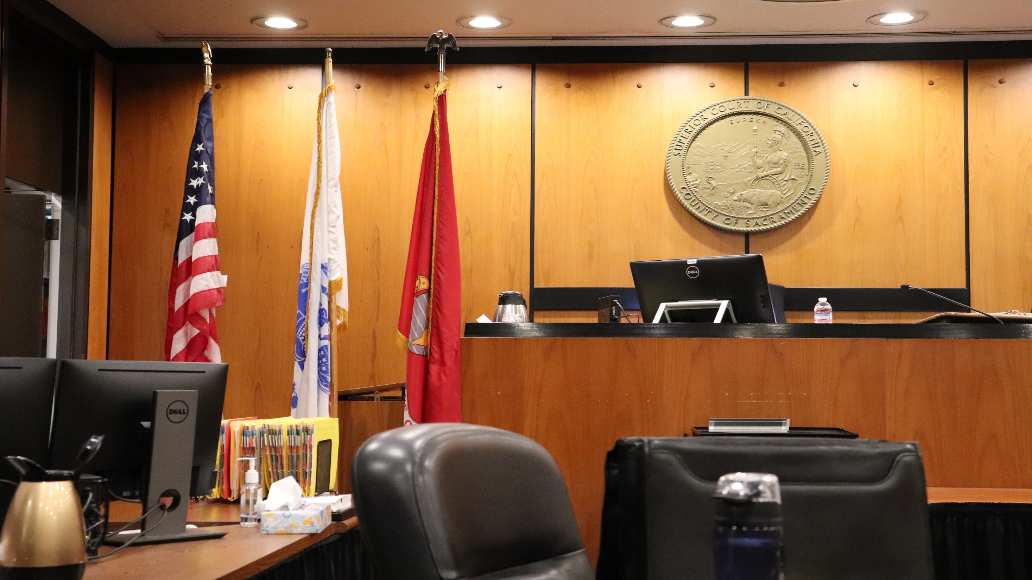
Human resources slide 3
ZOOM ACCESS & CHARGING STATION
RECORD CLEANING
SERVICES
MHD Granted
CLIENT
ATTORNEY & SOCIAL WORKERS PUBLIC DEFENDER
BEHAVIORAL HEALTH CLASSES
DEPARTMENT OF HUMAN ASSISTANCE
SUPT
CLINICIANS
MENTAL HEALTH CLINICIANS
PROBATION OFFICER
Continued Support through the JDTRC Team
SOCIAL SECURITY LINKAGE
PRE-TRIAL SUPPORT SERVICES

Slide 13
Human resources slide 3
Supporting the Diversion Population
Remove the barrier of going to multiple locations for support & Services
1
Create a space where community, criminal justice partners, and court can coordinate
2
Combine integrated care with a multi-disciplinary approach
3

Slide 14
Human resources slide 3
Mental Health Assessments
3 BHS Sr Mental Health Counselors (SMHC) sited at JDTRC
Mental Health Process
BHS SMHC completes a mental health assessment
Outcome determines County Mental Health Plan eligibility & service level
Public Defender Office is provided assessment outcome
Service Request is submitted to the Sac County Access Team to link to mental health services

Slide 15
Substance Use Treatment Services Process
Substance Use Disorder Assessments
1 SUPT Sr Mental Health Counselor (SMHC) sited at JDTRC
SUPT SMHC completes a substance use disorder assessment
Outcome determines substance use treatment level
Residential Treatment
Intensive Outpatient Treatment
Outpatient Treatment
Medically Assisted Treatment
All involved parties are provided assessment outcomes
If the client is in agreement, a Service Request is submitted to the appropriate substance use provider

Slide 16
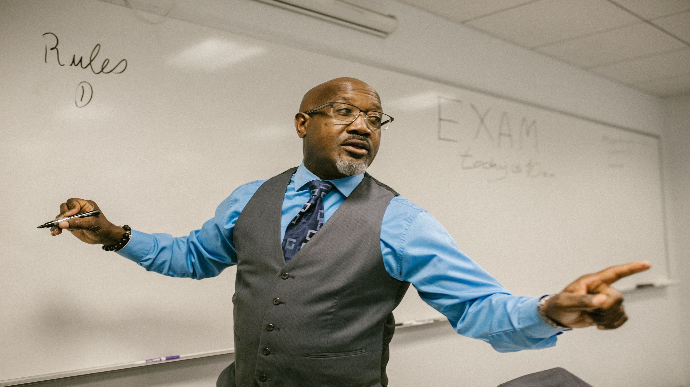
Behavioral Health Groups
5 BHS & 3 SUPT SMHC’s will rotate to facilitate weekly behavioral health groups for MHD participants
Groups will support participants with improving emotion regulation, interpersonal effectiveness, relapse prevention, substance use education, and mindfulness
Goal: To improve quality of life, improve relationships, and decrease incarcerations

Slide 17
Sample Onsite Classes
Grief & Loss
Managing Anxiety
Social Support
Relapse Prevention
Enhancing Motivation for Change
Seeking Safety
Thinking for Change
Trauma & Memory
Anger Management for SUD
My Ongoing Recovery Experience
CBI – Substance Use

Slide 18
Questions?
JDTRC
LeeAnn McCluskey
Assistant Chief Deputy
916-875-0018
Kim Grimes
Human Services Program Planner
916-875-2038
Tiffanie Synnott
Chief Assistant Public Defender
916-874-6411
Notes:
Add all names

