Slide 1
Vaccine Hesitancy:
Using Motivational Interviewing to Help Patients
3
Elizabeth Morrison PhD, LCSW

Slide 2
Motivational Interviewing:
An empathy-based communication approach for patients with SUD
Elizabeth Morrison PhD, LCSW
Notes:
Main point: MI is an empathy-based and equity-based approach; however with our continued evolution of understanding about how trauma and toxic stress has impacted most of us and most of our clients, it seemed important to emphasize specifically the TIC-congruent nature of MI.

Slide 3




MI Research
General
Race/Ethnicity
Conditions
Settings & Roles
Over 90 Clinical Trails Show MI effectiveness across a range of behavior change areas
Research supports MI across cultures, including with African Americans, API populations and Latinos and others
MI has been shown to be effective with SUD, depression, anxiety, chronic disease management and more…
MI has been shown to be effective medical, dental and behavioral health care; with physicians, MA's nurses, CHWs, therapists and more

Slide 4
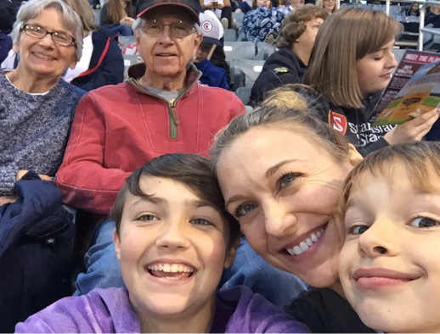
MI is just as applicable to our relationships with our friends, family, & ourselves
Notes:
Important point: The strategies and techniques we are going to talk about today are just as applicable to our family and friends as they are to our work with patients/clients.
Why: 1) Adult learners tend not to internalize new information when it is work-only specific (such as new EHR systems, time-cards, etc.). When information is useful both in and out of work, learning tends to go deeper, and is more internalized. Because the communication skills we discuss here are foundationally skillful for any relationship, we want to ensure participants know this early on.
2) Often in workplace we are told we are learning things so we can do a better job for the company, for clients, for the bottom line. In some ways this makes sense when we work in mission driven fields; it does however feel different when we let people know this is also something we are doing because we want to support them, in their lives, outside of work too.
This is a good place to have a picture of your family/friends if you feel comfortable with this, or if it suits you more to have a less personal disclosure, to have a more general picture of children, family, marriage, etc..

Slide 5


Foundational MI Strategies
Establishing Empathy
Developing trust through empathy
Assessing Importance
Finding out where someone is, regarding the change
Eliciting Change Talk
Responding effectively to wherever someone is

Slide 6


Slide 7
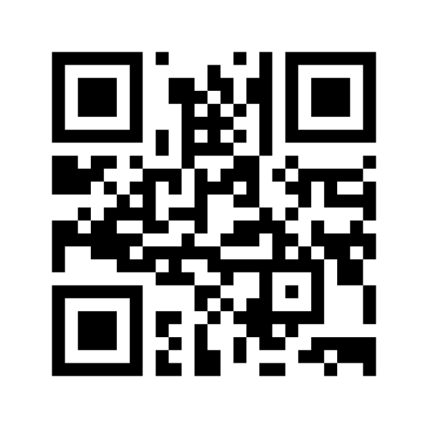
Menti.com
52 84 44 8

Slide 8
What is so important about empathy in helping others make changes?
Notes:
Main Point: Returning to this question, next reason.

Slide 9

What is Empathy?
Compassion
Trauma-informed care
Humility
Understanding
Respect
Caring
Kindness
Goodwill
Therapeutic-alliance
Perspective-taking
Rapport

Slide 10



Empathy is a Treatment For:
Common
cold
Pain
control
Substance use disorders
Notes:
Main point: Empathy is an evidenced-based treatment. It isn't touchy-feely or wishy-washy niceness. It is a well-researched treatment, which has shown unequivocal effectiveness in a wide range of conditions.
Common cold: Research has shown that people with a common cold who feel empathy from their health care team have less severe symptoms, for less time. The research has been replicated.
Pain Control: People who feel empathy from their helping professional report less pain. This has been replicated multiple times, in many different settings. Most of us have seen this first hand with children. This doesn't mean pain is 'in our heads', it means empathy allows our nervous system to relax, lowers cortisol and other stress responses, lowering physical pain.
SUD: The 'unconditional love' article may be one of the best to talk about here. There is a ton of research showing that when someone with an SUD feels empathy from helping professionals they are more apt to recover.
TIP: This part is usually important to hit it out of the park in terms of research highlights. Skimming the bibliography can be helpful, or changing the conditions here to other research you are familiar with is useful to.
TIP: It is important to share that this is just a sampling of findings- there are hundreds more.
TIP: This is a good place to ask people about what they've seen, their own experiences with this, as clients or as helping professionals. Most people 'know' this intuitively due to their experiences.

Slide 11



Empathy is a Treatment For:
Anxiety
Diabetes
Depression
Notes:
Main Point: Sam as previous. Both slides have a mix of 'medical' and 'MH' and 'SUD' conditions, to speak to all participant groups.
Anxiety: When we feel judged, criticized, stigmatized, this causes a stress response in our bodies (increased adrenalin and cortisol), making anxiety worse; empathy does just the opposite.
Diabetes: The higher the HA1C (blood sugar measurement- higher is worse), the lower the empathy levels patients felt from the care team; the higher the empathy levels were rated by patients, the lower the HA1C. This has been replicated.
Depression: Similar to anxiety.

Slide 12
Communicating Empathy
Conveying interest in the experience of another….
Open ended questions
Reflecting back (kindly) what we hear
Empathic Reflection
Looking for and reflecting back, the good we see
Affirming Strengths
Empathic Reflection

Slide 13

The gold standard of communication
  Open Ended Questions
Notes:
Main Point: Define normalizing as letting someone know they are normal- not pathological, not abnormal, not alone in what they are feeling or experiencing.

Slide 14
How do you feel about smoking?
Tell me more about that…
What are your thoughts about your alcohol use…
Notes:
Main Point: These are examples of how we might communicate normalizing (have examples ready to finish these sentences). Specifically call out the use of 'us' and 'we' as an example of normalizing.
TIP: This is a good place to ask others for how they might communicate normalizing.
TIP: inviting discussion from participants about use of self disclosure can be useful- re: how we make decisions about self disclosure, what levels of self disclosure, after we disclose how quickly we need to get back to the person in front of us so they trust they won't have to take care of us, trust that we can stay focused on them…

Slide 15

Empathic Reflection
It sounds like…..
I can hear….
If I'm hearing you right…
If I'm understanding you…..
You are….
Skillfully repeating back what we hear and see; assuring others we are 'with' them….creating space for others to self reflect.

Slide 16
"You have really mixed feelings about this"
"I can hear you feel strongly it is dangerous for you"
Double sided: "On one hand you want to get the vaccine to help your sister worry less; on the other hand, you are scared"
Notes:
Main Points: Defining different types of reflection.
Sub point: Exact word reflection has its own body of research behind it- many of us are cautious of it- we only pick one or two words someone has said, not whole phrases or sentences.
Sub point: Double side reflection is particularly important when people have shared some ambivalence – having examples is important here.

Slide 17

Looking for, noticing and verbalizing a person’s strengths
  Affirming Strengths
Notes:
Main Point: Defining Affirming strengths: Noticing and articulating the good things you see about someone. Often starts with ‘I’m impressed with your…’ ‘I’m inspired by your....’,’ I appreciate your....’ or 'I'm struck by..' I can' really hear….' (in giving examples, need to finish the sentence). Affirming strengths is a part of 'strength-based philosophy, it is the actual communication of this.
Sub point: Strengths can be someone's effort, intentions, what they care about, what is meaningful to them, what their values are, qualities you see….
Sub point: In order to fully utilize this communication strategy, we are always 'looking' for strengths, as if we have special strength-finding glasses on. No matter how down someone is, how demoralized, embarrassed, distressed someone is, we can still always see strengths in them.

Slide 18
Affirming Strengths
You really care about your family…
You really care about your health
You've given this a lot of though….
Notes:
Main point: These are examples of stems we use sometimes.
TIP: This is a good point to ask participants how they communicate strengths…

Slide 19
Connect & Practice: Empathy
Practice
Practice
Practice
OEQ
Empathic Reflection
Affirming Strengths
Pair
Up!
Switch!
Notes:
Main Directions (see guidance on practice episodes in the companion guide for more detail)
TIP: If you are co-facilitating, doing a mini demonstration is usually very well received. Usually doing something spontaneous, to mirror what participants will be doing, is best. Missteps are no problem at all, we can just model taking a pause and starting over.
In person Pairs or threes. Avoid ’counting off’, it causes movement, commotion and some chaos which increases people's nervousness. We want people just practicing with those next to them, as they usually are more comfortable with those they sat by. Go around the room and just dividing people into three.
Virtual workshop: Use break out rooms. If the group is very large, divide into threes to ensure each group has at least two people who can practice. If the group is smaller, under 20 and everyone is on video and has audio and video merged, pairs are preferred.
Give roles: 1. Person practicing 2. Person being practice with 3. Observer if in threes.
The person who is practicing asks their partner an open ended question about their family. After their partner shares, they can ask a follow up open ended question, then empathically reflect what they heard, or they can reflect first and see if their partner is continues on naturally, then they reflect again. So either: Open ended question, open ended question and then reflection; or Open ended question to start, reflection, then another reflection.
Be very clear again that it we are just ourselves, we are not role playing. For this reason, again it is important to share only what they feel comfortable sharing (giving permission for any level of vulnerability).
The practicer asks the partner how it felt; after sharing, they switch roles.
The practice is timed, with 4-5 minutes for each person. Call out when it is time to switch in person; virtually chat in the break out rooms when it is time to switch.
Ask people again to be very conscious to avoid any advice.
Pause to ask what questions there might be before breaking out.
After participants come back, take 3-5 minutes to ask people who might want to share about their experience. If virtual, take off screen share to discuss.

Slide 20
Maintenance
Action
Preparation
Stages of
Change
Contemplation
Preconcentration
Notes:
Main Point: The second reason empathy is so important is because in its absence, behavior change is stymied. If we want to help others (in our families, friend groups, our clients and patients make changes in their lives, successfully conveying empathy is vital.
TIP: this is a great slide to ask for participant input. You can ask who might want to define these (start with pre-contemplation and work clock wise. This is usually a chance to practice skillful reflective listening and also how to ‘correct’ without correcting, because often people wrongly define pre-contemplation as ’thinking about it’ or ‘ambivalence’ which is contemplation.
It is important here that as a trainer you feel very competent and confident about your own understanding of each stage of change, so you can give examples of what happens during each stage. It is also very useful to share examples from your own life, or an example from one of your patients (no names of course).
Here are some basic explanations:.
Pre-contemplation: Do not think it is a problem. No thought about changing. Sometimes called ‘denial’
Contemplation: also called ‘ambivalence’. Considering change; one step forward 1 step back, etc..
Preparation: no change yet, however the decision has been made, and preparations are happening, such as telling people (that the diet will start in 2 weeks, that the quit date for cigarettes is next month, etc..), buying supplies, looking for apartments (in the case of leaving a relationship, etc..). This is a good place to use an example from your own life or one of your patients.
Action: self explanatory
Maintenance: self explanatory
Identification is sometimes talked about as the 'last' stage (if a participant mentions): so identified with the change, relapse is very unlikely.
TIP: It is often useful to give an example of a behavior change and walk through each step with it. Using something from your own life if you are comfortable, or from a client story works as well. Asking participants to think about a behavior change in their life and walk through it in their minds is also often effective.
You can add that relapse can happen after action, and often does for any behavior change.

Slide 21



Increasing Importance
Strengthen the Relationship
Explore Ambivalence – go LOW!
Avoid Harm (roll with resistance; non-judgment)

Slide 22


Affirming Autonomy & Eliciting Change Talk
Everyone feels differently, and how you feel, what your thoughts are….that is the most important thing. Only you know what is best for you. What are your thoughts on this decision?
I see you marked a 3 on the ruler….I so appreciate you sharing this with us. It sounds like you are not so sure it is important to get the vaccine. Can you tell me more what made you check a 3, and not a 1?

Slide 23
AATA
Ask what patient already knows
Ask permission to give information
Tell patient the most important information
Ask patient what they think about it

Slide 24

Barriers to Empathic Communication

Slide 25
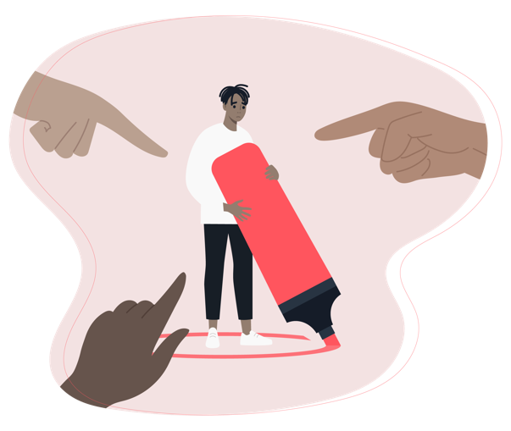
Advice
1
2
The Righting Reflex
3
Bias, judgment

Slide 26

You need to think about your kids….
Yes, but…
Have you thought of…..
SHAME
ARGUE
ADVICE
CORNERING
INFANTILIZE
Don't you think….
We just want what's best for you…
Notes:
Main Point: To see how common it is that we can fall into doing things instead of acknowledging feelings.
TIP: This is a good spot to just let participants read the slide, no need to read it to them- and to ask what else others would add, or what examples they might have of either doing these things or being on the receiving end of these…
TIP: It can be helpful sometimes to say these aren't necessarily bad/unskillful all of the time- usually acknowledging feelings before going into one of these strategies though will make it more effective at communicating empathy.

Slide 27

www.emorrisonconsulting.com

