Slide 1
What we know about Addiction
Aimee Moulin MD
Emergency Medicine
UC Davis
Notes:
In your presentation we’re hoping you will generally cover (in any way you see fit to address the subject of “Understanding the Science of Addiction”): How Opioids interact with the brain and body and the neuro-biological process of addiction – that it is a disease that can be treated. Conditions that increase the likelihood of misuse: mental health issues; problems at home; social and family norms; genetic predisposition.

Slide 2
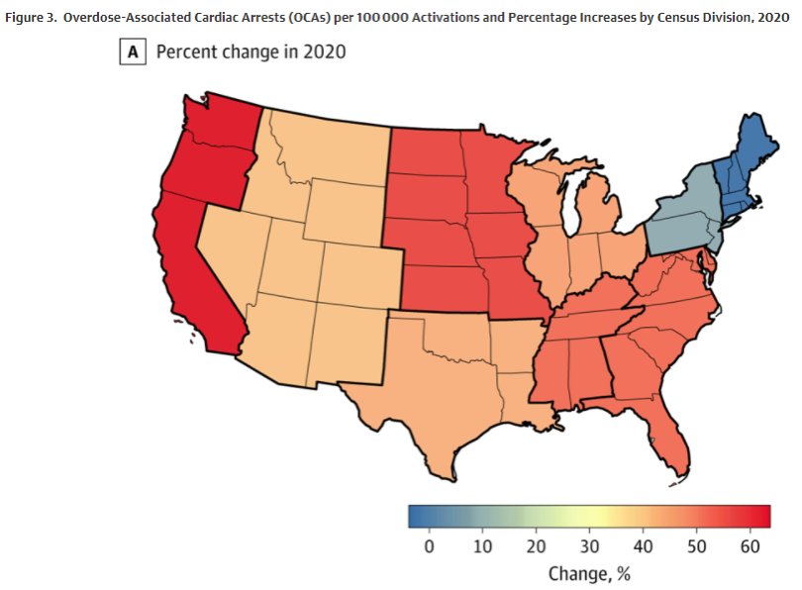
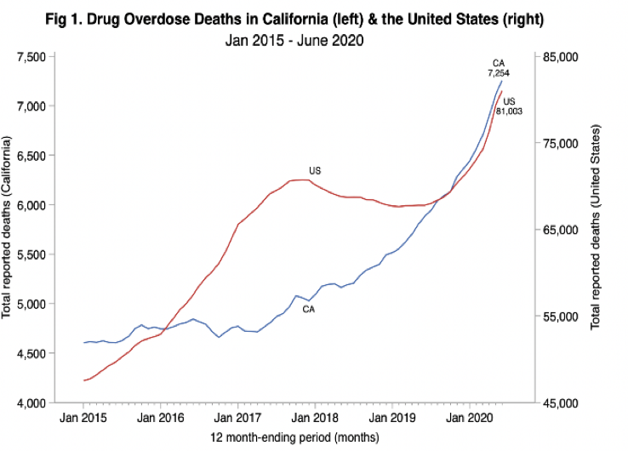
Fentanyl comes to California

Slide 3
Risk of death after overdose
Patients who receive naloxone after an overdose have a high risk of death.
5.5% mortality in the first year
20% of deaths occurred in the first month
Spike in deaths at 48 hours
Number of deaths after ED treatment for nonfatal overdose by number of days after discharge in the first month (n=130)
Weiner, Scott, etal.. Annals of Emergency Medicine. 2019.

Slide 4
What are we going to talk about
Addiction is a disease
Addiction is treatable
Treatment saves lives

Slide 5
Neuro-anatomy
Frontal Lobe vs Midbrain
Frontal Lobe development @26yo

Slide 6
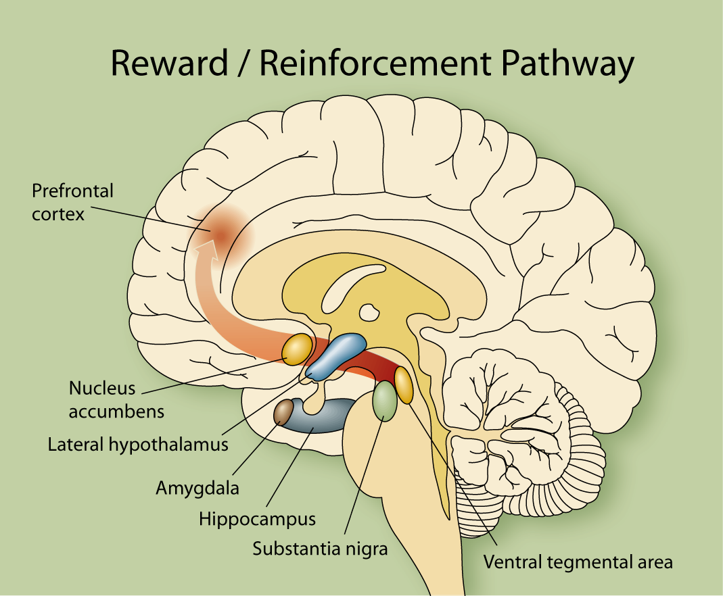
Notes:
This is the rise in drug overdose deaths 1980 to 2017. Look at peak gun deaths in 1993, peak HIV deaths in 1995, peak car crash deaths in 1972. Think of everything we have done through the Automotive industry and ensuring seatbelt safety as part of our medical conversations to save lives. Now look at 70,237 people died from drug overdose in the US in 2017.

Slide 7
Stop Switch
Go Switch
Notes:
This is the rise in drug overdose deaths 1980 to 2017. Look at peak gun deaths in 1993, peak HIV deaths in 1995, peak car crash deaths in 1972. Think of everything we have done through the Automotive industry and ensuring seatbelt safety as part of our medical conversations to save lives. Now look at 70,237 people died from drug overdose in the US in 2017.

Slide 8
Neuro-anatomy
Frontal Lobe vs Midbrain
Frontal Lobe development @26yo

Slide 9
Dopamine
Hedonic threshold
Better than expected
As expected
Worse than expected
Notes:
It has been discovered that nearly all drugs of abuse increase nucleus accumbens dopamine, and for years, the prevailing hypothesis was that dopamine was the key neurotransmitter subserving the reinforcing effects of all drugs of abuse. In recent years, however, it has become apparent that dopamine is not the only “reward” neurotransmitter, and that other neurotransmitters play key roles. In support of this, destroying the dopaminergic projection from the VTA to the nucleus accumbens does not alter alcohol intake in animals. Clearly, other neurotransmitters are involved.
Opioid peptides have also been shown to play an important role in alcohol intake. The arcuate nucleus of the hypothalamus contains opioid peptides which can be released and can bind to receptors in the nucleus accumbens and VTA. As such, opioid peptides are reward neurotransmitters in much the same way that dopamine is.
Drs. Jennifer Mitchell & Howard Field UCSF’s Gallo Institute Endorphin Study 1/12/12 fMRI show those prone to alcoholism release more endorphin in both the limbic system and the pre frontal cortex.

Slide 10
Fentanyl/Heroin

Slide 11
No Longer Chasing the High
Euphoria
Normal
Withdrawal
Opioid Agonist Therapy
Tolerance & Physical Dependence
Acute use
Chronic use
Notes:
https://elearning.asam.org/buprenorphine-waiver-course
The ASAM Treatment of Opioid Use Disorder Course: Includes Waiver Qualifying Requirements
Prevent withdrawal, prevent cravings, prevent getting high, no sedation

Slide 12
What is MAT?
“MAT” Medication Assisted Treatment (or Medication for Addiction Treatment)
“MOUD” Medication for Opiate Use Disorder
Methadone – Full Opiate
Buprenorphine (Suboxone) – Partial Opiate
Naltrexone – Anti Opiate

Slide 13
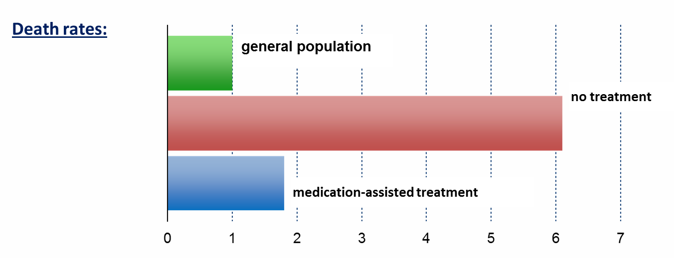
Treatment Saves Lives
Dupouy et al., 2017
Evans et al., 2015
Sordo et al., 2017
Standardized Mortality Ratio
Notes:
Speaker Notes:
Key Point #1: Patients out of treatment died at about 6 times the rate of people in the general population, while medication-assisted treatment with methadone brought this to less than 2 times.
Key Point #2: Retention in methadone and buprenorphine treatment is associated with substantial reductions in the risk for all cause and overdose mortality in people dependent on opioids.

Slide 14
How Long do Patients Need MAT?

Slide 15
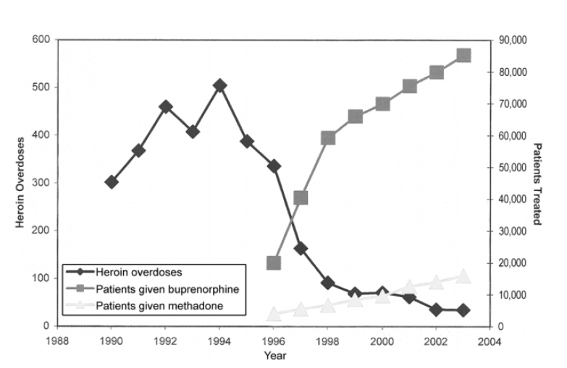
Notes:
Auriacombe M, Fatséas M, Dubernet J, Daulouède JP, Tignol J. French field experience with buprenorphine. Am J Addict. 2004;13 Suppl 1:S17-28. doi: 10.1080/10550490490440780. PMID: 15204673.

Slide 16
10.3% of people aged 12 or older who need treatment for substance use received any substance use treatment in the past year
Notes:
https://www.samhsa.gov/data/sites/default/files/reports/rpt29393/2019NSDUHFFRPDFWHTML/2019NSDUHFFR090120.htm#tx1
Substance Abuse and Mental Health Services Administration. (2020). Key substance use and mental health indicators in the United States: Results from the 2019 National Survey on Drug Use and Health (HHS Publication No. PEP20-07-01-001, NSDUH Series H-55). Rockville, MD: Center for Behavioral Health Statistics and Quality, Substance Abuse and Mental Health Services Administration. Retrieved from https://www.samhsa.gov/data/

Slide 17
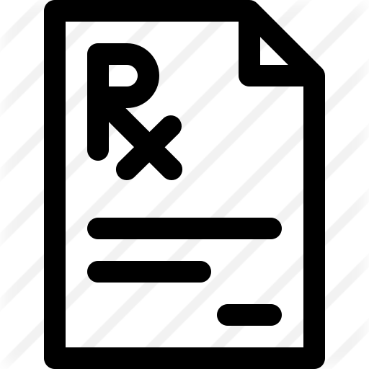
CA Bridge Impact: To-Date
Cumulative totals across all reporting CA Bridge sites (n = 86), April 2019-March 2021
48,007 | 24,191 | 10,471
SUN encounters | patients identified with OUD | encounters where MAT was prescribed or administered
SUN: Substance Use Navigator
OUD: Opioid Use Disorder
MAT: Medication for Addiction Treatment
Notes:
Aimee
First Program year data, updated metrics to-date, shown in next slide

Slide 18
Myth of Treatment Resistance
Review of 294 patients at UC Davis
75% Medicaid Coverage
45% Experiencing homelessness
34% Comorbid psychiatric diagnosis
*Homelessness was associated with connection to treatment OR 2.34 p 0.01
Notes:
https://doi.org/10.1080/14659891.2020.1789231

Slide 19
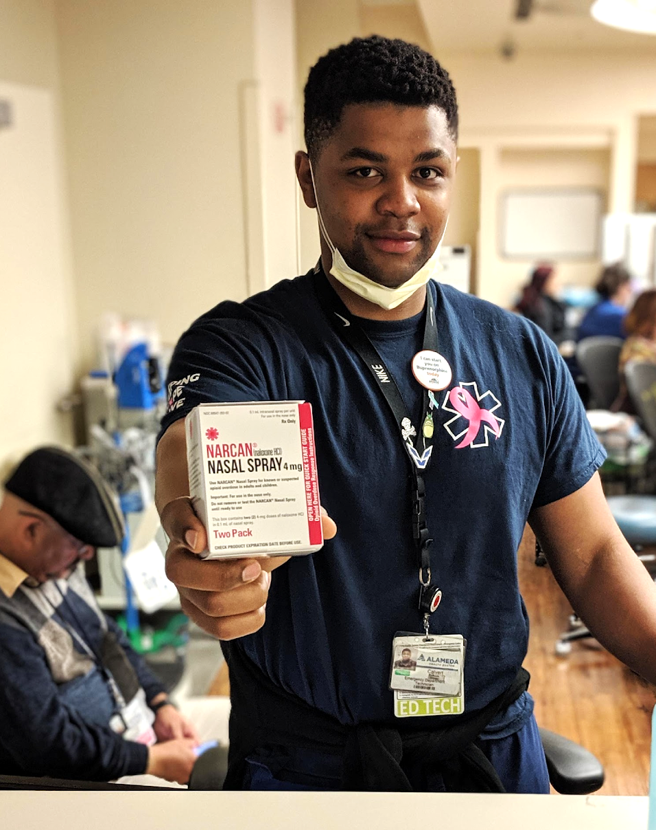
What should we do?
MAT is started on demand in all settings EDs, community clinics, primary care, hospitals…
Naloxone Naloxone Naloxone
Notes:
Culture Change, Normalizing Addiction and Addiction Treatment

