Slide 1
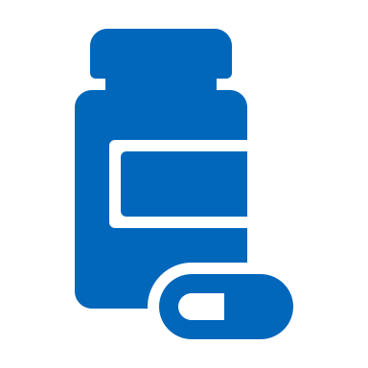
California Overdose Surveillance Dashboard
https://cdph.ca.gov/opioiddashboard

Slide 2
Purpose
Support and improve data sharing and integration
Serves as the primary data dissemination tool for opioid-related and other drug overdose data that incorporates statewide and geographically-specific opioid overdose and prescription data and displays them in enhanced visualizations
Data available on the dashboard includes:
Death data
Emergency Department visit data
Hospitalization data
Prescription dispensing data
Notes:
California continues to face a serious public health crisis with the overdose epidemic having substantial effects on the health and wellbeing of Californians. The epidemic is dynamic and rapidly changing, and overdose patterns have shifted in recent years to involve more synthetic opioids, including fentanyl.
The complexity of the issue necessitates data-informed actions through multi-sector, strategic collaboration at both the state and local levels to address the problem comprehensively.
With a preliminary count of nearly 7,000 opioid-related overdose deaths occurring in 2021 alone and the wide variation of overdose rates across counties and demographic groups, there is a need for integrated, timely, actionable data for use by state policymakers, local opioid safety coalitions, media, community stakeholders, and the public to monitor and combat this dynamic epidemic at the state and local level.
The California Overdose Surveillance Dashboard is an effective tool for monitoring drug overdose in your jurisdictions and understanding how different communities are impacted.

Slide 3
Dashboard Data Sources
Death Data
California Department of Public Health Center for Health Statistics and Informatics(CHSI)
Available for 2006 - Preliminary 2021
Patient Discharge Data (PDD) Hospitalizations
California Department of Health Care Access and Information (HCAI)*
Available for 2006 - 2021
Emergency Department (ED)
Visit Data
California Department of Health Care Access and Information (HCAI)*
Available for 2006 - 2021
Prescription data
California Department of Justice Controlled Substance Utilization Review and Evaluation System (CURES) Available for 2008-2021

Slide 4
Any Opioid-Related Age-Adjusted Rates, County Residents, 2020
 | El Dorado County | Placer County | Sacramento County | Yolo County
Overdose Deaths | 22 (11.7 /100k) | 45 (12.2 /100k) | 107 (6.8 /100k) | 10 (4 /100k)
Non-fatal Overdose ED Visits | 47 (30 /100k) | 112 (30.8 /100k) | 507 (32.2 /100k) | 63 (25 /100k)
Non-fatal Overdose Hospitalizations | 24 (8.7 /100k) | 23 (4.8 /100k) | 158 (9.2 /100k) | 19 (7.2 /100k)
Any Opioid Prescriptions | 110,748 (422.3 /1k) | 211,312 (415.7 /1k) | 716,683 (412.8 /1k) | 75,029 (346.8 /1k)
Source: CDPH Center for Health Statistics and Informatics Vital Statistics - Multiple Cause of Death and California Comprehensive Death Files, California Department of Health Care Access and Information - Emergency Department and Inpatient Discharge Data,
California Department of Justice - Controlled Substance Utilization Review and Evaluation System Data
Prepared by: California Department of Public Health, Substance and Addiction Prevention Branch.

Slide 5
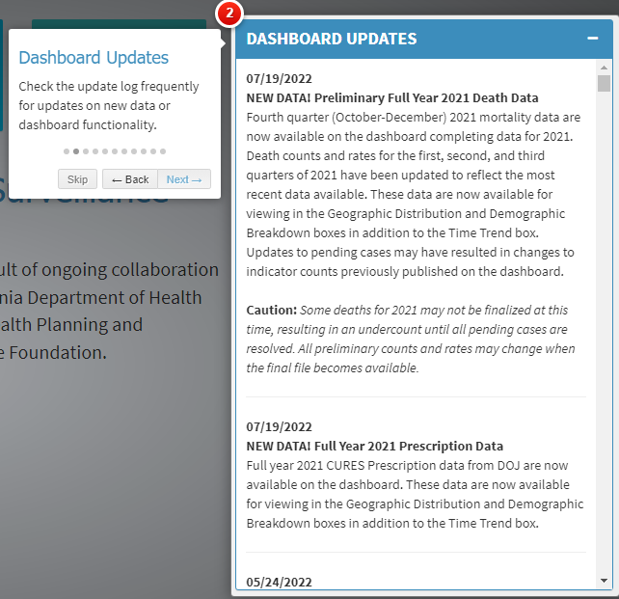
Dashboard Help
The California Overdose Surveillance Dashboard includes a built in Help feature that walks through many Dashboard features with short descriptions

Slide 6
Data Visualizations
Geographic Distribution
Best place to compare counties to other counties (CA Dashboard) or age-adjusted rates by zip code (County Dashboard)
Table – best place to see county counts by year
Time Trend
Best place for most up-to-date quarterly data and trends
Graph displays indicator change over time
Demographic Breakdown
Best place to view indicators by a chosen demographic (sex, age, or race/ethnicity)
Bar Chart – displays annual data for chosen indicator by chosen demographic
Graph – displays data for chosen indicator by chosen demographic over time.
Notes:
The County Dashboard also has these three data visualizations – the Geographic distribution displays age-adjusted rates by zip code

Slide 7
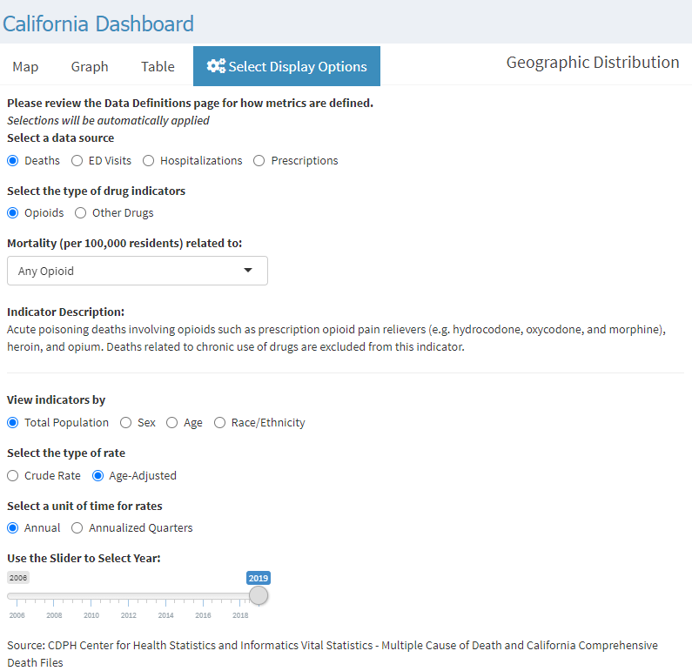
Settings are available for each visualization box
Click the “Select Display Options Tab” for a list of settings including
Data source
Drug indicators
Demographic group
Type of rate and unit of time for rates
Year
Not all settings will be available for every visualization
Notes:
All selections will be automatically applied when you click one of the other tabs.

Slide 8
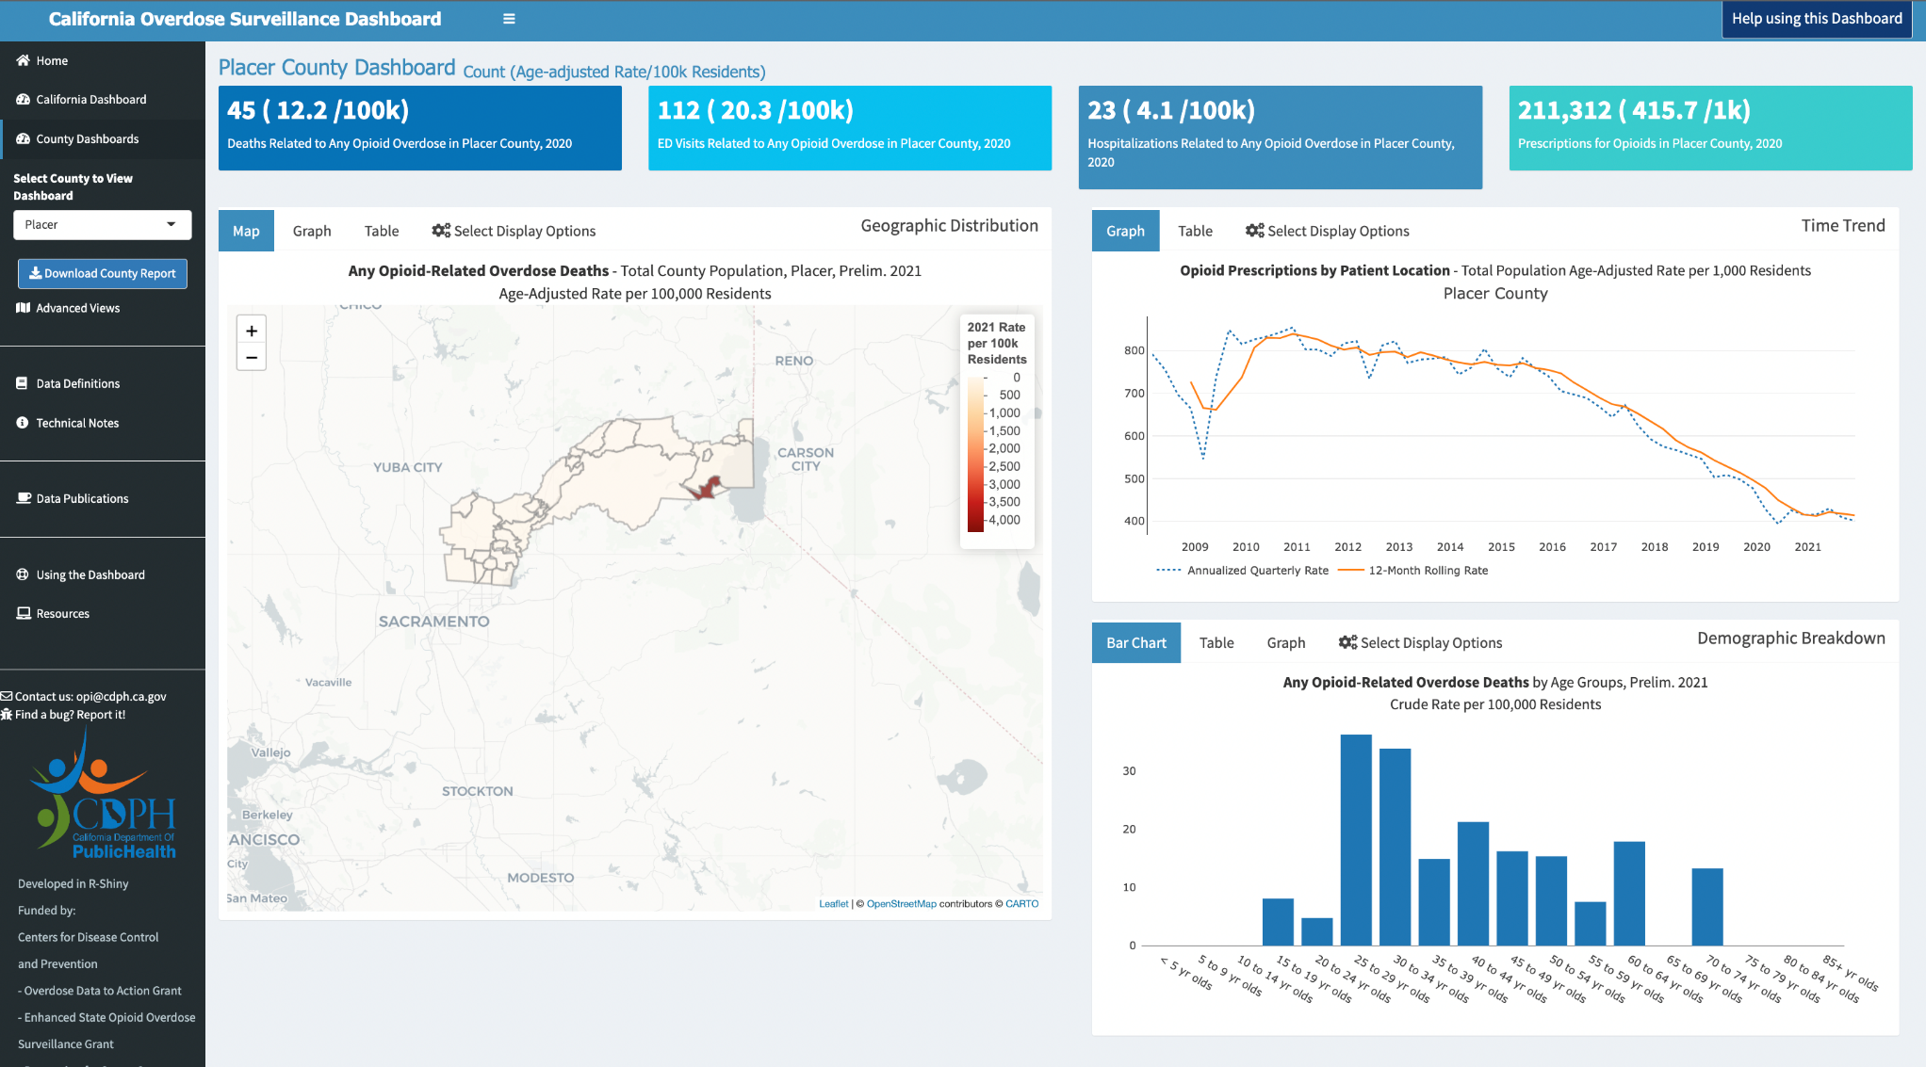
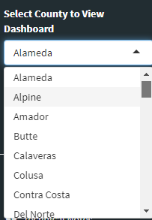
View Overdose Data in Your Community
Notes:
To view data for your county, click on the drop-down menu and select your county.

Slide 9
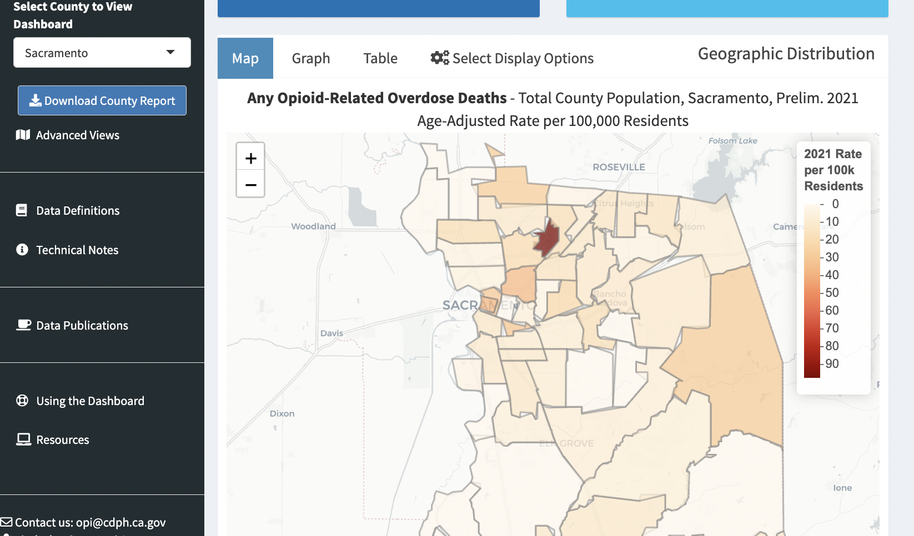
County-Specific Data
Notes:
MP edit: Dashboard users can explore county data using the geographic distribution visualization box to explore overdose-related indicators by zip code. Only age-adjusted rates are available at the zip code level to comply with agency data de-identification guidelines. Zip code level rates are usually unstable because they are based on small counts. Stable rates will not vary much from one year to the next. An unstable rate varies from one year to the next due to chance alone. Users can also look at the 95% confidence intervals to assess stability. Wider confidence intervals for a rate indicate instability.

Slide 10
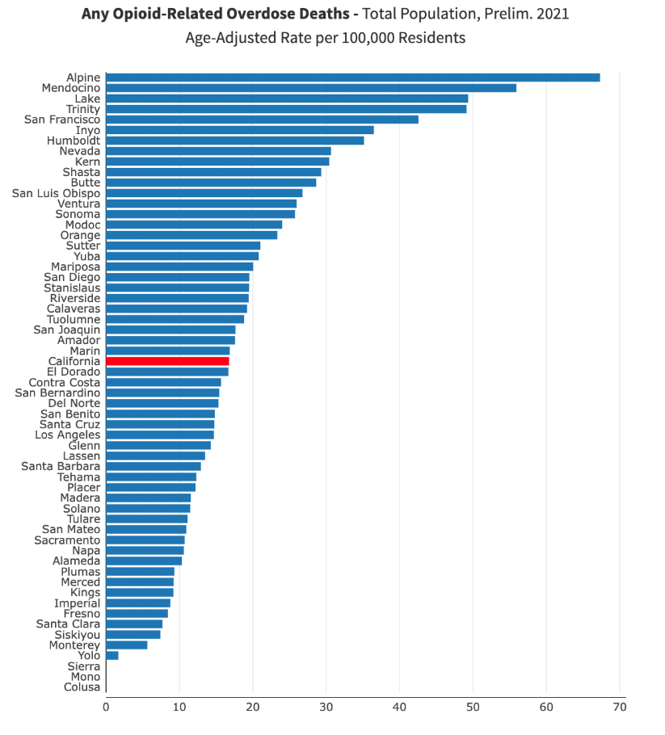
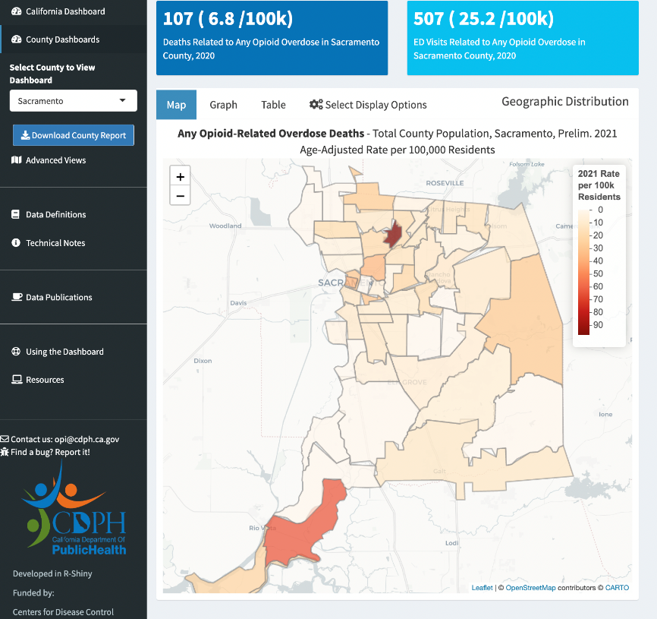
Geographic Distribution
Notes:
The CA Dashboard geographic distribution visualization box is the best place to compare counties to other counties.
The Table is the best place to see county counts by year. It provides a broad overview.

Slide 11
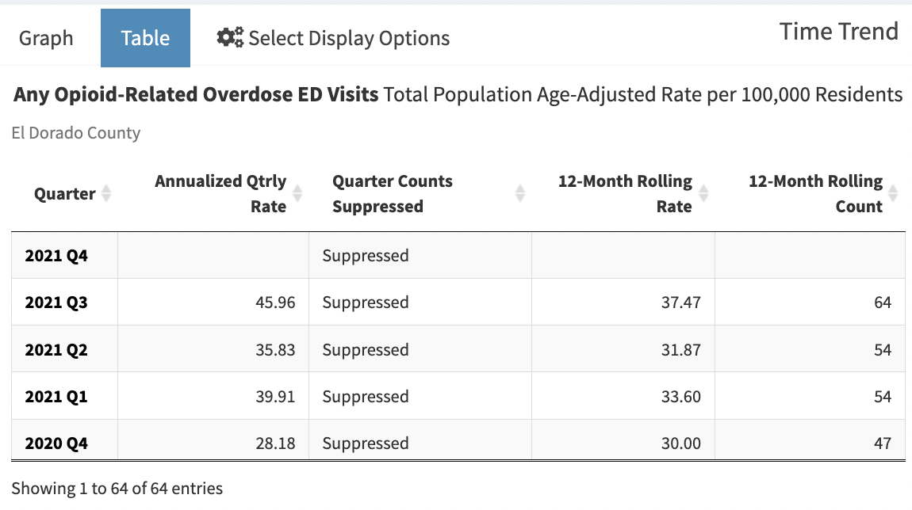
Time Trend
Notes:
The Time Trend visualization box is the Best place for most up-to-date quarterly data and trends. Quarterly counts are suppressed on county dashboards to comply with agency data de-identification guidelines.
Graph displays indicator change over time
The table can be used for looking at specific values

Slide 12
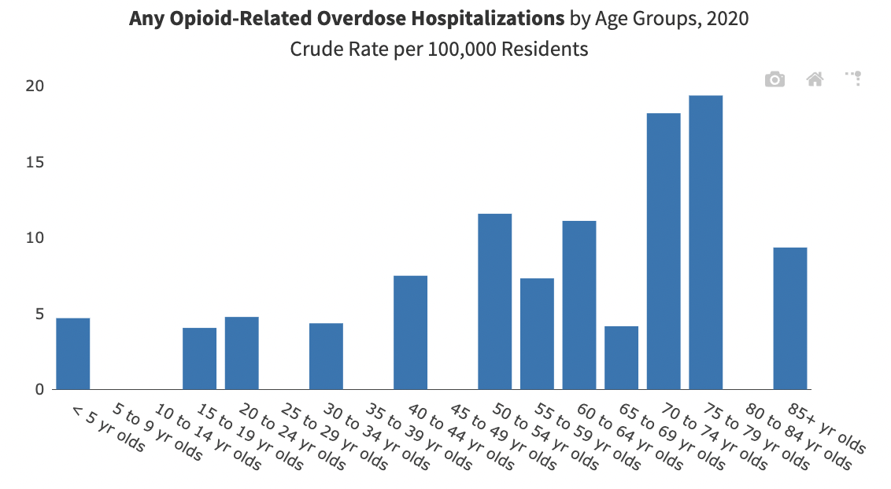
Demographics
Notes:
Best place to view indicators by a chosen demographic (sex, age, or race/ethnicity)
Bar Chart – displays annual data for chosen indicator by chosen demographic

Slide 13
Contact for Dashboard Questions
Mar-y-sol Pasquiers, MPH, CPH
Mar-y-sol.Pasquiers@cdph.ca.gov

