Slide 1
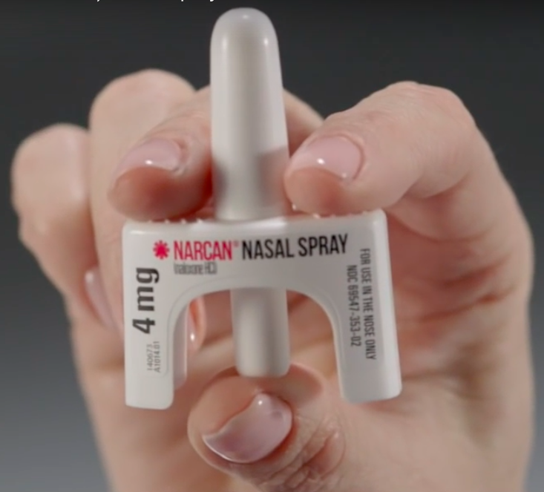
What is NARCAN?
Naloxone Nasal Spray, 2 Doses- 4 mg each
Restores breathing to those who are overwhelmed with opioids in their system

Slide 2
Recognizing an Overdose
High/sedated vs OD
Muscles become relaxed Deep snoring or gurgling, none
Speech is slowed/blurred Blue - grayish skin, lips, fingernails
Sleepy looking Pale clammy skin
Vomiting, erratic pulse, no pulse
Will respond to stimulation
like yelling, pinching Heavy nod, will not respond

Slide 3
How to Respond With NARCAN
S - Stimulate: is the person responsive? Send for help: 911
A - Airway and Administer Naloxone, then wait 2-3 minutes until next dose
V - Ventilation: are they breathing? Open airway, begin
rescue breathing- 1 breath every 5 seconds
E - Evaluate: are they breathing or responsive?
M -Manage: Monitor, recovery position, or Naloxone,
rescue breathing
E - Evaluate again: repeat process, breathing or responsive?
Reassure, Prevent more use, Recovery Position

Slide 4
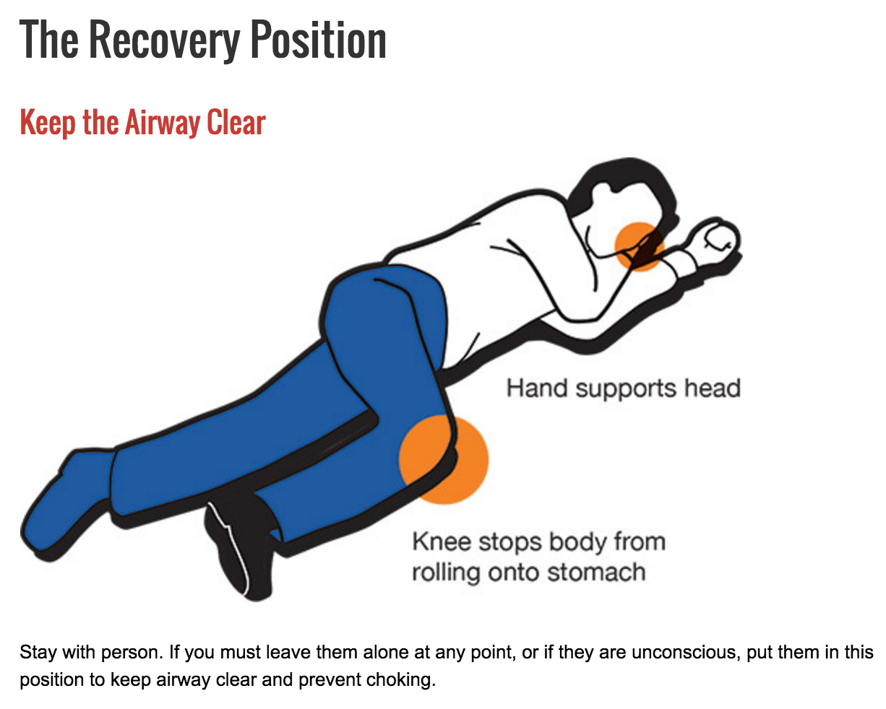

Slide 5
Naloxone Facts
No potential for abuse, does no harm to children, pets
Glass slipper: 30-90 minutes
Good Samaritan Law AB 472
Obtain for free without prescription at your local pharmacy, needle exchanges, or harm reduction center
“Communities with high saturation of naloxone distribution experience lower opioid overdose death rates”

Slide 6
What if you don't have Naloxone?
Engage, revive (non-violently)
Moving around moves opioids throughout the body
Keep an eye on them if you suspect the condition will worsen, ensure their airway is open
Rescue breathing: 13 minute rule while waiting for 911

