Slide 1
XYLAZINE

Slide 2
What is It?
Other Names:
TRANQ
Tranq Dope
Sleep-Cut

Slide 3
What is It?
NOT APPROVED for use in humans
NOT an opioid. It’s a deep sedative. It starts quickly
and “makes you fall out hard” for about the first hour if
not used to it
Xylazine extends the high, “gives fentanyl legs” so it’s more potent and very dangerous
Warning:
Little is known about the health effects
of chronic exposure to xylazine

Slide 4
Deadly Threat
“Xylazine is making the deadliest drug threat our country has ever faced, fentanyl, even deadlier,” said DEA Administrator Milgram.
DEA has seized xylazine and fentanyl mixtures in 48 of 50 States.
Recently, there was been more awareness and alerts from FDA, DEA, and the White House.

Slide 5
Emergence in Sacramento
Local Data:
Xylazine has become prevalent in the drug supply.
We still don’t know the full health impact of xylazine in our communities.
In 2022 -10 deaths in Sac County mixed with fentanyl.
4 solids
3 powders
3 tablets

Slide 6
Response to Xylazine
Xylazine can be swallowed, inhaled, smoked, snorted, or injected into the muscle or vein
Time to effect: 1-2 minutes
Time to drug effect: peaks 30 minutes
Duration of effect: up to 4 hours
Can improve euphoria and prolong the duration of fentanyl
Extends the high, it gives the dope more of a heroin effect
“Tranq seems to give fentanyl legs”
Fentanyl mixed with Xylazine
increases the risk of overdose and death
Friedman et al. Drug and Alcohol Dependence 2022 Adapted from D’Orazio: Toxicity of Xylazine. COBRE on Opioids and Overdose. 2022

Slide 7
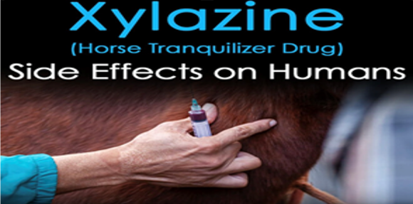
Health Effects

Slide 8
Heavy Sedation
Causes central nervous system depression, respiratory depression
Acute toxicity from xylazine can be similar to opioid overdoses
Symptoms present for several hours (exceeds duration of fentanyl’s effects)
Low blood pressure, slowed breathing, slowed heart rate
If combined with other sedating drugs,
↑ central nervous system depression, and ↑ risk of overdose

Slide 9
WARNING
Next slide contains graphic content about injection drug use related wounds that might disturb some of you.

Slide 10
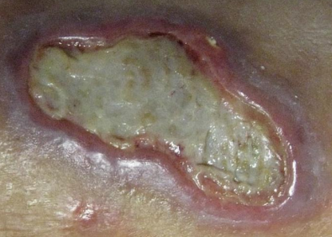
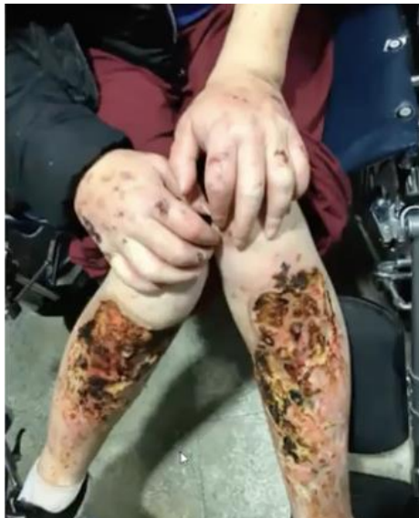
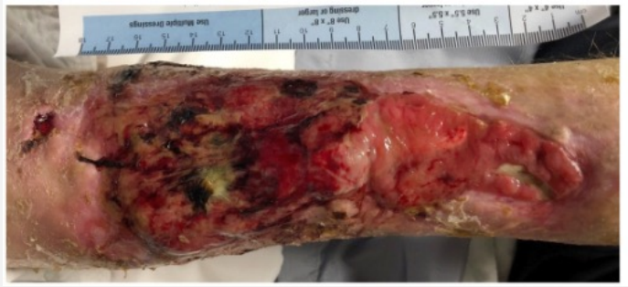
Skin Wounds
Xylazine is thought to cause peripheral vasoconstriction leading to poor blood flow to the tissues. • Xylazine-related wounds are distinct from injection-related abscesses: • Necrotic wounds • Can become extensive in size • Can be chronic and very difficult to heal on their own
McNinch, JR; Maguire, M; Wallace, L.
A CASE OF SKIN NECROSIS CAUSED BY INTRAVENOUS XYLAZINE ABUSE.
Abstract published at SHM Converge 2021.Abstract 559 Journal of Hospital Medicine.
https://shmabstracts.org/abstract/a-case-of-skin-necrosis-caused-by-intravenous-xylazine-abuse/.April 13th 2023

Slide 11
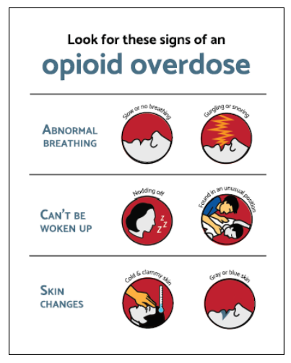
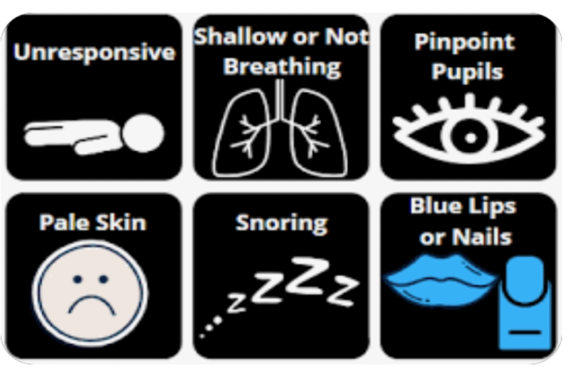
Signs of Overdose

Slide 12
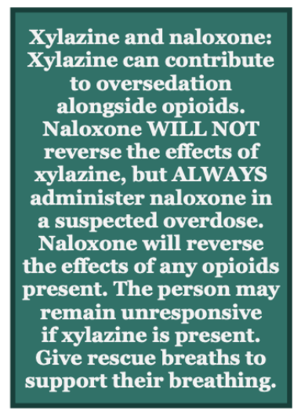
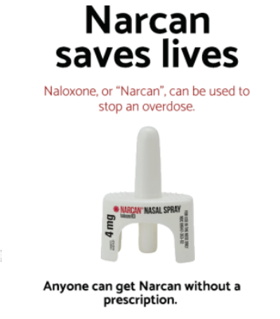
Risk of Overdose and Narcan
Xylazine may ↑↑ overdose risk
Naloxone may not fully reverse overdose symptoms
Individuals may continue to have period of profound
sedation after naloxone is administered
Johnson et al. BMJ Injury Prevention 2021 Nunez et al., Am. J. Forensic Med. Pathol. 2021

Slide 13
Harm Reduction Strategies
Watch for people who are sedated or unconscious longer than usual
• Make sure to check that breathing and heart rate are adequate
• Put people in recovery position, avoid atypical positions
• Roll from one side to another every 1-2 hours
• Place padding under boney areas (heels, hip, shoulder ankles, etc.)

Slide 14
Community Needs
Expand access to community-based drug checking services
Create Xylazine overdose reversal drug
In the healthcare system, improve compassionate care between providers and patients. Make it a safe, respectful place
In the community (syringe services programs), increase access to wound care, antibiotics for infections, and training for people to care for their wounds
Develop wound care guidance specific to xylazine-related wounds
Xylazine test strips in the works
More research is needed to understand and treat the side effects of Xylazine

Slide 15
Information and Sources
Fact Sheet
Xylazine Fact Sheet​ (PDF)
CDPH Alerts on Xylazine
Issue Brief: Xylazine, Health Risks and Harm Reduction Strategies (PDF)​​​
Letter to Local Health Officers from CDPH Director and State Public Health Offi​cer, Dr. Tomás J. Aragón​ (PDF)​
Sources
FDA Warning: Xylazine in Humans (PDF)
DEA Public Safety Alert: DEA Reports Widespread Threat of Fentanyl Mixed with Xylazine ​
National Institute on Drug Abuse
DEA: The Growing Threat of Xylazine and its Mixture with Illicit Drugs (PDF)
Center for Disease Control and Prevention's Polysubstance Use Facts​​
Grayken Center of Addiction

Slide 16
Thank You and Questions
Lori Miller, LCSW| Division Manager
Substance Use Prevention and Treatment
Millerlori@saccounty.gov

