Slide 1
Sacramento County Behavioral Health Services
Substance Use Prevention and Treatment
1/23/2023

Slide 2
About Us
Our Mission
Our Vision
To provide a culturally competent system of care that promotes holistic recovery, optimum health, and resiliency.
We envision a community where persons from diverse backgrounds across the life continuum have opportunity to experience optimum wellness.
Lori Miller, LCSW
Division Manager
Substance Use Prevention and Treatment
Diverse
Bilingual, Cultural, Lived Experience
Professionals
Edward Dziuk
Health Program Manager
Michelle Besse
Health Program Manager
Educated, Trained, Licensed Staff
Administrative Services
Administrative Support
Program Services
Contract Monitoring
System of Care
Subject Matter Experts
Regulations, Contracting, Substance Use
Options for Recovery
Collaborative
Courts

Slide 3
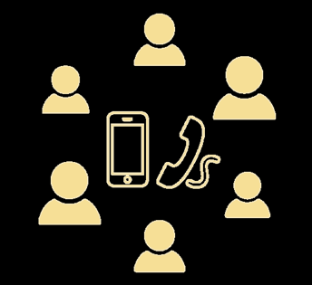
COVID-19 Response
COVID
Substance Use Support Group
Monday-Friday
11 am - noon
and
2:00 pm - 3:00 pm
Conference Call
(916) 876-4100
ID # 9951372
In compliance with COVID social distancing protocols, County and provider staff transitioned to telecommuting and telehealth service provisions.
The use of telehealth services have proven to be effective for substance use services.
COVID outbreaks in residential treatment facilities were challenging as quarantines halted admissions and resulted in delayed placements.
SUD Assessments at the Sacramento County Main Jail and the Rio Cosumnes Correctional Center were halted due to outbreak. SUD Assessments have resumed.
County COVID General Resource webpage
County COVID Provider Resource webpage

Slide 4
Cultural & Language
Needs
We embrace the cultural and linguistic diversity in our community and understand the importance of providing services that meet the unique needs of our beneficiaries.
Culturally and linguistically competent services are provided free of charge and are incorporated into a beneficiary’s treatment plan.
Interpreters for a wide-range of languages are available at no cost, including American Sign Language.
Threshold Languages
Arabic
Cantonese
Farsi
Hmong
Russian
Spanish
Vietnamese
Substance Use Prevention and Treatment

Slide 5
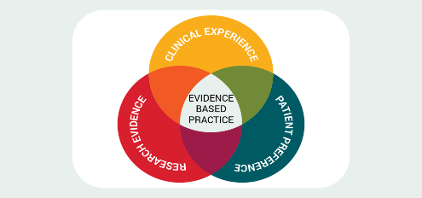
Drug Medi-Cal (DMC)
Organized Delivery System (ODS) Waiver
Increased requests for SUD services due to DMC-ODS implementation and continued community outreach providing details on services provided under Waiver.
Successfully implemented new services: case management, physician consultation, expanded medication-assisted treatment, expanded residential treatment, and withdrawal management.
Continued efforts focus on further expansion of recovery services, withdrawal management, residential treatment, and youth services.
Managed Care Partners
Substance Use Prevention and Treatment

Slide 6
Residential
Outpatient Services
Intensive Outpatient
Detox / Withdrawal Management
Medication Assisted Treatment
Sober Living Environments
Continuum of Care
Prevention Services
Perinatal Services
(Options for Recovery)
DUI Programs
Drug Diversion Programs
Specialty Courts

Slide 7
THE CLIENT
The needs of the client and where they are in their recovery journey drives care.

Slide 8
Assessment and Referral Access Points
Adult
Youth
System of Care
Probation Department
Sacramento County Jail
Youth Detention Facility
Substance Use Prevention and Treatment
Guest House Homeless Clinic
Child Protective Services
Primary Care Center
Collaborative Courts / Self-Referral

Slide 9
System of Care
Entry point for Substance Use Prevention and Treatment Services
Assessment and referral to alcohol and drug treatment service provider
Monday - Friday
8:00 A.M.- 5:00 P.M.
ALL ASSESSMENTS ARE CONDUCTED BY PHONE APPOINTMENT
MOST APPOINTMENTS ARE SAME DAY SERVICE (916) 874-9754
Substance Use Prevention and Treatment

Slide 10
Federal Priorities
Pregnant IV Drug Users
All Others
Substance Use Prevention and Treatment
Multisystem Involved
Pregnant
IV Drug Users

Slide 11
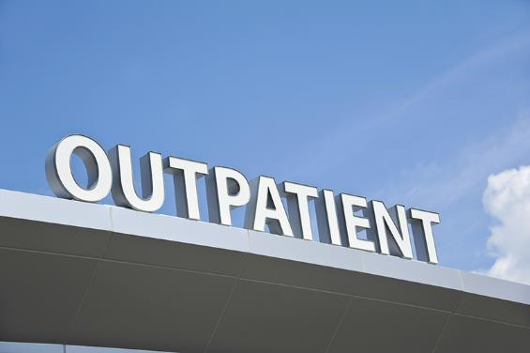
Outpatient/Intensive Outpatient
Level - 1 Outpatient
For adults, less than 9 hours per week
For adolescents, 6 hours per week
Specialty groups: perinatal groups, co-occurring, fathers, Prop 36, and other various groups for specific populations
Level 2 - Intensive Outpatient
Nine (9) hours or more per week to treat multidimensional instability requiring high-intensity, treatment
Substance Use Prevention and Treatment

Slide 12
Withdrawal Management
Level 1 and Level 2 Outpatient Withdrawal Management
Narcotic Treatment Program structure
21 day detox programs and 180 day detox programs
Level 3.2 Withdrawal Management Residential Beds
Within residential treatment facilities
Total beds: 12
Includes 2 beds for perinatal women (pregnant and parenting), 4 for women, and 6 for men or women.
Substance Use Prevention and Treatment

Slide 13
Residential Treatment
Level 3.1 Residential
Structured SUD treatment / recovery services that are provided in a 24-hour residential care setting with patients receiving at least 5 hours of clinical services per week.
Level 3.5 Residential
24-hour structured living environments with high-intensity clinical services for individuals who have multiple challenges to recovery and require safe, stable recovery environment combined with a high level of treatment services.
Designated to be either 3.1 or 3.5.
Substance Use Prevention and Treatment

Slide 14
Narcotic/Opioid Treatment Programs
Narcotic treatment programs for opioid addiction and stabilization including counseling, methadone, other FDA medications, and coordination of care. All are billing for non-methadone required medications.
Additional MAT: Buprenorphine/Suboxone, Naloxone, Naltrexone, Disulfirim
In-County program sites
Out-of-County program sites
Substance Use Prevention and Treatment

Slide 15
Recovery Residences/Sober Living
24-hour residential drug-free housing for individuals in outpatient or intensive outpatient treatment who need drug-free housing to support their sobriety and recovery while in treatment.
Substance Use Prevention and Treatment
Beds for women and their accompanying children
Limited beds for men with children with active Cal-Works Cases.

Slide 16
Youth Treatment
Three(3) Providers across Sacramento County.
12+ Ages; some providers servicing TAY (ages 18-25).
Located in community and schools.
Treatment for Alcohol and other drugs of choice.
Substance Use Prevention and Treatment
Youth Residential Treatment
COMING SOON

Slide 17
Prevention Programs
Friday Night Live
Club Live
Friday Night Live Mentoring Program
Leadership and Advocacy Project
Youth Engaged in Action
Community Education for Drug-Free Youth
Families and Communities Together
Sacramento County Coalition for Youth
Active Parenting of Teens
Family Matters
Teens in Action
Arrive Alive, CA
Substance Use Prevention and Treatment
Our Prevention
Campaigns

Slide 18
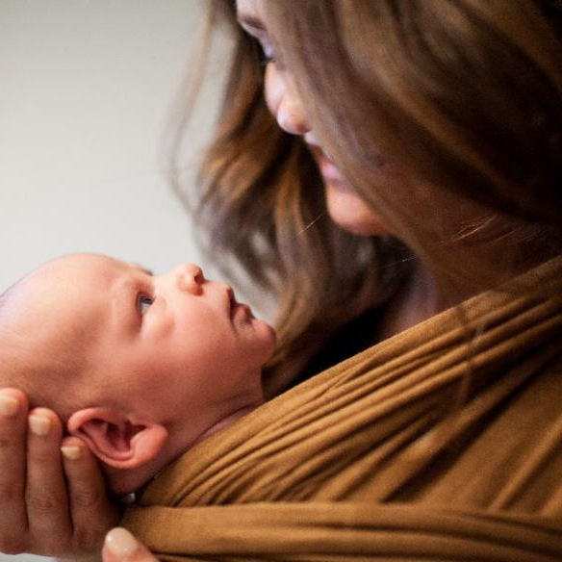
Options for Recovery Program
The Options for Recovery Program is designed to meet the unique SUD treatment and recovery needs of pregnant and parenting women of minor children.
Outpatient Treatment
Intensive Outpatient Treatment
Withdrawal Management/Detoxification
Residential Treatment (Children 5 and under can live with mother in residential program).
Transitional Living/Recovery Residence
Case Management
Educational Women’s Perinatal Services
Child Play Care
Service is on demand-
No wait for treatment
Substance Use Prevention and Treatment

Slide 19
Collaborative
Courts & Programs
Recovery Court
Family Treatment Courts
Dependency Family Treatment Court
Early Intervention Family Treatment Court
Mental Health Treatment Court
Re-Entry Court
Veterans Treatment Court
Prop 36 Court
Chronic Nuisance Offender (CNO) Program
Driving Under the Influence (DUI) Treatment Court
Drug Diversion Program

Slide 20
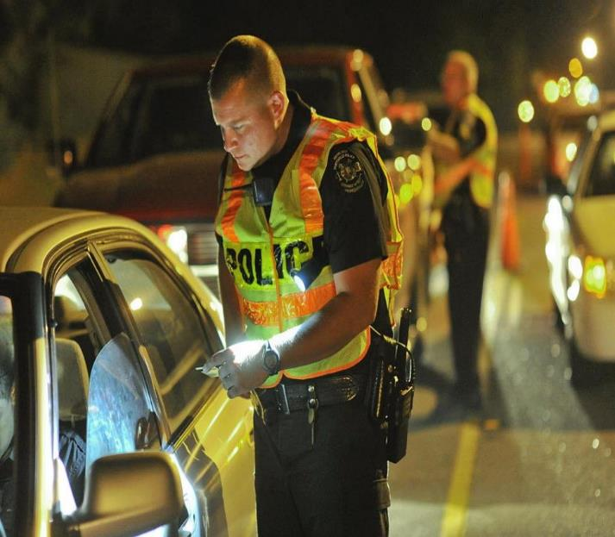
Driving Under the Influence (DUI) Programs
State-licensed DUI Programs are offered through:
Bridges Professional Treatment Services
Safety Center, Inc.
Terra Nova Counseling Center
1st Offender Programs
Wet & Reckless
3-Month Program
6-Month Program
9-Month Program
Multiple Offender Program
18-Month Program

Slide 21
Our Coalitions
Together, We Save Lives
Sacramento County Coalition for Youth
Community members working together to make Sacramento a safe place for young people to grow up, free from the influences of substances that are addictive and harmful.
Sacramento County Opioid Coalition
Collaboration of healthcare professionals, community based organizations, law enforcement, county agencies, and concerned citizens determined committed to saving lives by preventing overdoses through expanding treatment access, promoting safe disposal, encouraging early intervention, treatment and recovery, enhancing opioid surveillance, and expanding public education and media outreach.
Sacramento County Methamphetamine Coalition
The goal of the Methamphetamine Coalition is to identify and implement initiatives addressing the methamphetamine use problem and reducing meth use and its impact in Sacramento County.
Methamphetamine
Coalition

Slide 22
Other Partnerships
UC Davis Medical Center partnership to address the relationship between meth and heart disease, education on SUPT services/access to care and training on meth, mental health and HIV. Recently Medi-Cal Certified – ED Bridge Program/Opioid and Stimulant Use Disorders
Primary Heath/ Sacramento County Health Center partnership to increase access to SUPT services and patient awareness and education on behavioral health services.
Public Health partnership on education on the relationship between meth and syphilis including previous training on meth and perinatal impacts.Opioid overdose education and awareness

Slide 23
Other Partnerships
Child Welfare partnership to provide increased training on access to care and referral opportunities. Part of several workgroups/projects currently.
Criminal Justice partnerships as we have partnered on recent grants to increase capacity and availability of mental health and SUPT assessment and treatment in collaborative courts and jail setting, for example. Part of several workgroups/projects currently.
Hospital partnerships providing bidirectional referral process and access to SUPT services with all Managed Care Plans.

Slide 24
Substance Use Prevention and Treatment
Lori Miller, LCSW
Division Manager
Millerlori@saccounty.gov
916-875-2046
Michelle Besse, LMFT
Health Program Manager
BesseM@saccounty.gov
Please keep this slide for attribution.

