Slide 1
Opioid Addiction, MAT, and Black Voices
Presented by: Dr. BJ Davis

Slide 2
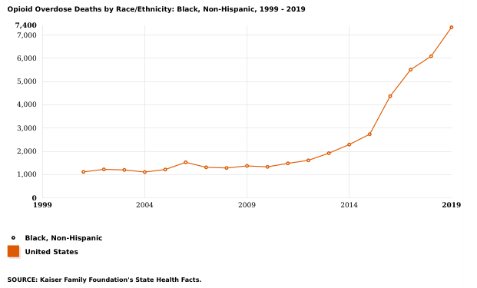
OPIOID OVERDOSE DEATHS AMONG BLACK PEOPLE 1999-2019 (KFF)

Slide 3
FENTYNAL OVERDOSE
This all it takes to cause a fentanyl overdose in most users

Slide 4
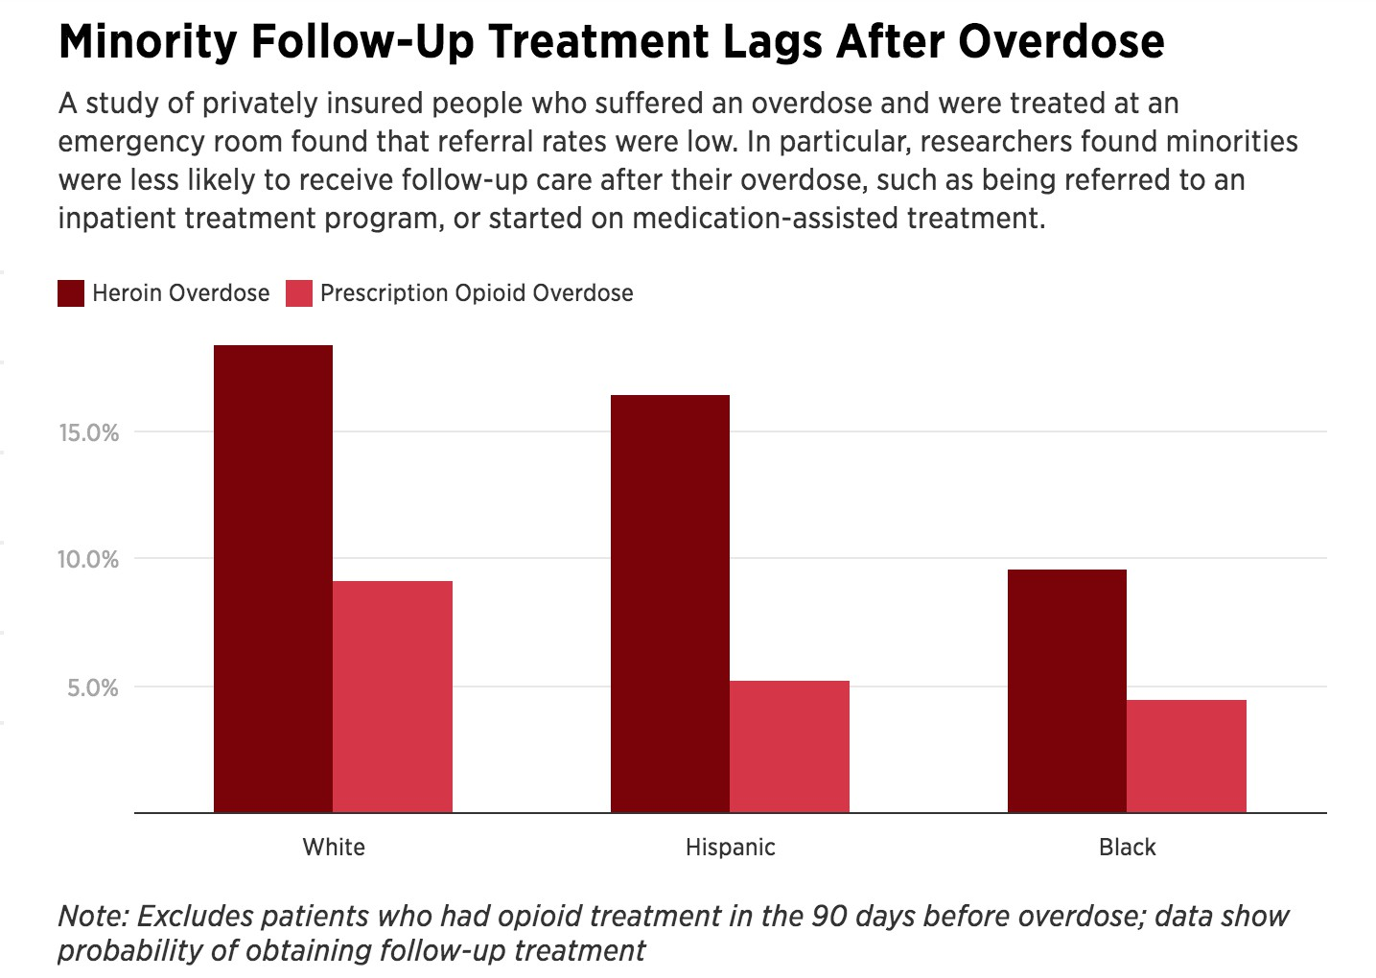
INEQUITIES IN ADDICTION TREATMENT
Black patients were half as likely to obtain treatment following overdose compared with non- Hispanic white patients even when privately insured.
Kilaru 2020

Slide 5
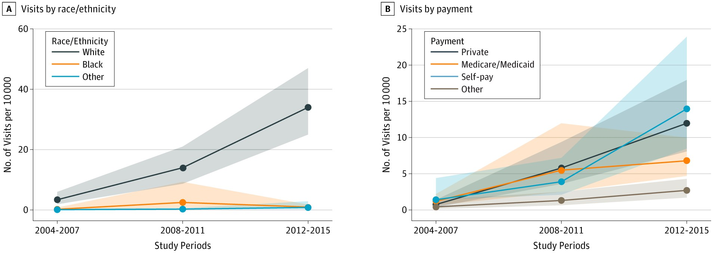
INEQUITIES IN ADDICTION TREATMENT
Black patients were 70% less likely to receive a prescription for buprenorphine at their visit when controlling for payment method, sex and age
This study demonstrates that buprenorphine treatment is concentrated among white persons and those with private insurance or use self-pay.
Lagisetty 2019

Slide 6
Racial Disparities in Opioid Addiction Treatment
Although Opiate use disorder (OUD) rates are similar between black and white populations (3.5% for blacks, 4.7% for whites), the prescription distribution is starkly different.
White patients accounted for 12.7 million buprenorphine visits, while minority patients (including African Americans) accounted for only 363,000 visits.
Black patients are 77 percent less likely to be prescribed buprenorphine and more likely to receive methadone treatment.

Slide 7
Racial Disparities in Opioid Addiction Treatment
They are both FDA-approved to treat opioid use disorder (OUD), but this creates two issues with access.
First, methadone is a much more restricted treatment regimen, with most patients having to show up daily to be administered the medication.
That can make it nearly impossible to keep a job or manage other obligations.
Second, overreliance on methadone for uninsured and publicly insured patients—who are disproportionately black in urban settings—may preclude individuals from accessing one of the other approved medicines that could be more effective for them.
Taken together, these hurdles greatly decrease meaningful access to OUD medication options for black patients and low-income individuals

Slide 8
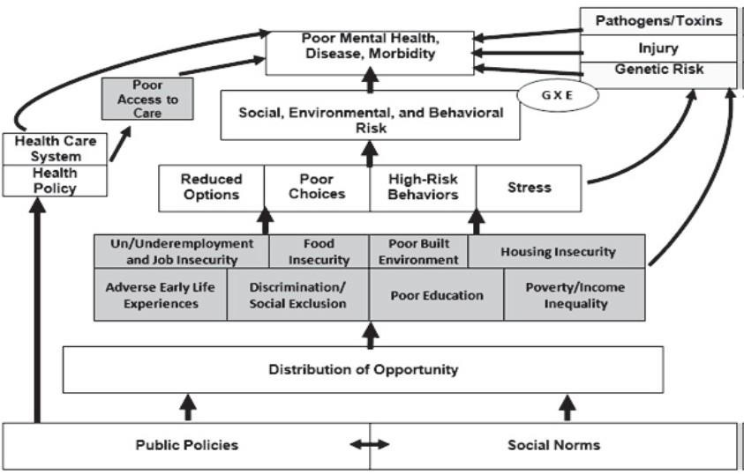
CHALLENGES TO PREVENTION, TREATMENT, AND RECOVERY FOR AFRICAN AMERICANS
Negative representations, stereotyping and stigma
Intergenerational substance use and polysubstance use
Fear of legal consequences
Misperceptions and faulty explanations about addiction and opioids.
Lack of culturally responsive and respectful care
Discrimination and trauma
Source: The Social Determinants of Mental Health. Michael T. Compton, M.D., M.P.H., and Ruth S. Shim, M.D., M.P.H., Focus Vol. 13, No. 4, Fall 2015

Slide 9
Barriers to MAT for African Americans (What the Research Suggests)
Stigma: Negative perceptions and stereotypes around MAT can discourage Black patients from seeking treatment.
Lack of Insurance: Insufficient insurance coverage remains a significant barrier. Without adequate coverage, individuals may struggle to afford MAT services.
Unawareness: Lack of awareness about available MAT services can prevent Black patients from seeking help.
Cultural Appropriateness: MAT programs may not always be culturally sensitive or tailored to the needs of Black communities.
Financial Constraints: High costs associated with MAT can be prohibitive for those with limited financial resources.
Racial Disparities: Research shows that MAT is disproportionately accessible to white patients compared to Black patients.

Slide 10
(MAT) Black Voices (Results From a 2020 Sacramento Focus Group experiences of substance use/opioid use disorder and treatment among Black/African Americans)
Confuse methadone and MAT
Lack of knowledge about MAT
Feelings about MAT largely negative
Skeptical about how helpful MAT or methadone can be
Methadone was a means of financial support because they would “just sell it.”
Methadone providers are just “selling you legal dope”

Slide 11
Barriers for Black/African American Patients to Obtain MAT Services
Accessing Health Care
Transportation
Stigma of Addiction
Staying Clean to Receive MAT
Suboxone requires 12 hours clean before starting medication
Lack of Knowledge about MAT/Resistance Towards Taking Medication
Shame that “ I can't kick this on my own”
“I'm not really in recovery if I'm on medication”
Afraid they won't be able to get off once they start
Interactions with Providers
Black patients more likely to get kick out of clinics (without cause)
General perception will be troublemakers for staff
Black/African American Community
Not felt safe in the hands of the medical establishment
Longer to establish trust, or for the counselor to establish rapport with them to earn trust
Dealing with outside stressors and factors, including racial discrimination

Slide 12
Not Feeling Comfortable in Treatment
Didn’t feel like counselor “got them”
Lived experience was general requirement for feeling comfortable with staff and counselors regardless of race
Couldn't relate to what I had been through
Lack of cultural competence among staff
Value in being in groups with other peers in recovery who were Black
Feelings of resentment being the only Black face in the group also reflects being under-represented in treatment and images of treatment

Slide 13
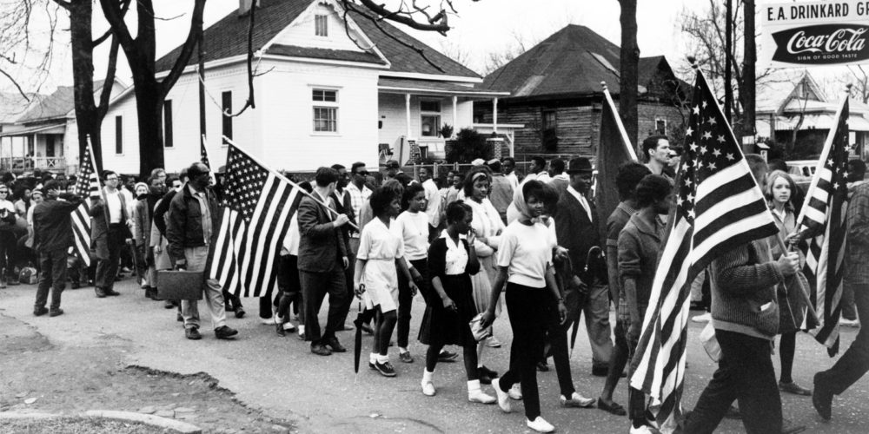
WHAT WORKS? Removing bias from process, not people.

Slide 14
STRATEGIES TO ADDRESS OPIOID MISUSE AND OUD IN BLACK/AFRICAN AMERICAN COMMUNITIES
Implement
Involve
Increase
Employ
Create
Implement a comprehensive, holistic approach
Involve the community and develop multisectoral, diverse community partnerships
Increase culturally relevant public awareness
Employ culturally specific engagement strategies
Create a culturally relevant and diverse workforce

Slide 15
Elements in Culturally Affirming MAT Services - Black Voices
Be Flexible
Emphasize that MAT is not new
Emphasize conveniences
Explain decreased diversion potential for Vivitrol
Encourage enrollment in outpatient services to “help figure out what’s going on there”
Bring message to where the people are with consistent, high-visibility advertising & outreach.
Eliminate the perception that opioid use disorders are white problems
Avoid monolithic programs – If it works for white – its right!
Check in with people
Build shared rapport
Representation matters – diversify staff
Work to earn that trust
Provide individual counseling utilizing Black counselors
Have a diverse staff and establish multiple sites in the historically black communities.

Slide 16
Adapting MAT for Black/African American Patients (Black voices)
Combining MAT and Counseling
Sobriety is not binary.
MAT without counseling doesn’t address root issues/cause
“If you don’t have the counseling piece, you are less likely as an organization, to be able to establish the emotional sobriety that is going to reduce the risk for future relapses.
Don’t want/let anything to be a barrier
The underlying issue is not being handled just by medication
Lack of participation in counseling by African Americans may be because of their cultural differences
“this is how I was raised, this is my family, what they do when I go back home. It’s going to be around me.”
Providing one piece of an intervention is not going to be effective compared to providing all of it.

Slide 17
Sacramento County’s response has been commendable.
They have invested monies in expanding the county’s capacity for offering MAT services especially in residential programs.
Have actively conducted outreach to the black community regard MAT.
Have encouraged AOD counseling providers to create formal referral processes with MAT providers.
Have made MAT training mandatory for all AOD treatment provider counseling staff.

Slide 18
Regarding Black History ‘’The Race Gap”
Education
Less that 1/3 of Black students obtain a Bachelors Degree or higher compared to almost ½ of white students.
Employment
In 2023, the unemployment rate of African Americans in the United States stood at 5.5 percent. This was over the national average of 3.6 percent and 3.3 for White people.
Black workers are twice as likely to be unemployed as white workers at almost every educational level.
Pregnancy- Related Deaths
1 out of every 100,00 live births, 42 black women dies of pregnancy-related causes, more than 3x the rate for white women.
29 more black women die from pregnancy or post partum complications than white.
Health Care
Black adults are more than 1.5 times less likely to have health insurance than white adults

Slide 19
Regarding Black History ‘’The Race Gap”
Food Insecurity
Out of every 100 black households, 21 have difficulty providing enough food
1 in 10 black households included a member who ate less food than they needed because they didn’t make enough $$$
Wealth
Black families have 1/10th of the median net worth of white families
Home ownership
Black families are ½ as likely to own their home as white families.
Justice System
As of 2022, Black people were admitted to jail at more than four times the rate of White people
Black male offenders received federal sentences almost 20% longer than white male offenders for the same crimes
Blacks are 3x more likely to be killed by police and disproportionately more likely to be killed while unarmed or fleeing than White people.
Voting Disenfranchisement
Since 2016, 1 of every 13 Black people arrested lost the right to vote due to a felony conviction, compared to 1 in every 56 for white voters.

Slide 20
HOW BLACK POPULATIONS FEEL
The Wound of Rage
“It is virtually impossible to be the
Racial oppression
Internalized Devaluation
Assaulted Sense of Self
depository of perpetual negative and
debilitating messages and have one’s sense of self assaulted without experiencing rage. ....It is distinguishable from anger, which is an emotion connected to
immediate experiences.”
“…the culmination of recurring experiences with internalized devaluation.”
Internalized Voicelessness
“…results from and fuels internalized devaluation and an assaulted sense of self… it impairs the ability to advocate for oneself.”
“…oblivious to this infection but emotionally reactive to its effects”
“I am bad and unworthy”
“Profoundly devalued youth become hypervigilant about gaining respect… To some of these youth, death is preferable to disrespect.”
The Case of a Nobody
“…sense of hopelessness, despair, and rage are the by-products of chronic and repeated experiences of being
systematically devalued and having [one’s] sense of self assaulted.”
Healing the Hidden Wounds of Racial Trauma, Kenneth V Hardy
Journal: Reclaiming Children and Youth, (vol 22, number 1) pg. 24-29

Slide 21
Black people misuse drugs for the same reason as most people:
Pain
Trauma
Misery
Despair
Frustration
Hopelessness

Slide 22
And one important additional reason in clients' own words:
“Using heroin makes being Black easier!”

