Slide 1
Addressing substance misuse and addiction/jail mat services Sacramento county jail Tianna Hammock, Health Services Administrator
Presentation to the 2024 Fentanyl Awareness Summit
August 15, 2024

Slide 2
Jail SYSTEM
Main Jail
Two Adult Jails – 3265 ADP 8/4/24
Main Jail – Population –1789 (capacity 2380)
Basement (Pharmacy, Kitchen, Laundry)
1st floor (Intake, Release, Lobby, Courtrooms)
2nd floor (Medical Infirmary, Medical Housing, Acute Psychiatric Unit)
3rd floor (Mental Health housing – IOP, OPP, SITHU)
4th-8th (General population, 6E Withdrawal Monitoring & MAT induction unit, 7W Females)
8W (Segregated housing)
Rio Cosumnes Correctional Center – 1476 (capacity 1625)
Honors dorms, CBF (MH housing), SLF (women) MHU (Infirmary), A&B barracks, J&K barracks, Ramona, SBF, KBF, JKF (GP &PC)
Rio Cosumnes Correctional Center

Slide 3
Correctional Health population
High rates of serious mental health conditions, substance abuse, and chronic diseases (80% June 2024 Data).
High rates of poverty, unemployment, and homelessness (33-37% of population)
Low health literacy
Once released, many have difficulty navigating complex health and behavioral health systems of care
Barriers to care before and after release

Slide 4
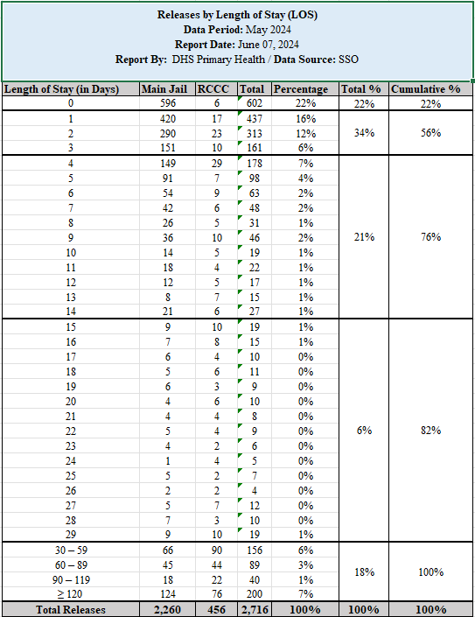
Jail constraints
High volume – high churn rate makes in house services and discharge planning difficult.
Physical plants – Not designed for health care
High need/High demand population

Slide 5
Range of Health services provided
Services provided onsite and offsite (county staff and contracted providers):
Physical Health
Primary healthcare, specialty services, chronic care
Substance Use Disorder Treatment
Withdrawal monitoring, MAT induction, SUD groups, individual sessions, discharge planning expansion
Dental
Fillings, root canals, stainless steel crowns, extractions, suturing, dentures, cleanings, fractured mandible care and evaluations
Pharmacy –
Both sites producing approx. 7000 medications daily (74% of pop), KOP, discharge meds (30 days supply)

Slide 6
Range of services cont.
EMERGENT MENTAL HEALTH REFERRALS
Month | 2021 | 2022 | 2023
January | 301 | 496 | 1121
February | 202 | 421 | 1032
March | 264 | 622 | 1004
April | 268 | 644 | 1043
May | 291 | 723 | 1168
June | 293 | 686 | 1398
July | 286 | 824 | 1493
August | 337 | 845 | 1121
September | 383 | 992 | 1041
October | 369 | 1267 | 1345
November | 426 | 1075 | 1108
December | 467 | 1213 | 1129
Total | 3,887 | 9,808 | 14,003
Mental Health
Acute Psychiatric Unit (APU) (17)
Intensive Outpatient Program (IOP) (68 male, 23 female)
Enhanced Outpatient Program (525 once fully staffed)
IOP expansion (10 female, 20 male), APU expansion (15 beds)
Emergent Referrals increased by 152% between Jan 2021 and Dec 2022 and 43% between Jan 2022 and Dec 2023

Slide 7
Withdrawal Monitoring Efforts
Intake Process Revision, Withdrawal Monitoring unit early 2023
CIWA-A/CIWA-B monitoring for alcohol and/or benzodiazepines
Provider withdrawal monitoring order sets
Dedicated provider for withdrawal monitoring in near future
2 medical/2 East housing for more intensive monitoring (every 4-6 hours)
Nurse intake changes to roll out at end of August to include band system by acuity to expedite their process.
7

Slide 8
Nationwide
The full array of MOUD and MAT is not consistently available
Persons with OUD released from corrections not engaged in MAT are much more likely to die from overdose
Over 70% of deaths within 2 weeks of release are due to overdose
MAT/MOUD can decrease that by 60-80%
MAT/MOUD for incarcerated persons is evidence-based and aligned with community standard of care

Slide 9
How to move past mat stigma in jails
Viewing OUD as a chronic disease that can be effectively treated by this medication similar to how high blood pressure and diabetes can be managed by medication.
MAT is evidenced based and proven to be effective.
Recognition that appropriate treatment can reduce custody challenges and other adverse incidents and outcomes (reduced overdose; reduced recidivism, increased treatment continuation upon release, etc.)
Growing body of case law finding liability for failure to provide access to MOUD to incarcerated persons

Slide 10
Sacramento county mat timeline
2019
Pre-2019
Methadone – Women with OUD/pregnant
Vivitrol – Small re-entry population (OUD/AUD). Partnership SSO Reentry, Adult Correctional Health, Wellspace.
2019
County MAT Expansion 2019- Health Management Associates, Inc. (HMA) Consultants working with counties to expand MAT in Criminal Justice settings – continuation meds (methadone contracted)
2023
County MAT Expansion 2023 – full induction program (X-waiver elimination)

Slide 11
MAT Expansion efforts
Intake Process Revision, MAT induction unit
MAT for OUD includes Methadone, Buprenorphine (oral, injectable) and Vivitrol
Use of Sublocade (injectable) – for those who would benefit and would otherwise be discontinued from program
Continuity of Care transitions – Referrals to ADS providers
Education for staff and SSO, identifying diversion, frequent team meetings, tracking data, being trauma informed

Slide 12
Notes:
Dr. Abdalla

Slide 13
SUD Treatment
Funded for three SUD Counselors/ SUPT has assisted in the transition
SUD education groups, individual counseling
Discharge planning, community MAT connections
Recognize the need for more…
SUD education, community resource education on inmate tablets, partner with SUPT

Slide 14
summary
Evolving process…. This is one major change among many…
My vision for Sacramento County Jails as HSA
Questions?
Notes:
Dynamic – it is constant process of change.

