Slide 1

Sacramento County Opioid Coalition
Amber Arif
Program Coordinator

Slide 2
Who Are We?
“The Sacramento County Opioid Coalition's mission is to bring the greater Sacramento community together. We commit ourselves to saving lives through expanding treatment access, promoting safe disposal, encouraging early intervention, treatment and recovery, enhancing opioid surveillance, and expanding public education through outreach.”

Slide 3
Who Are We?
320+ coalition members with wide community representation
  District Attorney’s Office
  Sacramento Sheriff Department
  Sacramento County
    Public Health, Substance Use Prevention & Treatment, Schools and Universities
  Arrive Alive
  Behavioral health, recovery centers, harm reduction centers
  Local nonprofits
  Concerned community members

Slide 4
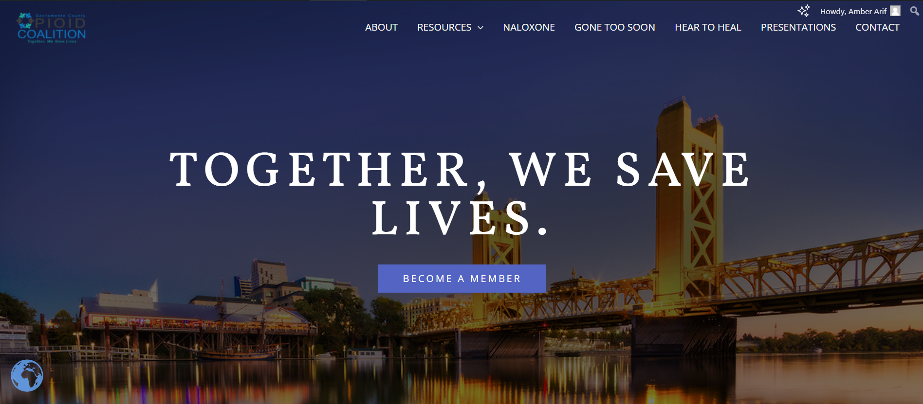
We’ve updated our website! sacopioidcoalition.org

Slide 5
Harm Reduction
Harm reduction is about humanizing those of us who suffer from substance use disorder
Addresses the broader issues that contribute to why people use substances
Empowering people to make healthier choices rather than shame
Give people the tools to improve their situation
Examples of harm reduction include:
Reducing stigma
Building a supportive community
Promoting healing and health
Distributing overdose medication (i.e. Narcan/Naloxone)
Lifting those up with lived experience to inspire others

Slide 6
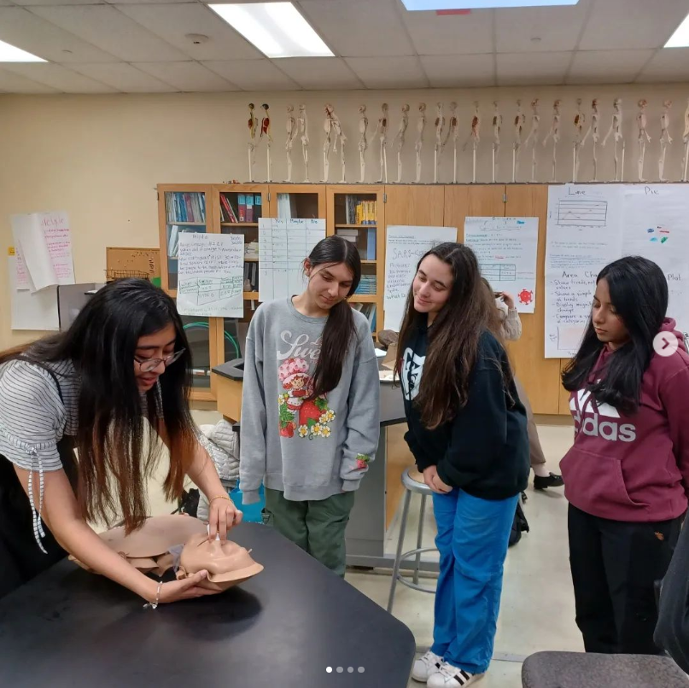
Community Outreach
Naloxone Training and Distribution
Free Naloxone distribution and trainings to organizations, communities, and individuals
Over 4,000 kits distributed to date in 2024
Community Events
Providing informative resources on opioids, fentanyl, recovery centers, MAT, our services, and more
Distribute Narcan at events and teach how to use Narcan and recognize an overdose

Slide 7
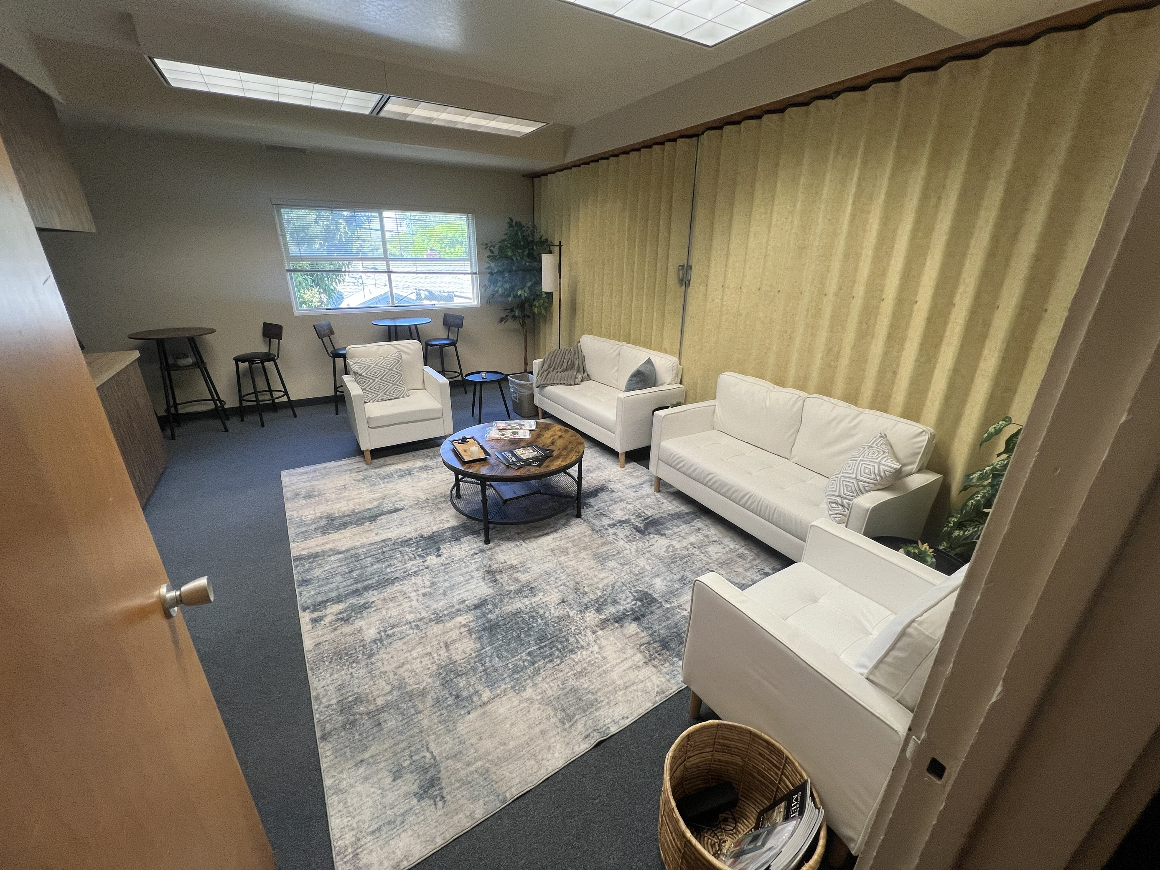
Hear to Heal
Our monthly, free support group for those who have lost their loved ones to opioids and fentanyl
Facilitated by a licensed behavioral health specialist every first Tuesday of the month usually (6-7pm)
Hosted in the SSVMS office, new lounge room
Check the Hear to Heal folder in the QR code to sign up and learn more!

Slide 8
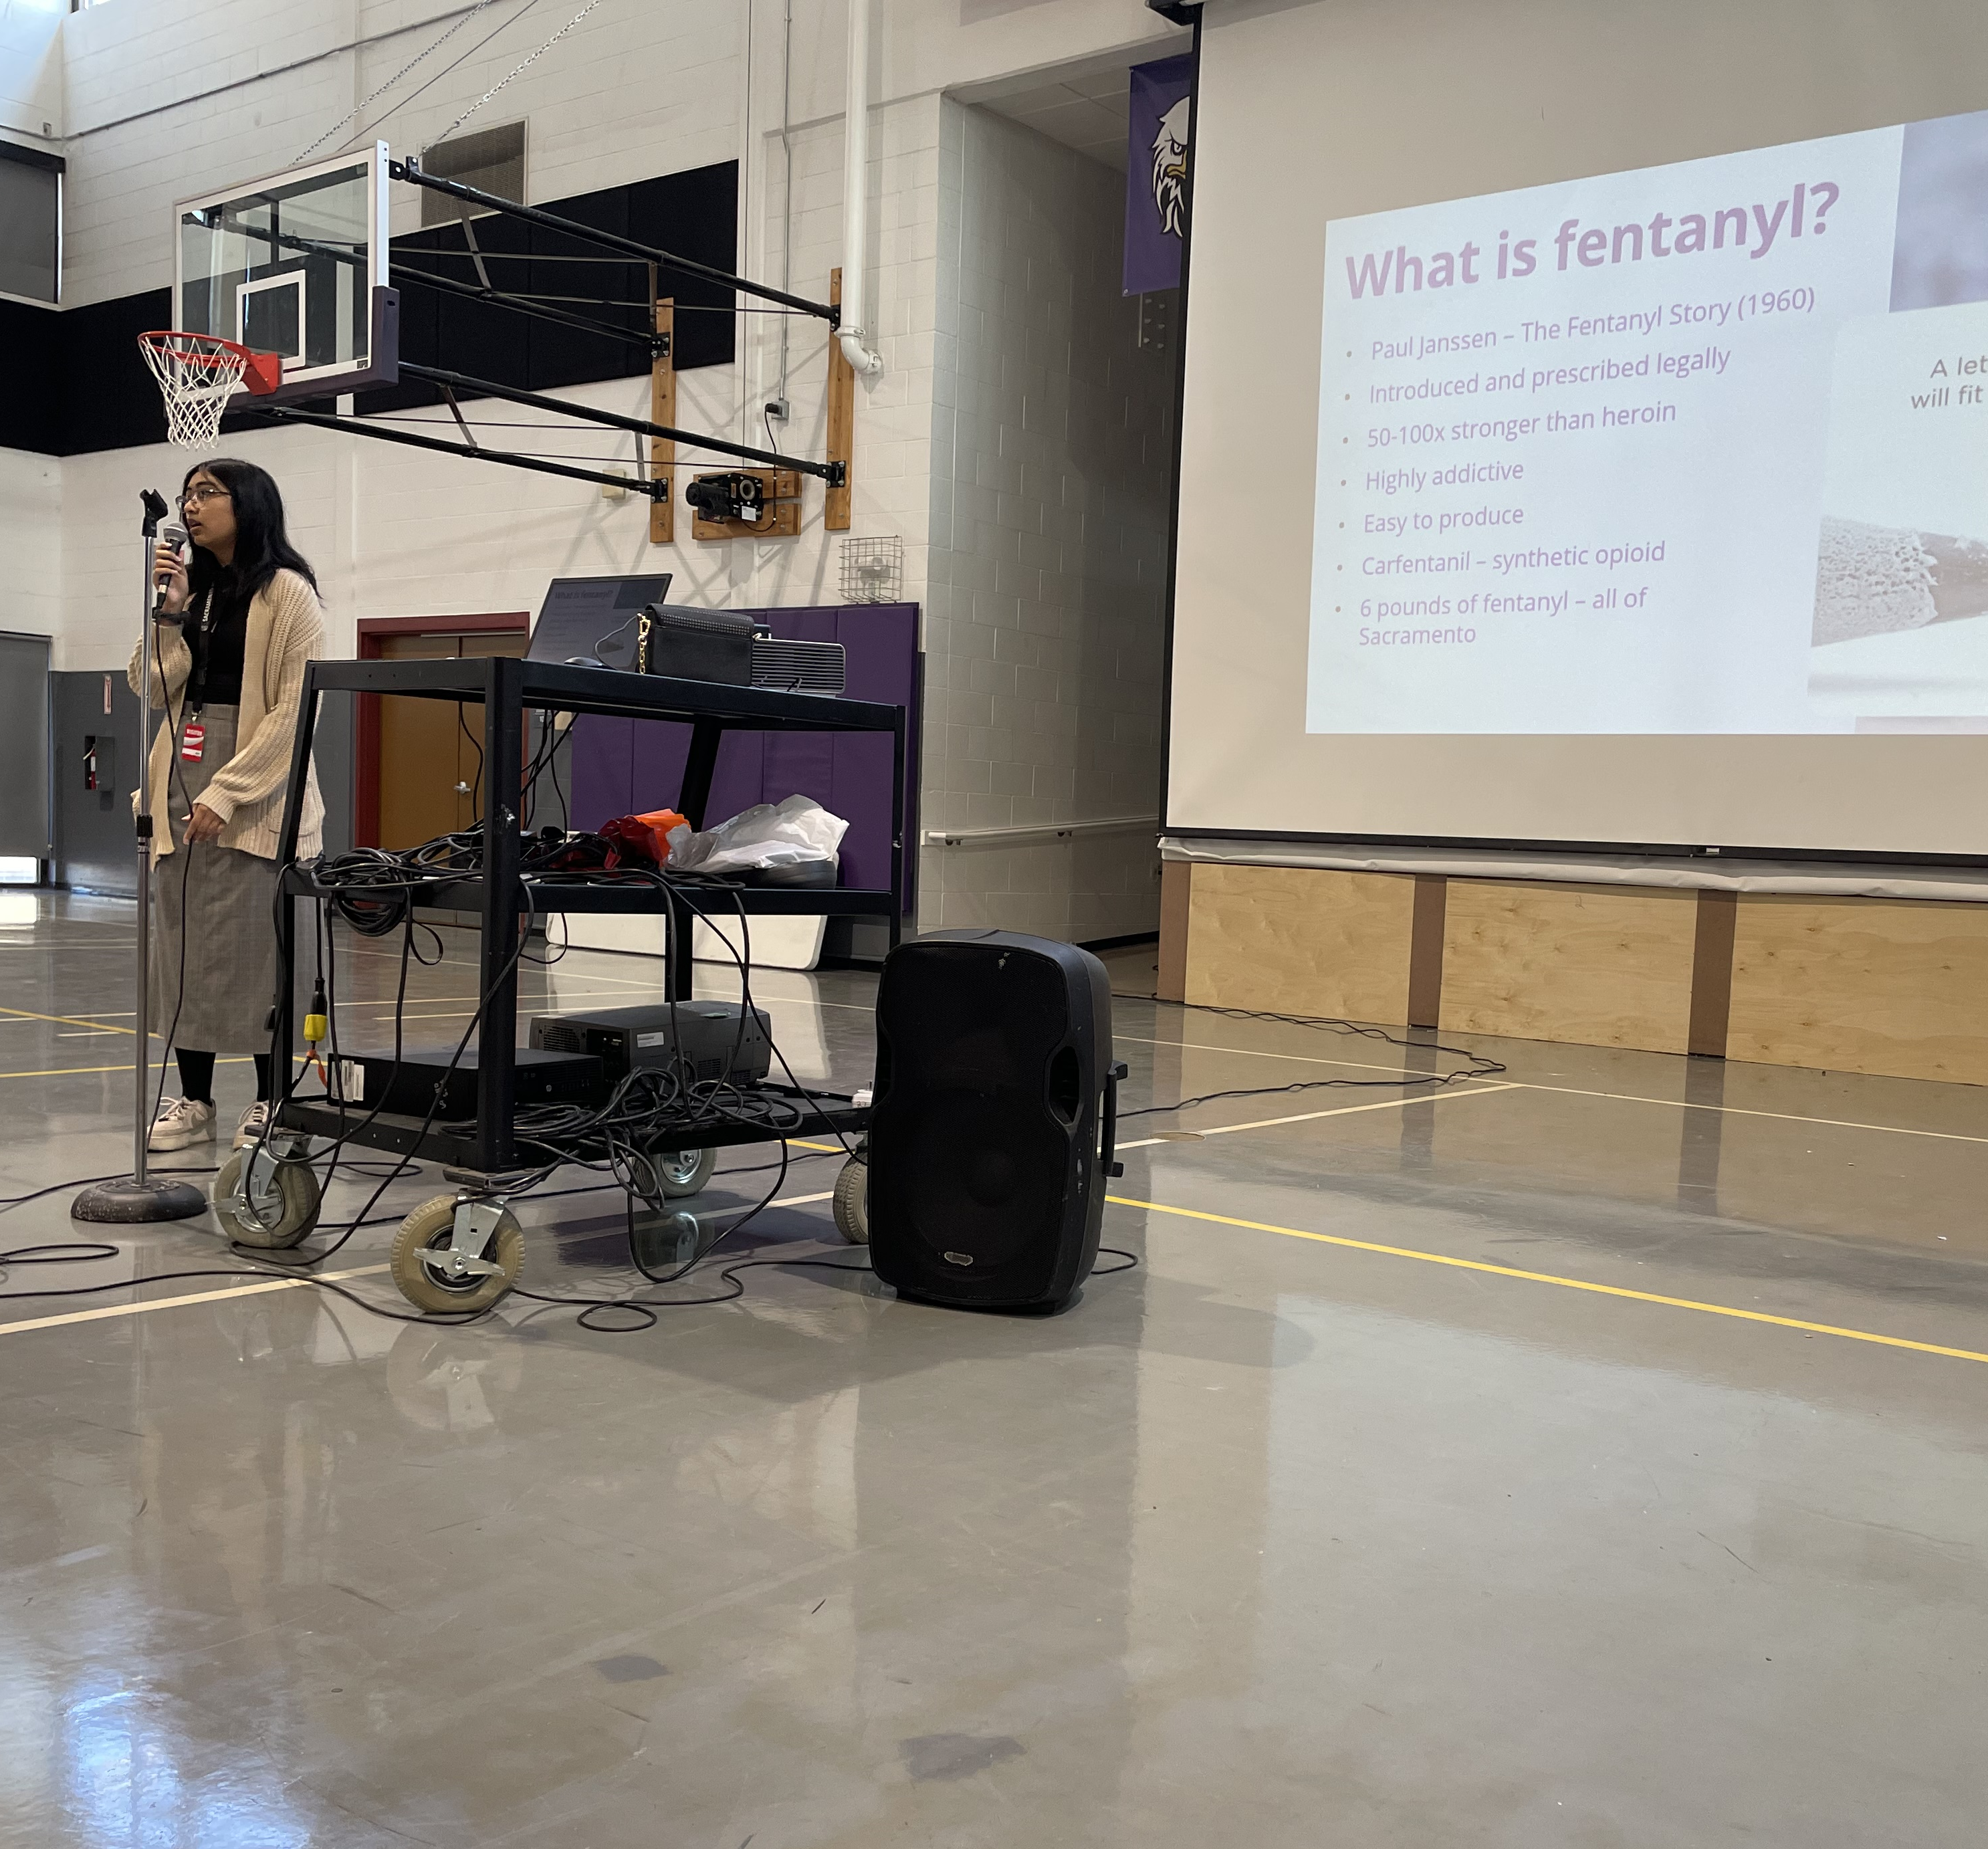
Fentanyl Education and Awareness
Fentanyl Education
Fentanyl Awareness
Fentanyl Exposure – how fentanyl gets into the system, how to approach unknown substances, etc.
Fentanyl Test Strips
Free fentanyl test strip education and distribution to the community and organizations in the greater Sacramento region
Staying in the Know
Staying up to date on statistics, news, and resources

Slide 9
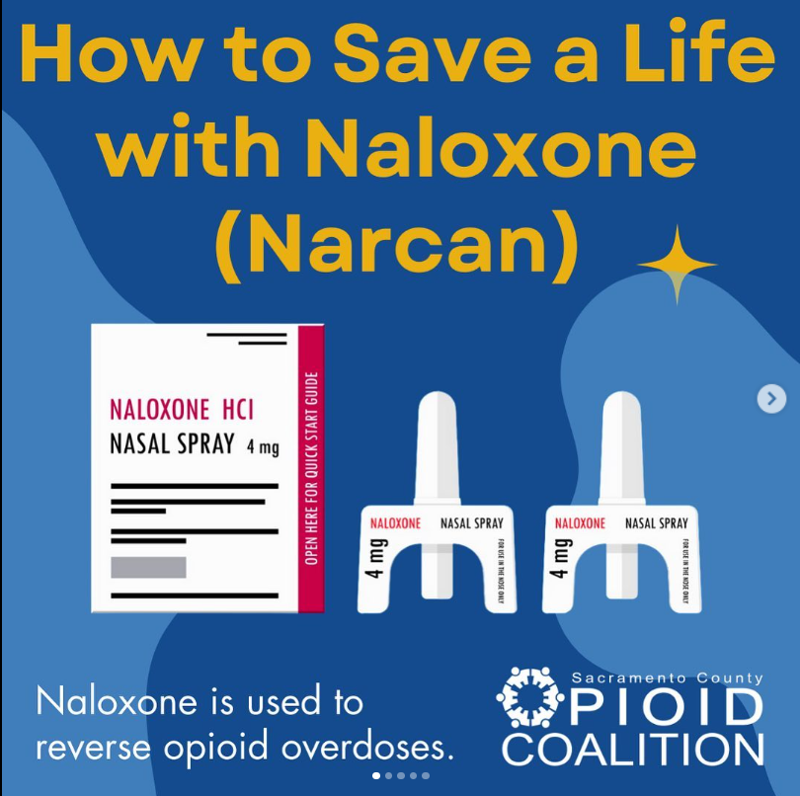
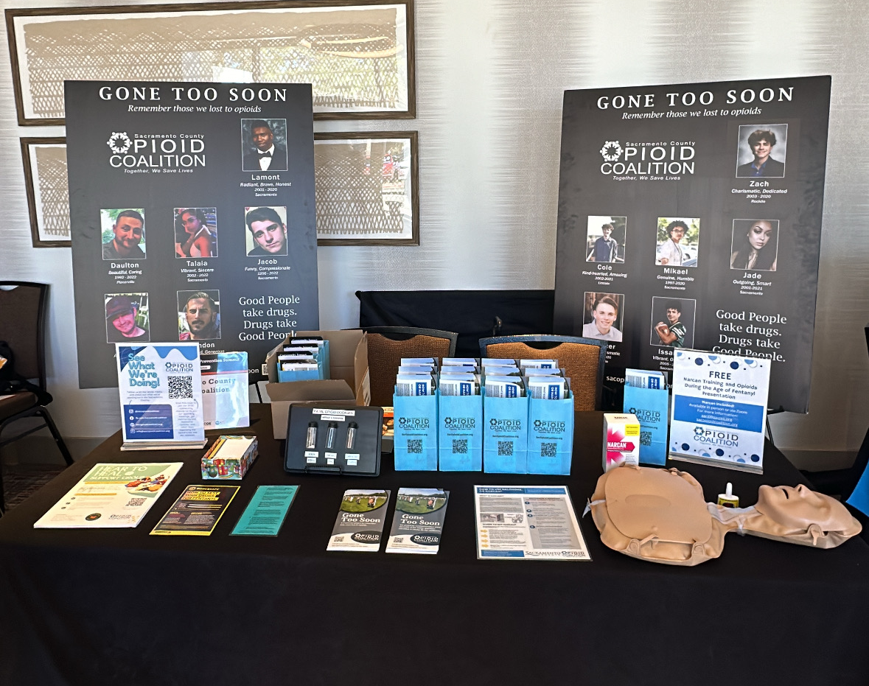
Anti-Stigma Campaigns
Gone too Soon
Poster memorial project of those who have lost their lives to opioids
Posters and stories are shared in the Sacramento community and on social media
Social Media Campaign
Regular informative posts on our social media on Narcan, opioids, and relevant updates
Collaboration with community nonprofits, local influencers, and a social media organization in creating anti-stigma and educational content on opioids, Narcan, and resources

Slide 10
What Can We Do?
Join the Sacramento County Opioid and Meth Coalition! Attend quarterly meetings to stay up to date on information, and new resources available.
Learn how to use Narcan/Naloxone, and how to recognize an opioid overdose. Gone too Soon and Hear to Heal.
If you have a story of lived experience, share with us and your community.
Talk about it on social media! Repost content from the coalition and Safer Sacramento to start a productive discussion with your community.
Encourage harm reduction practices rather than stigmatizing substance use.

Slide 11
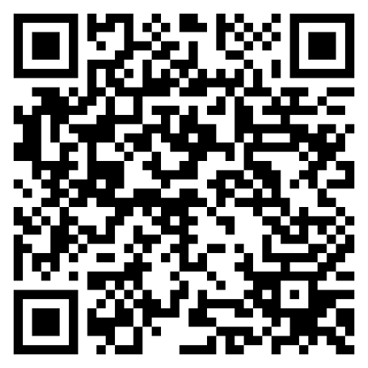
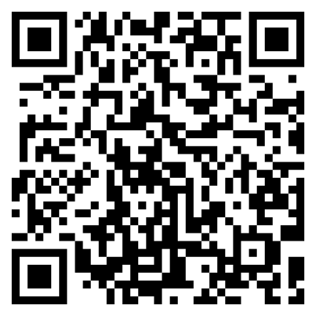
Become a Member!
Sacramento County Opioid Coalition
Sacramento County Meth Coalition

Slide 12

Thanks!
Do you have any questions?
aarif@ssvms.org
sacopioidcoalition.org
+1 (916) 456-1017
facebook.com/sacopioidcoalition
@sacopioidcoalition
@sacopioidcoalition

