Slide 1
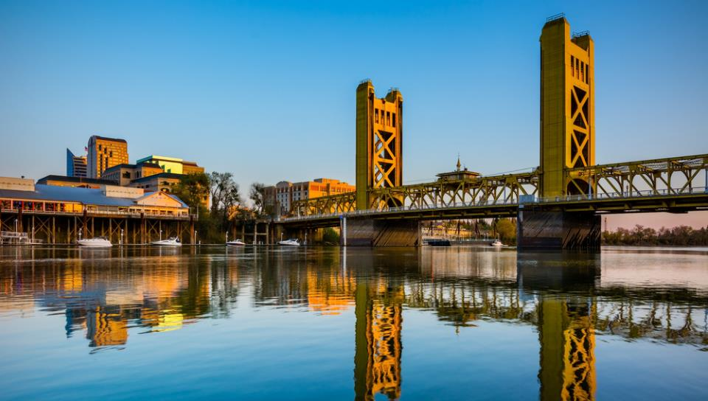
www.safersacramento.com

Slide 2
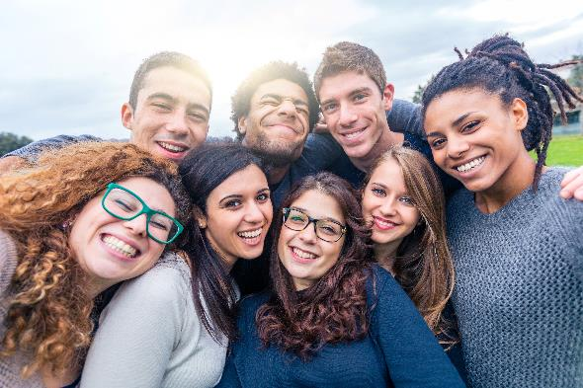
SAFER SACRAMENTO MISSION
EDUCATION FOR ALL
Safer Sacramento provides educational multimedia resources to guide individuals to make healthy choices and to avoid or reduce the potential harm from the use or misuse of alcohol, tobacco, marijuana, and other substances.
We leverage digital tools and platforms to reach communities across Sacramento County.

Slide 3
SAFER SACRAMENTO GOALS
EQUITABLE ACCESS TO PREVENTION, INTERVENTION, TREATMENT, AND HARM REDUCTION SERVICES
Seamlessly blend science, art, and expertise to educate the citizens of Sacramento County on the effects of substance use and the importance of prevention and treatment.
Contribute to reducing the rate of substance use and its potential harm.
Promote equitable access to prevention, intervention, and treatment services for the citizens of Sacramento County.

Slide 4
SAFER SACRAMENTO DIGITAL ECOSYSTEM

Slide 5
MEETING PEOPLE WHERE THEY ARE SOCIAL MEDIA
By harnessing the power and reach of social media and crafting effective strategies across multiple channels and media types, our outreach efforts align with evidence-based practices for translating science into public health messages and promoting behavior change.
SOCIAL VALIDITY
IMMEDIACY
ECOLOGOCAL
VALIDITY
STAKEHOLDER
PARTICIPATION
Content is presented in a way that fits with the viewer’s life and values.
Content is grounded in current information and true stories that lend a sense of immediacy and importance to the content presented.
Content is delivered in a manner and within an online environment that is appropriate and non-threatening.
Content is designed to be engaging and to place learners in control of receiving the information, making them active learners.

Slide 6
KEY RESULTS PROJECT OVERVIEW SINCE MARCH 2023
3.9M+ IMPRESSIONS
141K+ ENGAGEMENTS
29K+ CLICKS
We saturated our target market with engaging content
Likes, clicks, shares, comments, saves
After seeing our content, audiences wanted to learn more
55K+ WEBSITE VISITS
24K+ FENTANYL FACTS
PAGE VISITS
742K+ TIKTOK VIEWS
1M+ VIDEO SHARES
We’re seeing strong website traffic
Time on page: 2:13.
Average is 50-60 seconds!
Young audiences shared info/content with friends

Slide 7
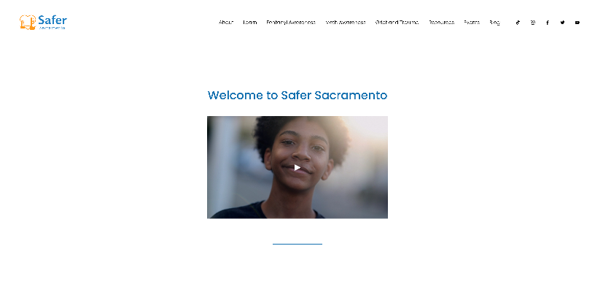
WEBSITE SAFER SACRAMENTO

Slide 8
WEBSITE FENTANYL EDUCATION

Slide 9
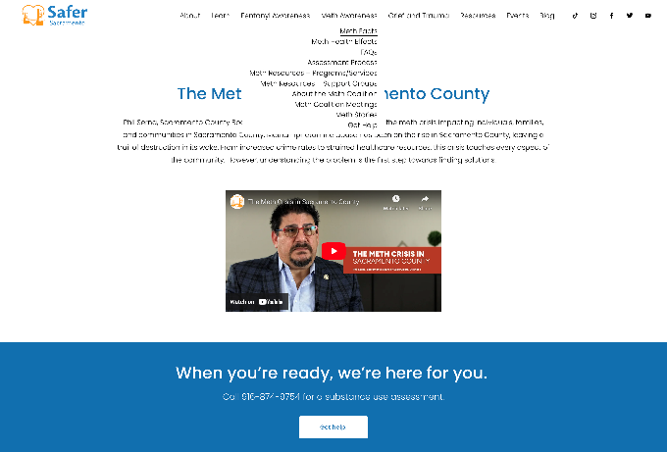
WEBSITE METH EDUCATION

Slide 10
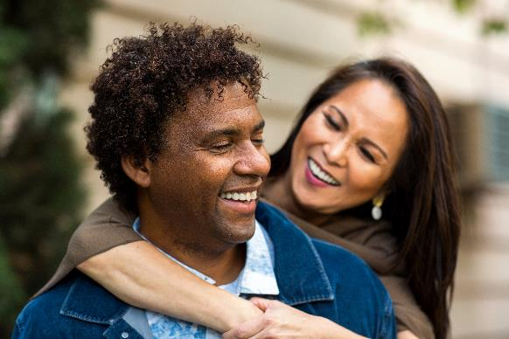
CAMPAIGN FENTANYL AWARENESS DAY, MAY 9, 2024
OBJECTIVES:
Leverage voices from the community to educate audiences about the dangers of fentanyl.
Use social media for storytelling, engaging audiences in conversation, and offering treatment and support services.
Warn citizens of Sacramento County about fake pills that may contain fentanyl.
Educate the community about the difference between fentanyl overdose and poisoning.
Drive audiences to the Safer Sacramento website for more information about treatment, recovery, harm reduction, and other support services.

Slide 11
CAMPAIGN FENTANYL AWARENESS DAY, MAY 9, 2024
KEY RESULTS, May 1 - May 31
327K+ IMPRESSIONS
26K+ ENGAGEMENTS
6,184+ CLICKS
We saturated our target market with engaging content
Likes, clicks, shares, comments, saves
After seeing our content, audiences wanted to learn more
8.2%
9.5K+ WEBSITE VISITS
4.7K+ FENTANYL FACTS
PAGE VISITS
ENGAGEMENT RATE
(1% to 3% is considered good!)
From April 17-May 31 we saw massive website traffic
Our primary call-to-action page during the campaign
This indicates how engaged people are with the brand/campaign

Slide 12
SAFER SACRAMENTO THE RIPPLE EFFECT
The Ripple Effect is an eight-part documentary blog series that integrates fact-based research and multimedia content to bring personal perspectives and expert testimony to the forefront. The new series sheds light on the harrowing reality of the fentanyl crisis in the U.S. and its impact on Sacramento County in particular. Each installment delves deep into the multifaceted aspects of this epidemic, exploring its origins, impact on families and the community, and the relentless efforts to combat the crisis.

Slide 13
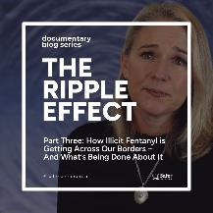
WE LAUNCHED THE RIPPLE EFFECT ON APRIL 30, 2024.
IT ALREADY HAS OVER 15K VIEWS, WITH A TIME-ON-PAGE AVERAGE OF 3:30.

Slide 14
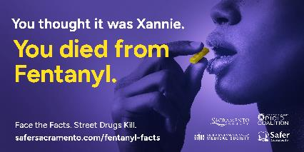
BILLBOARDS AND TRANSIT STOPS A NEW CREATIVE APPROACH
BILLBOARDS PLACED AROUND SACRAMENTO COUNTY

Slide 15
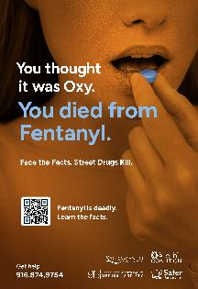
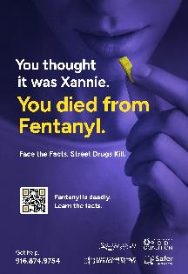
BILLBOARDS AND TRANSIT STOPS A NEW CREATIVE APPROACH
TRANSIT POSTERS PLACED AROUND SACRAMENTO COUNTY

Slide 16
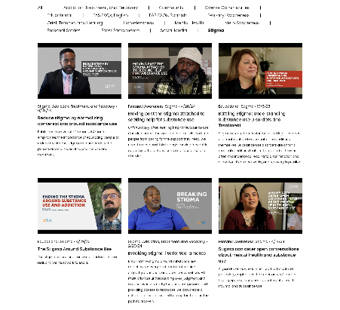
FREE RESOURCES VIDEO LEARNING
Video Learning Hundreds of free videos on the Safer Sacramento website cover various topics. Hear from experts, members of the community, and others.

Slide 17
FREE RESOURCES REMEMBERING THOSE WE’VE LOST

Slide 18
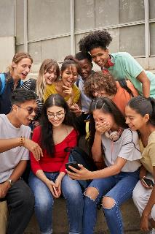
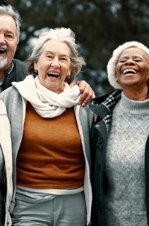
WHAT’S NEXT? UPCOMING PROJECTS
Youth Social Media Project
The Healing Center
Reaching Diverse Communities
Content for Older Adults

Slide 19
JOIN THE CONVERSATION
FIND US ON SOCIAL: @safersacramento
www.safersacramento.com

