Slide 1

I’m Amy Kimmons, a Senior Behavioral Health Peer Support Specialist with Sacramento County. Originally from St. Paul, Minnesota, I’ve been living in California for over 20 years. My personal journey as both a former and current consumer of various county programs, including SUPT, deeply influences my approach to my work.
I am passionate about my career and believe wholeheartedly in the power of resiliency. It’s incredibly rewarding to be able to spark hope and offer support to those who may not know where to turn. Outside of work, I am a proud mother of two beautiful daughters. I strive every day to be a positive role model for them and show them the importance of perseverance and hope.
My experiences, both personal and professional, have shaped who I am today, and I’m dedicated to making a meaningful difference in the lives of those I support.

Slide 2

Homeless Engagement and Response Team (HEART)
Department of Health Services
Division of Behavioral Health Services (BHS)

Slide 3

HEART Purpose and Values
Mental Health First
  Shelter/permanent housing as significant secondary priority
    Meaningful relationships with partners who have a housing first model
Recovery Oriented
  Person-centered, collaborative, strengths based
“Whatever it Takes” mentality
  Creative thinking and innovative approaches to service
Equity of access to services
  Reduce barriers by bringing services to the client

Slide 4
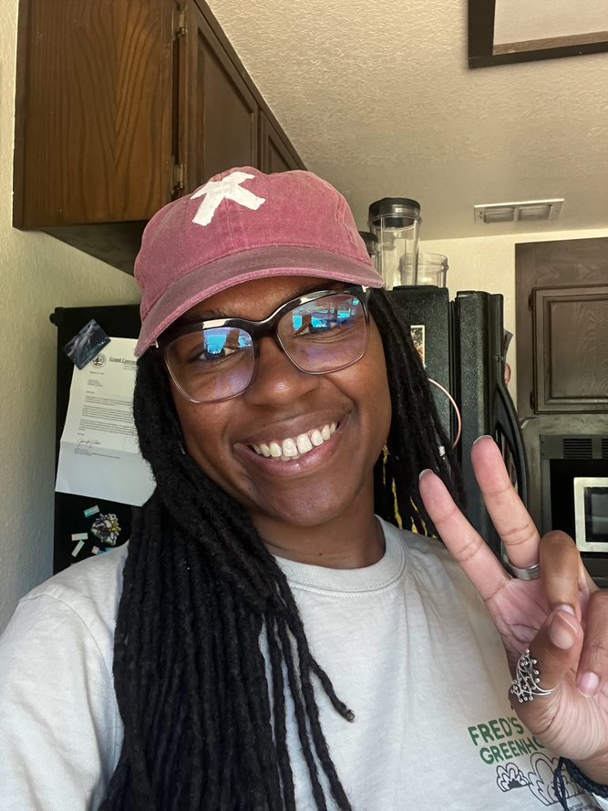
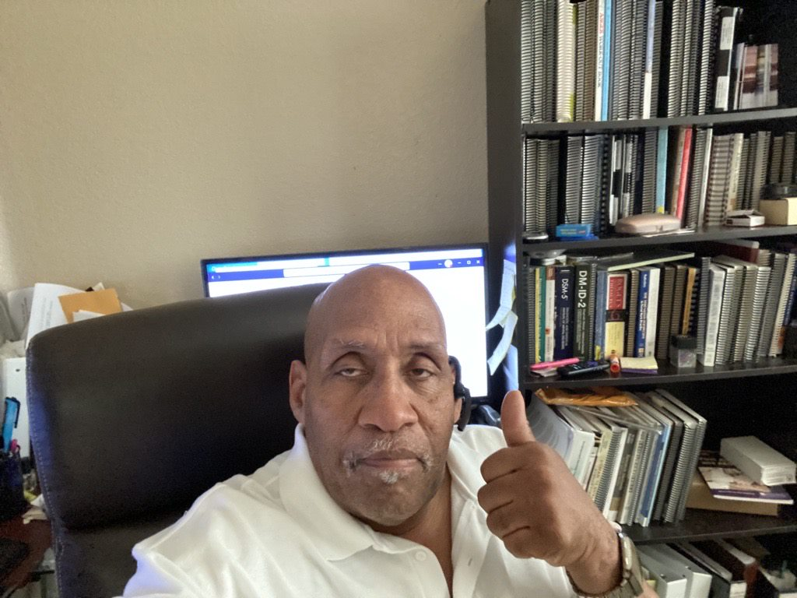


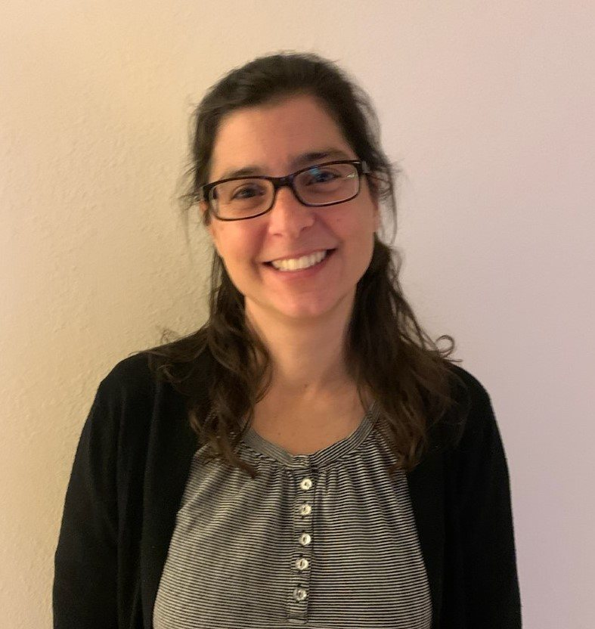
HEART Team
12 Mental Health Counselors
Conduct clinical assessments to determine need for further mental health or substance use prevention and treatment and at what level of service.
Admit client to directly to mental health providers.
Provide crisis intervention as appropriate.
Coordinate with social services providers for benefits acquisition, housing, shelters, medical care, etc.
Provide psycho-education regarding symptoms, symptom management and treatment options.
Coordinate with mental health providers, system partners, and community partners.

Slide 5
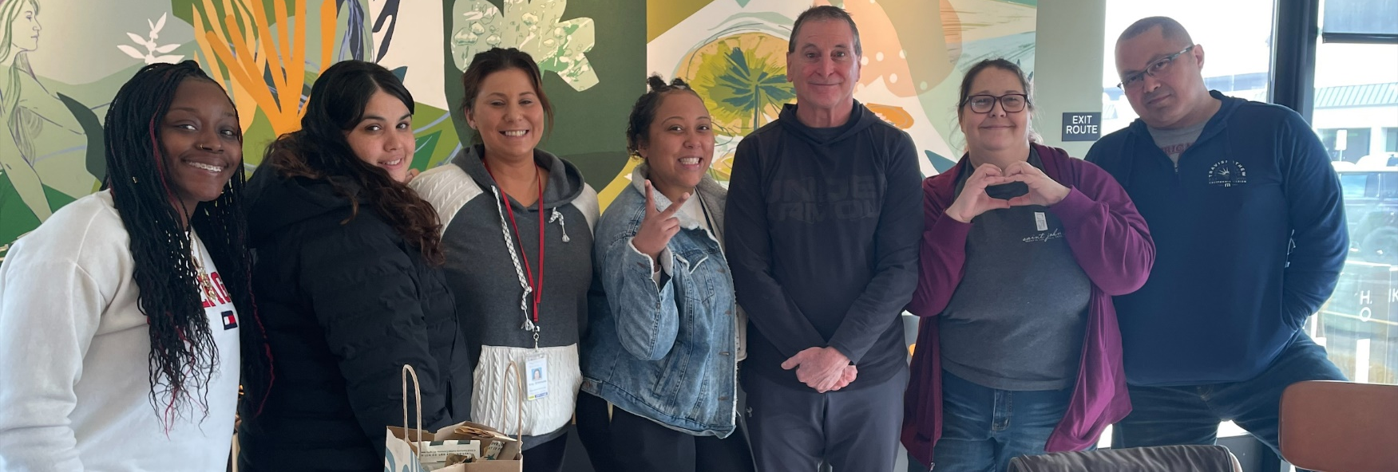
HEART Team
10 Behavioral Health Peer Specialists
Share personal lived experiences relating to homelessness, housing insecurity and/or behavioral health and recovery services.
Provide information, education, training and technical assistance on consumer and family member perspective for behavioral health system providers and partners.
Support client and family involvement in services through client-centered engagement.
Participate in countywide regional outreach activities related to Behavioral Health services.
Support clients prior to and during appointments, with the goal of increasing the client’s engagement with service providers and decreasing the stress and anxiety of these appointments.

Slide 6
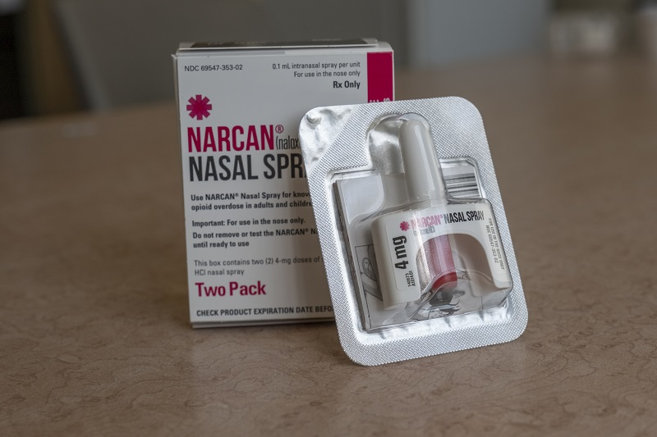

In The Streets
Fentanyl, Methamphetamine, Alcohol, Pain Pills, are most common.
Clients who learn about SUPT resources are interested in getting help.
NARCAN Saves Lives.
Barriers to being linked with Services.
Success Stories.

