Slide 1
Lived Experience Panel Getting Involved in Raising Awareness
Facilitated by Chris Didier – Parent of Zach, Forever 17
Regina Chavez, Parent of Jewels, Forever 15
Natasha Trusnik and Destiny Bohling, Lived Experience Adults
Impact SAC Youth

Slide 2
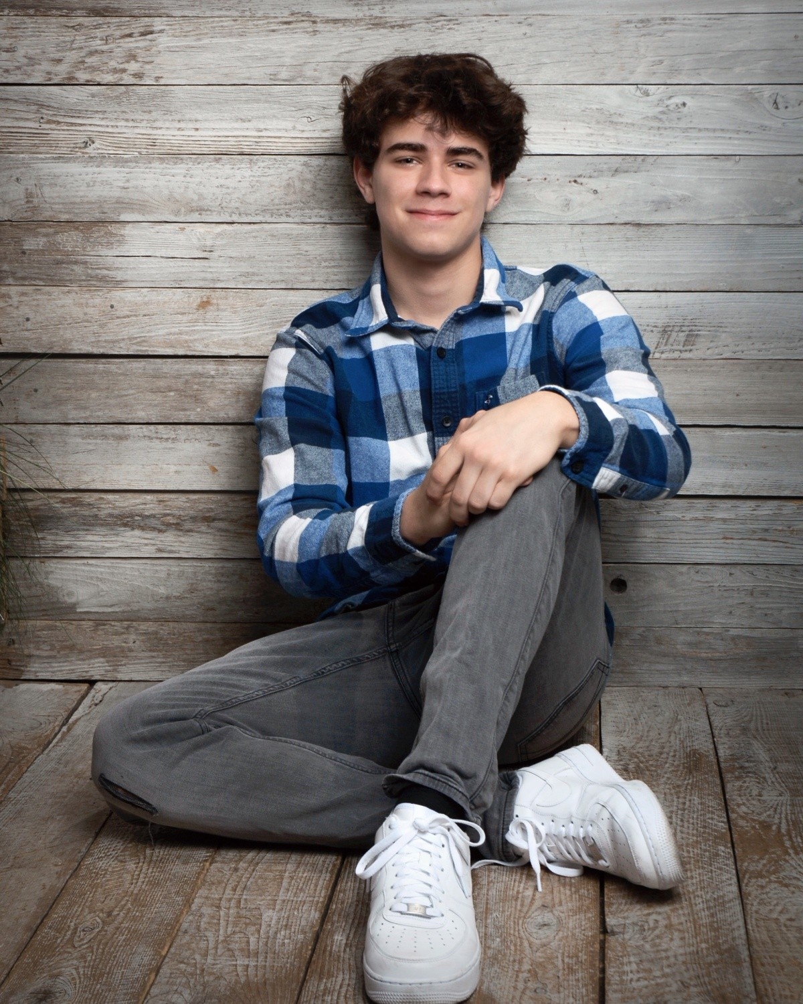
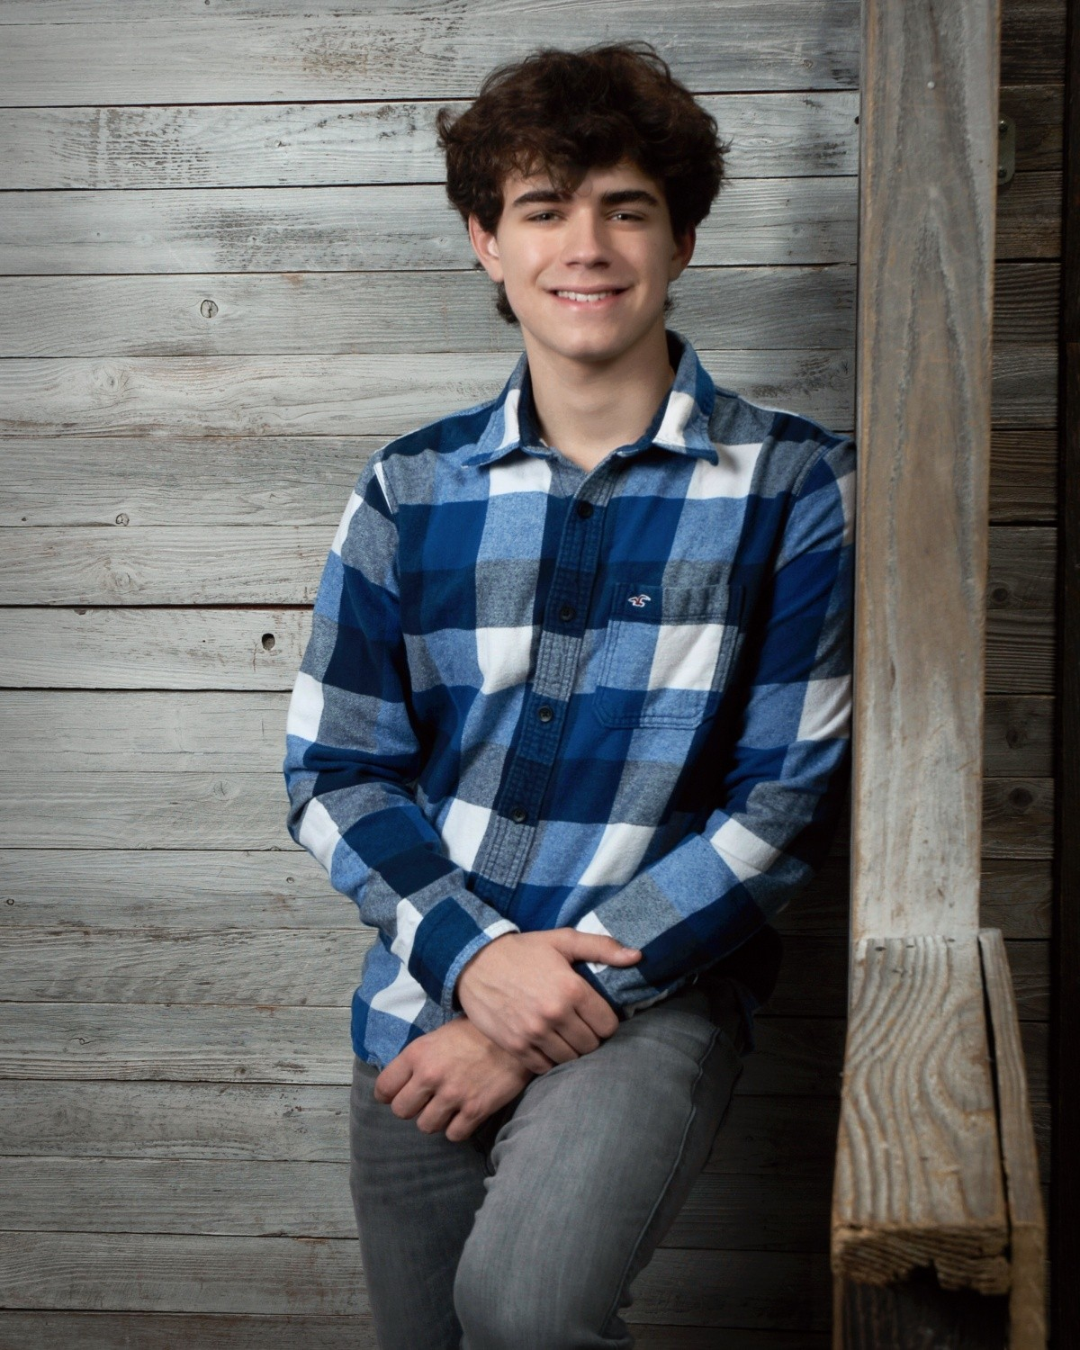
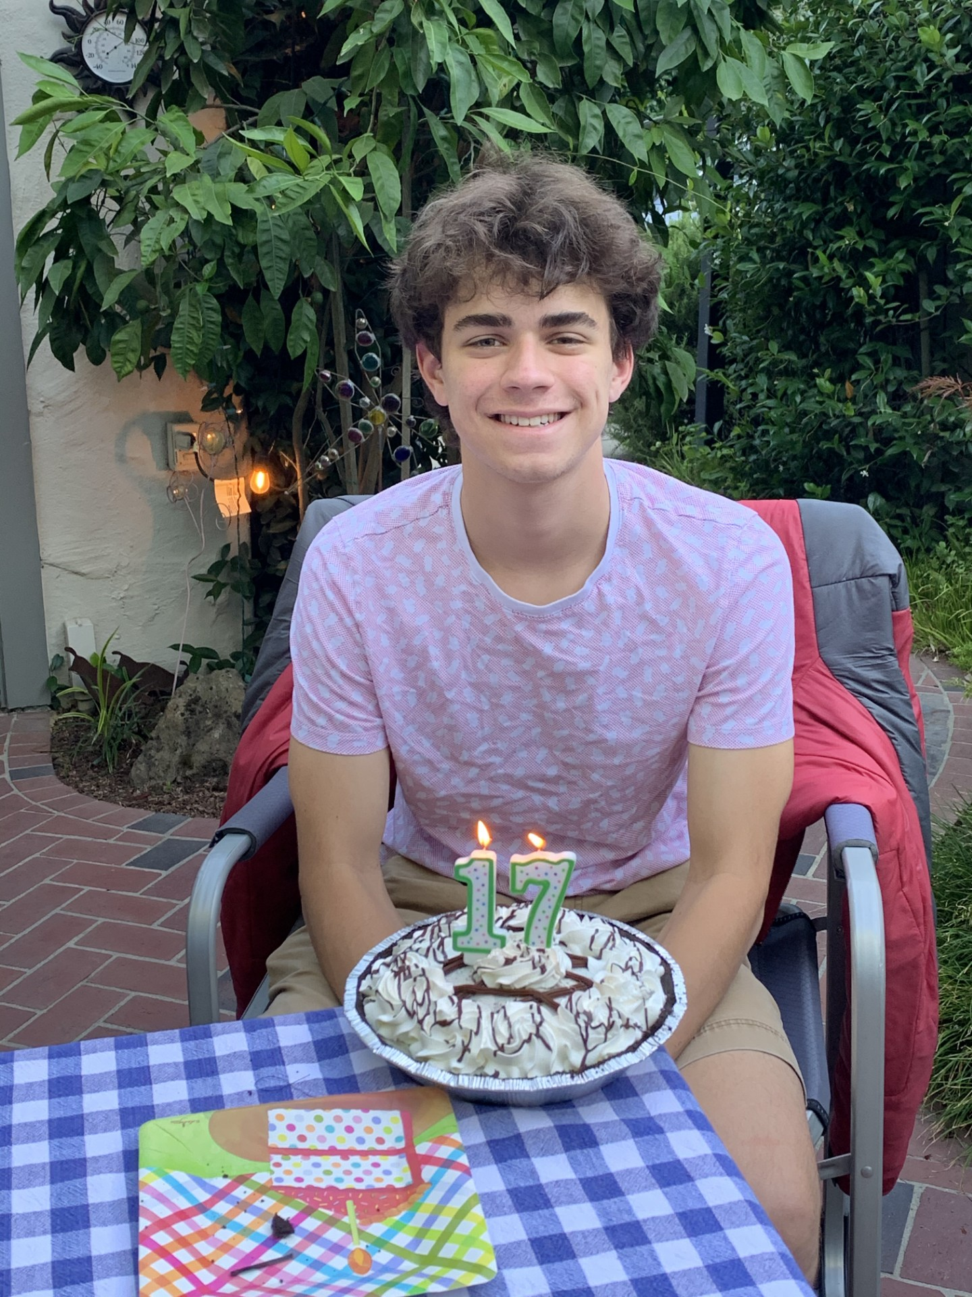
Zach Didier
Forever 17

Slide 3
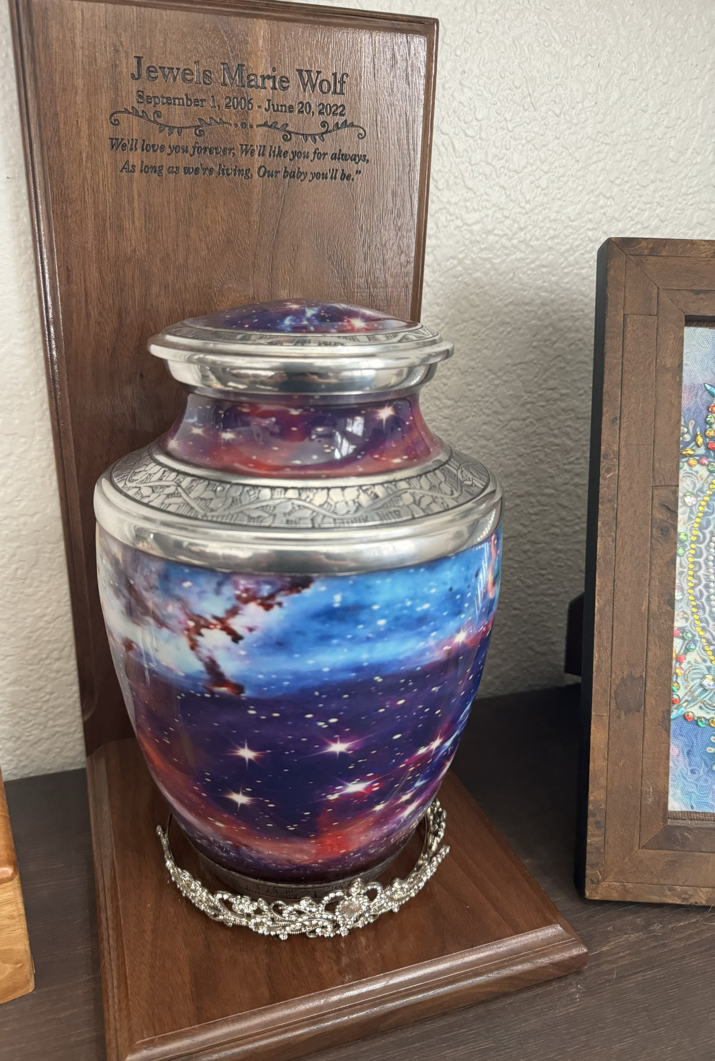
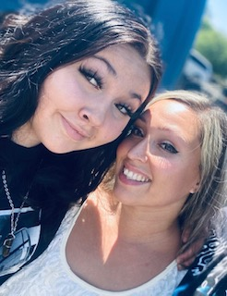
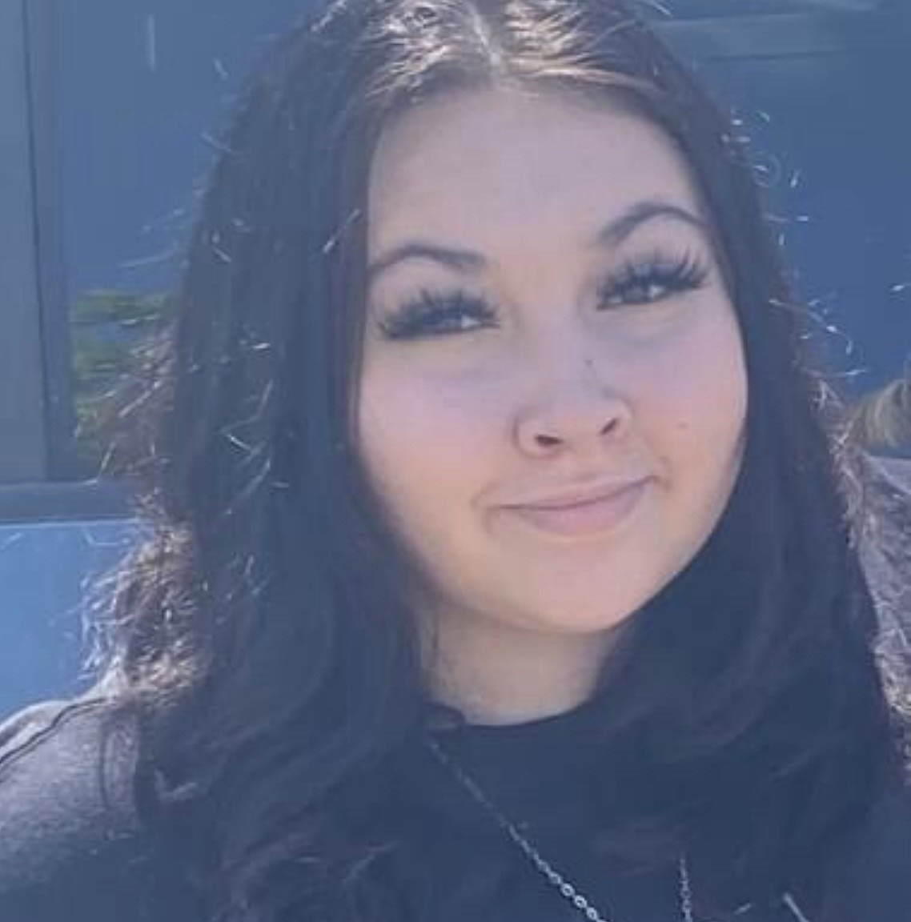
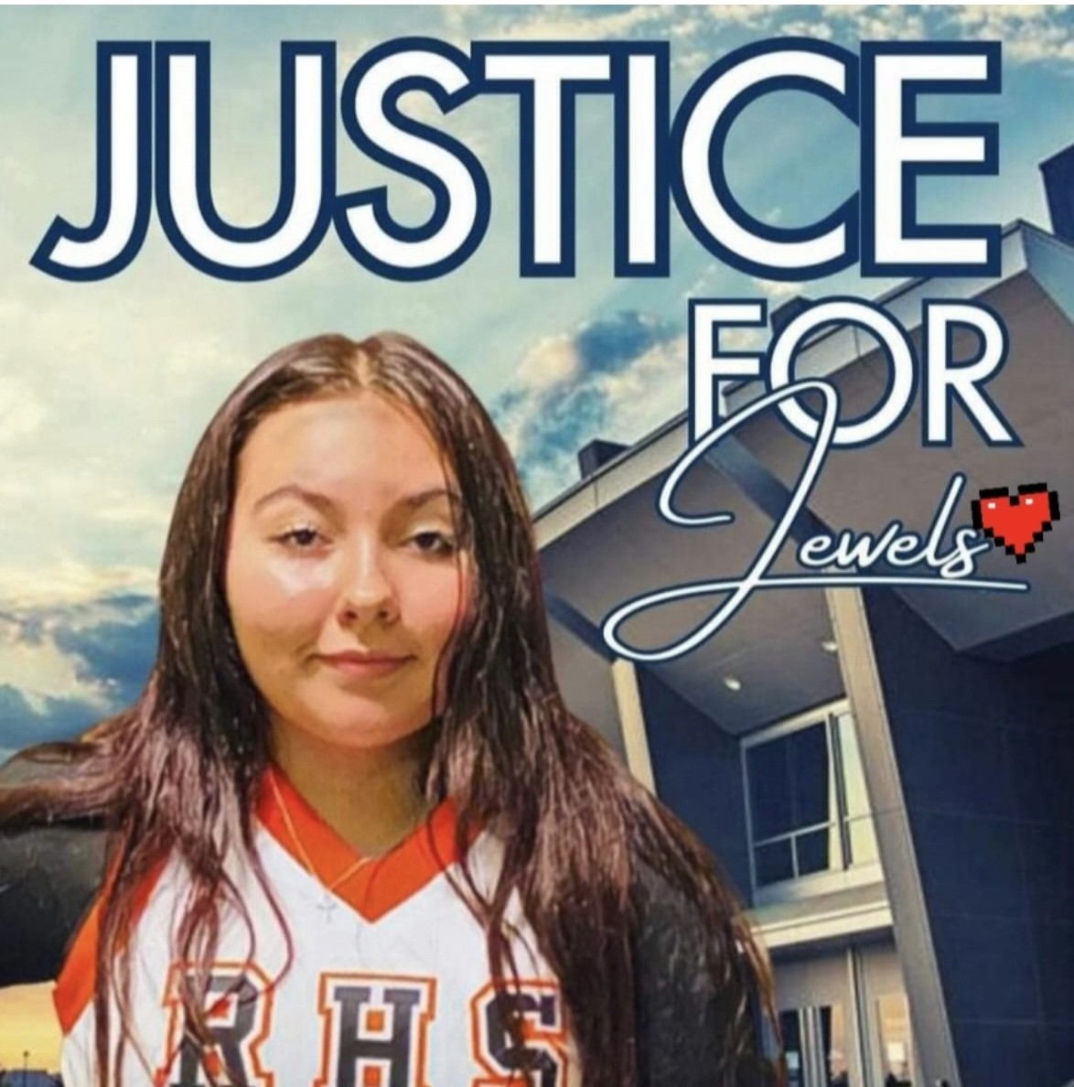
Jewels Marie Wolf
Sept. 1, 2006 - June 19, 2022
Forever 15

