Slide 1
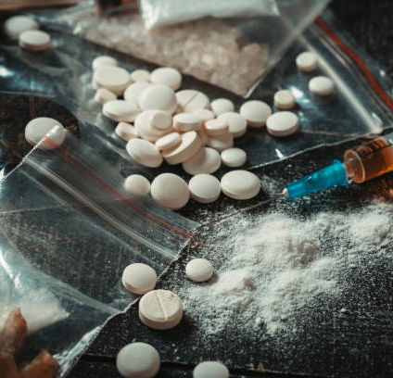
2024 opioid summit
Matt De Moura
Deputy District Attorney
Special Assistant U.S. Attorney
Notes:
Matt De Moura
Prosecutor for almost 13 years
Yolo County DDA
Special Assistant U.S. Attorney assigned to OCDETF Strike Force
Focusing on major narcotics trafficking and leaders and organizers of DTOs

Slide 2
Notes:
OCDETF is premier USDOJ program designed to combat TOC and curb flow of illegal drugs into and through US
Strike Force is an OCDETF multi-agency prosecutor led program that conducts intelligence-driven, multi-jurisdictional operations against priority targets and their affiliate illicit financial networks.
The goal of this Initiative is to bring together federal, state, and local law enforcement in a co-located setting that fosters communication and collaboration
Team is comprised of state and federal prosecutors, TFOs and agents, intel and financial analysts from all federal agencies

Slide 3
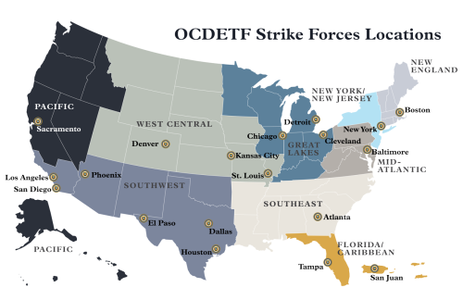
Notes:
Designed to investigate and prosecute the biggest contributors to drug trafficking and target finances
Many of these organizations are poly-drug trafficking organizations
Meaning they distribute meth, cocaine, and fentanyl and are often connected to other organizations
Our investigations and prosecutions have produced large drug seizures, high-level traffickers with extraditions from MX and other countries
Seizures have also included large amounts of firearms
Organizations include dismantling street gangs responsible for gun and drug trafficking, prison gangs and DTOs

Slide 4
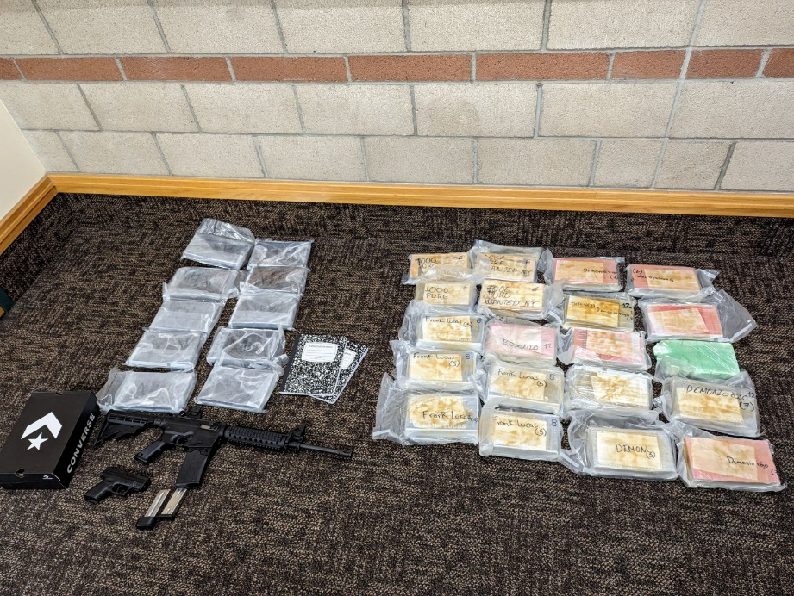
SOS and SUpply Lines
China
India
Mexico
Canada
POE
Notes:
With how much fentanyl we’re seeing, we’d think it’s produced here, but it’s not
Currently, we’re seeing seizures at the border upwards of 500,000 pills at a time and close to 100 kilos of powder
Nogales, AZ sees some of the largest seizures this year
Calixico, CA had an 8 million pill seizure in November
China used to be our biggest supplier of fentanyl, now it’s the biggest SOS for precursor chems
India also heavily supplies the chemicals
US POE along the border are the biggest avenues for bringing in fentanyl
A conservative estimate if we seize 3-5% of the dope coming across
Right now, there aren’t enough resources and personnel on the border
HSI has border teams that are supposed to help with big seizures, but it’s so much that the teams are overwhelmed with that and immigration
A lot of people will walk the drugs over from Tijuana into San Diego
El Paso and Loredo are some of the busiest POE in Texas

Slide 5
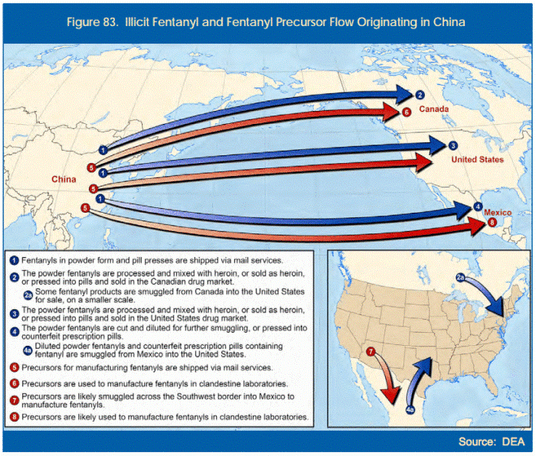
Notes:
Fentanyl is very rarely manufactured in the United States
Most of the precursor chemicals to make fentanyl are banned
NPP
ANPP
4-AP
Boc-4-AP
Piperidin-4-yl
Because they’re banned, it’s difficult to smuggle them in and not very cost effective
China, which on paper has banned fentanyl, is the biggest SOS of precursor chemicals
China used to be a major supplier of fentanyl to the U.S., but now it has shifted towards supplier the chemicals
India is also a supplier
The reason why China ships to Mexico is because the Mexican government isn’t in control – cartels are so there’s nothing to stop the flow of the chemicals into the country
Intel suggests that China is sending chemists to Mexico to help them produce the chemicals there
The reason China is supplying the chemicals is because it’s at war with the U.S. through non-traditional means (depleting our resources – money and bodies)
Chemicals are shipped to Mexico primarily, sometimes Canada and the U.S.
For the most part, fentanyl is produced in clandestine labs in Mexico using pill presses
It is extremely cheap to produce at 1-2 cents a pill and can be made year-round
It is also either to hide than more major manufacturing plants like cocaine and meth

Slide 6
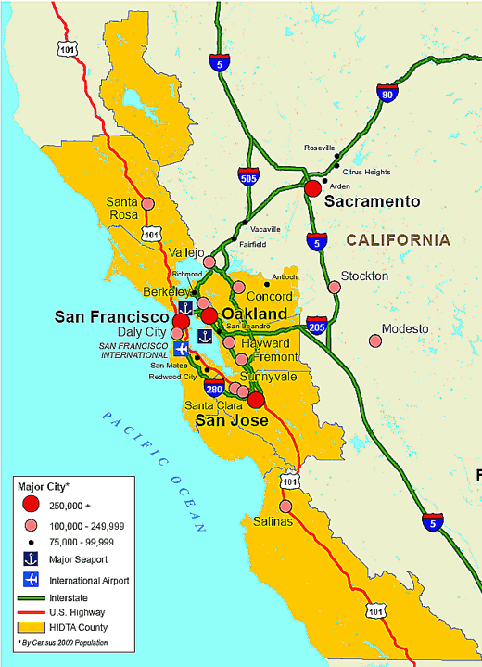
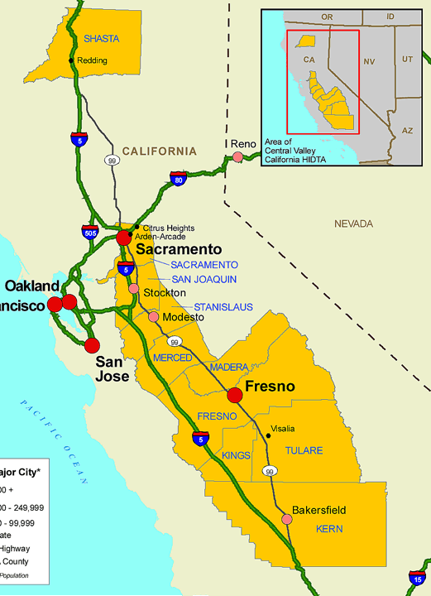
Notes:
In CA, there are four POE along the border, but 2 are the major ones (Calexico and San Yisdrio)
This is where we see our biggest fentanyl seizures
Trafficking done through:
People walking across
Hidden compartments
Tunnels
Air drops
Tractor trailers
In trafficking, drugs come up and money goes down
I-5 and I-80 are the two biggest drug corridors in CA
Once fentanyl gets across the border, it usually ends up in LA
We’ve seen decreases in the number of pills seized at the border, but LA has a massive supply of them right now
The major fentanyl hubs are all in the Central Valley – Fresno and Sacramento
After Sacramento, if we don’t stop you there, fentanyl will head up to Medford, OR and Jackson Co
HIDTA teams in Medford have arrested a lot of Mexican nationals with large quantities of fentanyl
Last December, CHP stopped 3 Mexican nationals with 41 lbs of fentanyl pills

Slide 7
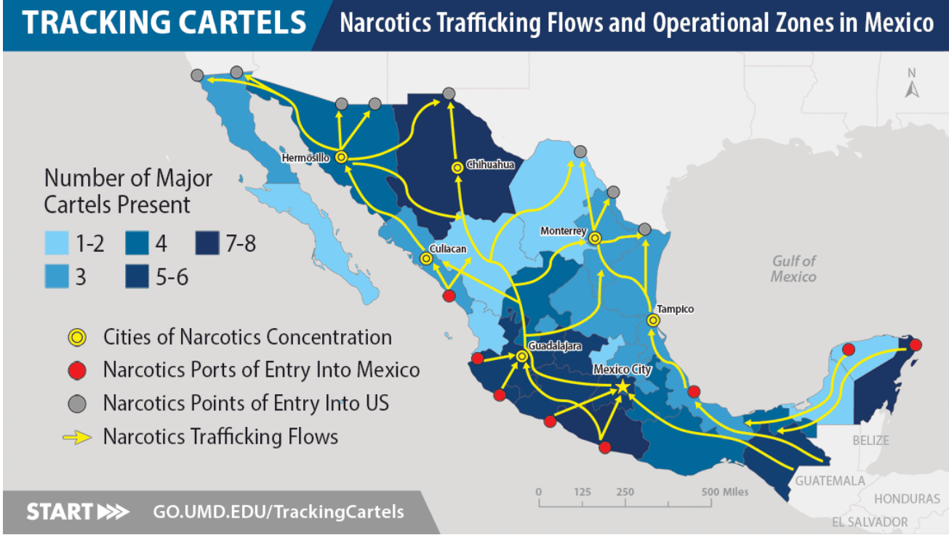
Notes:
Pro tip: If you ever go to Mexico, know that each area is controlled by a cartel and they’re usually in a war with another cartel
Cabo, PV, Tijuana are all cartel-controlled areas

Slide 8
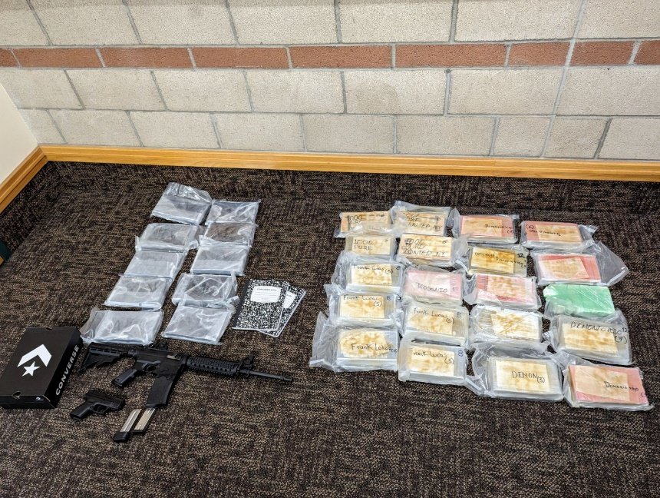
Notes:
High potency fentanyl (left)
Powder fentanyl and firearms (right)

Slide 9
Price, quantity, quality
Seeing fentanyl at lowest prices to date
Prices based on geographic region
Purity
Powder 14.4% pure
2.2 mg per pill
Mixtures and cutting agents
Notes:
1 year ago, fetty pills were selling for $15-25 a pill here
Average pill: .50-$4.50
Avg price per lb of powder is $7,000 (lb of meth is $800-1200, lb of coke is $16,000)
Fentanyl sales:

Slide 10
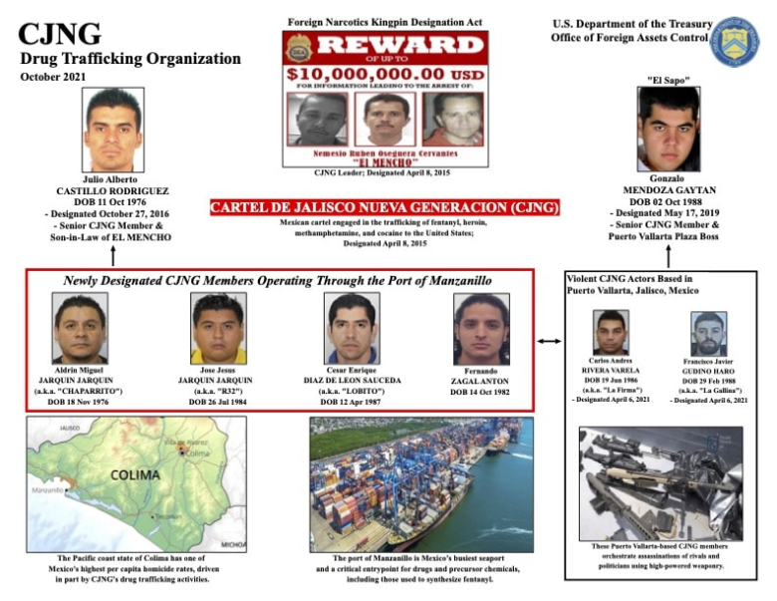
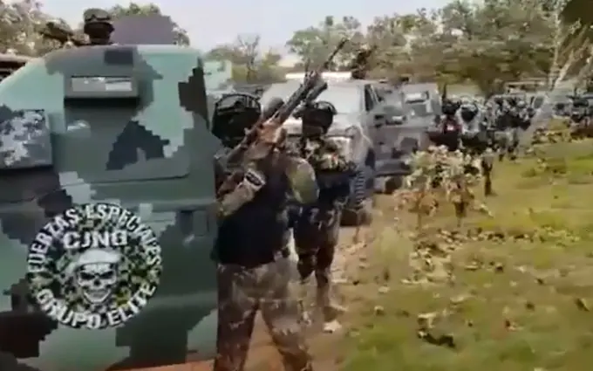
Cartels and DTOs
Notes:
CJNG:
Biggest supplier of fentanyl
They also control the avocado trade and extort avocado producers and lines
Sinaloa:

Slide 11
Cartels and DTOs
Notes:
CJNG:
Biggest supplier of fentanyl
Sinaloa:

Slide 12
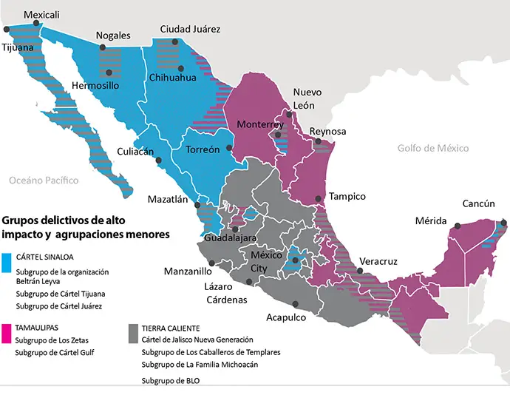
Notes:
There is a significant cartel presence in the central valley
Yolo County traffickers have direct ties to Mexico and primarily Sinaloa
Cartels will also supply the gangs
A lot of gangs are pushing coke and meth, but will still offer up pills

Slide 13
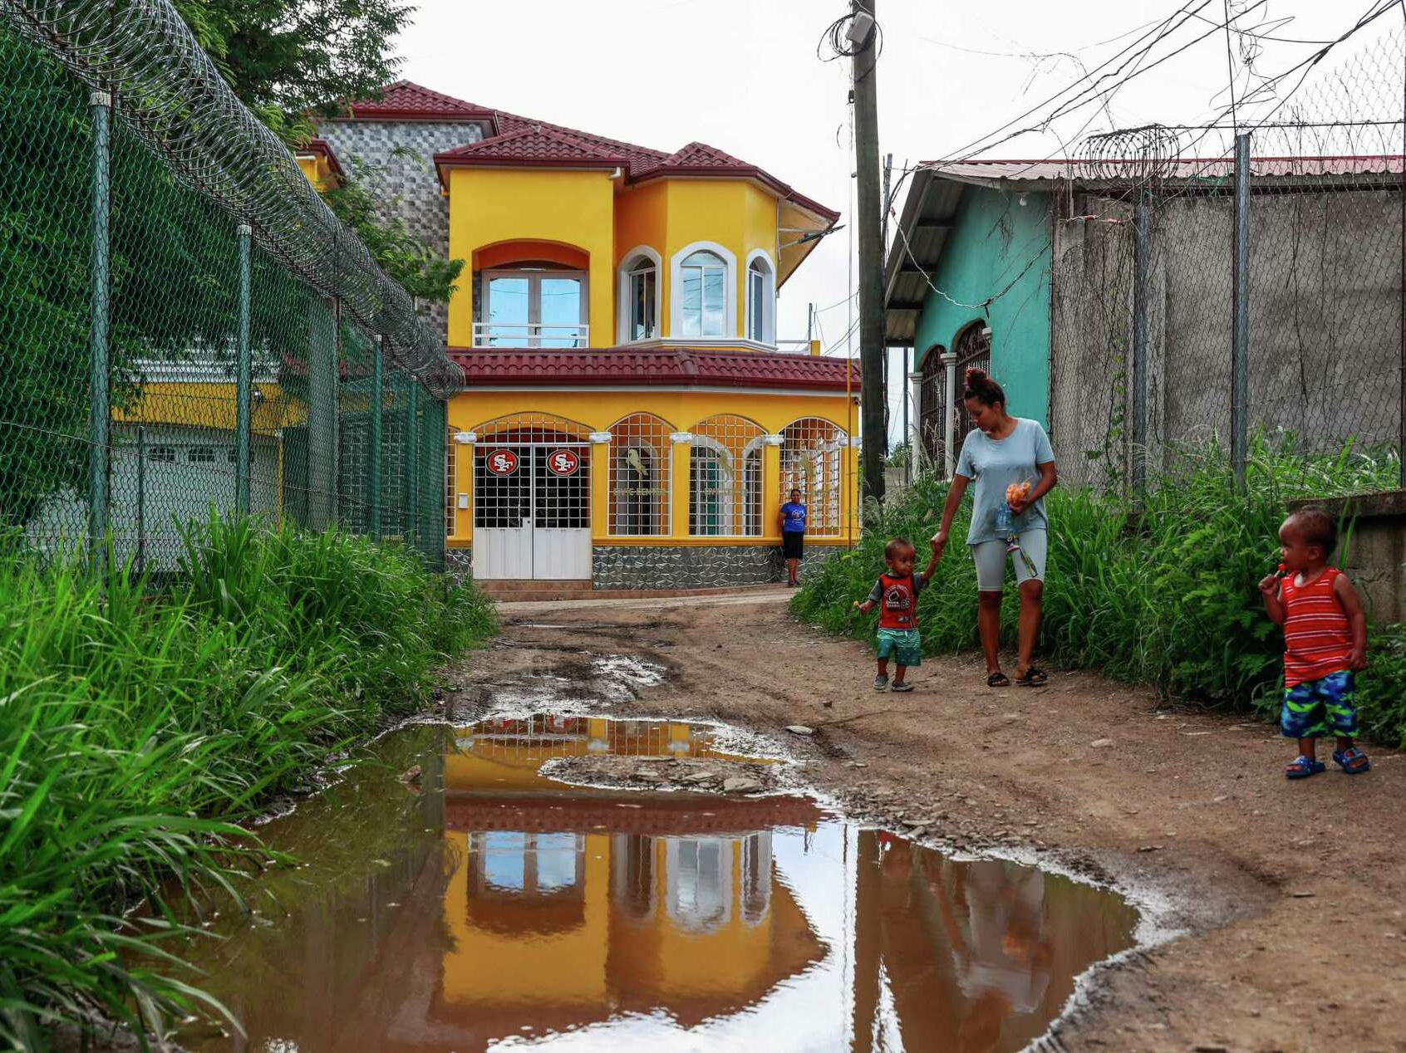
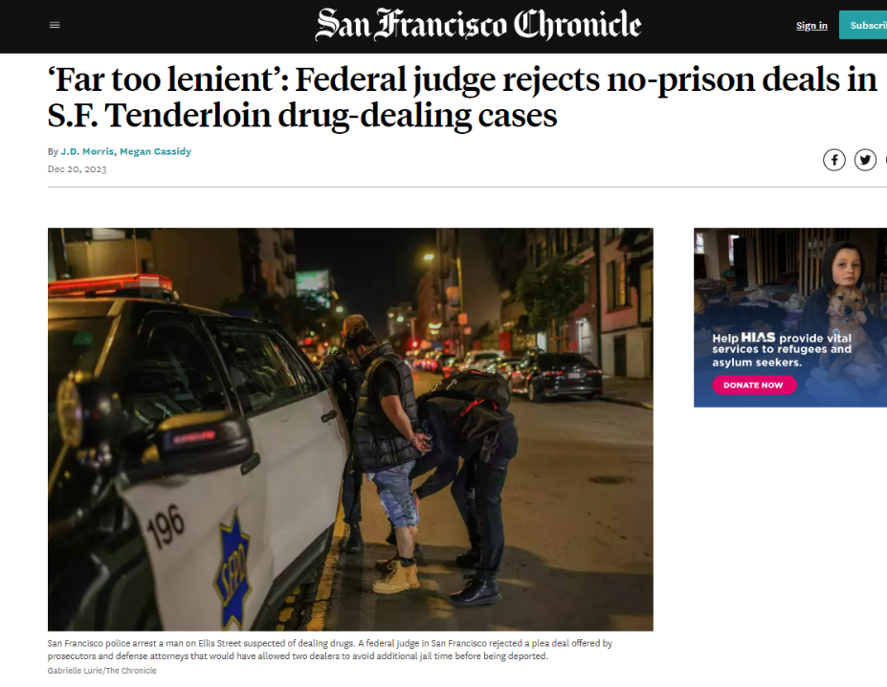
Honduran fentanyl DTOs
95% of Sac/Yolo powder fentanyl
Horizontal structure
Human trafficking
Money laundering
Notes:
SOS:
Investigation

Slide 14
Trends
Tranq
Iso
Nitazine
Carfentanil

Slide 15
DDA/SAUSA Matt De Moura Yolo County DA’s Office U.S. Attorney’s Office CVC HIDTA

