Slide 1
First Responders
Battalion Chief Scott Perryman
Dr. Alex Schmalz
Notes:
Scott - Well we are both very excited to share with you what we see from the first responder lens. As you know I’m Scott Perryman and I’m a Battalion Chief
Alex - (Alex interrupts and points at the slide) Let me guess Metro Fire. Nice subtlety on the slide there. No placement bias there.
Scott – Wait till you see the next slide. I did it just for you.

Slide 2
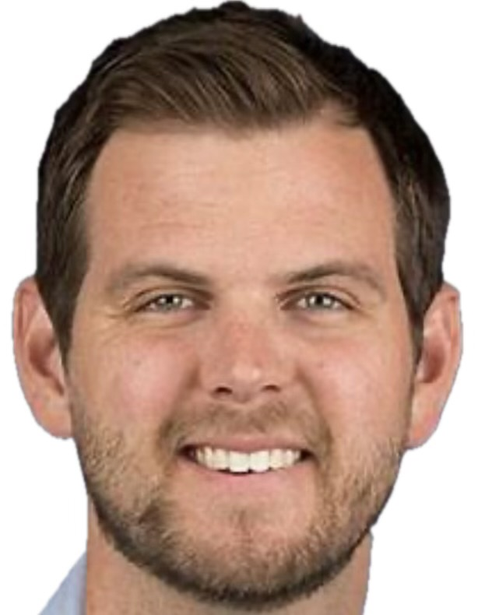
Dr. Alex Schmalz
Medical Director Metro Fire
Medical Director Metro MIH
Medica Director Stanislaus County EMS
Medical Director Metro Fire
Medical Director Metro Fire MIH Medical Director Stanislaus County EMS
Addiction Medicine Doctor, SANE
Notes:
Alex – Really?
Scott – I figured how often am I going to get this opportunity to introduce you.
Alex- Is that a 16 pack?
Scott – Yep, stop getting me off track. Dr. Schmalz is the medical director for Metro, MIH, Stanislaus County EMS, and addiction med…..
Alex – WOW, thanks? We are at the Fentanyl awareness summit and after seeing what you just did, you are on time out for a bit. So how bad is it really?

Slide 3
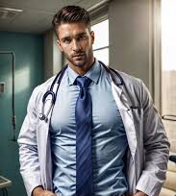
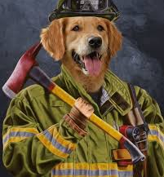
First Responders
Battalion Chief Scott Perryman
Physician Assistant
Firefighter
Paramedic
Notes:
Scott - Well we are both very excited to share with you what we see from the first responder lens. As you know I’m Scott Perryman and I’m a Battalion Chief
Alex - (Alex interrupts and points at the slide) Let me guess Metro Fire. Nice subtlety on the slide there. No placement bias there.
Scott – Wait till you see the next slide. I did it just for you.

Slide 4
How bad is it really?
EMSA Commission Report
December 13, 2023
Notes:
Alex
https://emsa.ca.gov/wp-content/uploads/sites/71/2023/12/December-Commission-Packet.pdf page 77
WWII 418,500 US deaths

Slide 5
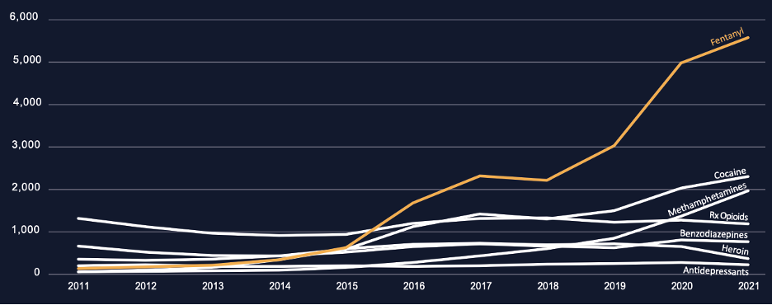
And its getting worse (Updated through 2022)
Deadliest “Events” in US History
Covid (1,186,000)
Opiate OD 1999-2022 (752,947)
107,941 deaths in 2022
Civil War (750,000)
1918 Flu Pandemic (675,000)
HIV / Aids (608,000)
Notes:
Alex
https://emsa.ca.gov/wp-content/uploads/sites/71/2023/12/December-Commission-Packet.pdf page 77
WWII 418,500 US deaths

Slide 6
Context
That’s two 737s crashing every day
Notes:
Alex
https://emsa.ca.gov/wp-content/uploads/sites/71/2023/12/December-Commission-Packet.pdf page 77
WWII 418,500 US deaths

Slide 7
Why is EMS Opiate Use Treatment Important?
#1 Cause of death nationwide under 55 years old
#1 Cause of years lost in Sacramento
EMS interacts with patients during their highest impact moments
1 year mortality for a heart attack is 5.6%
1 year mortality rate after opiate OD is 10%
20% die within 1 month
There is good treatment
Notes:
Alex

Slide 8
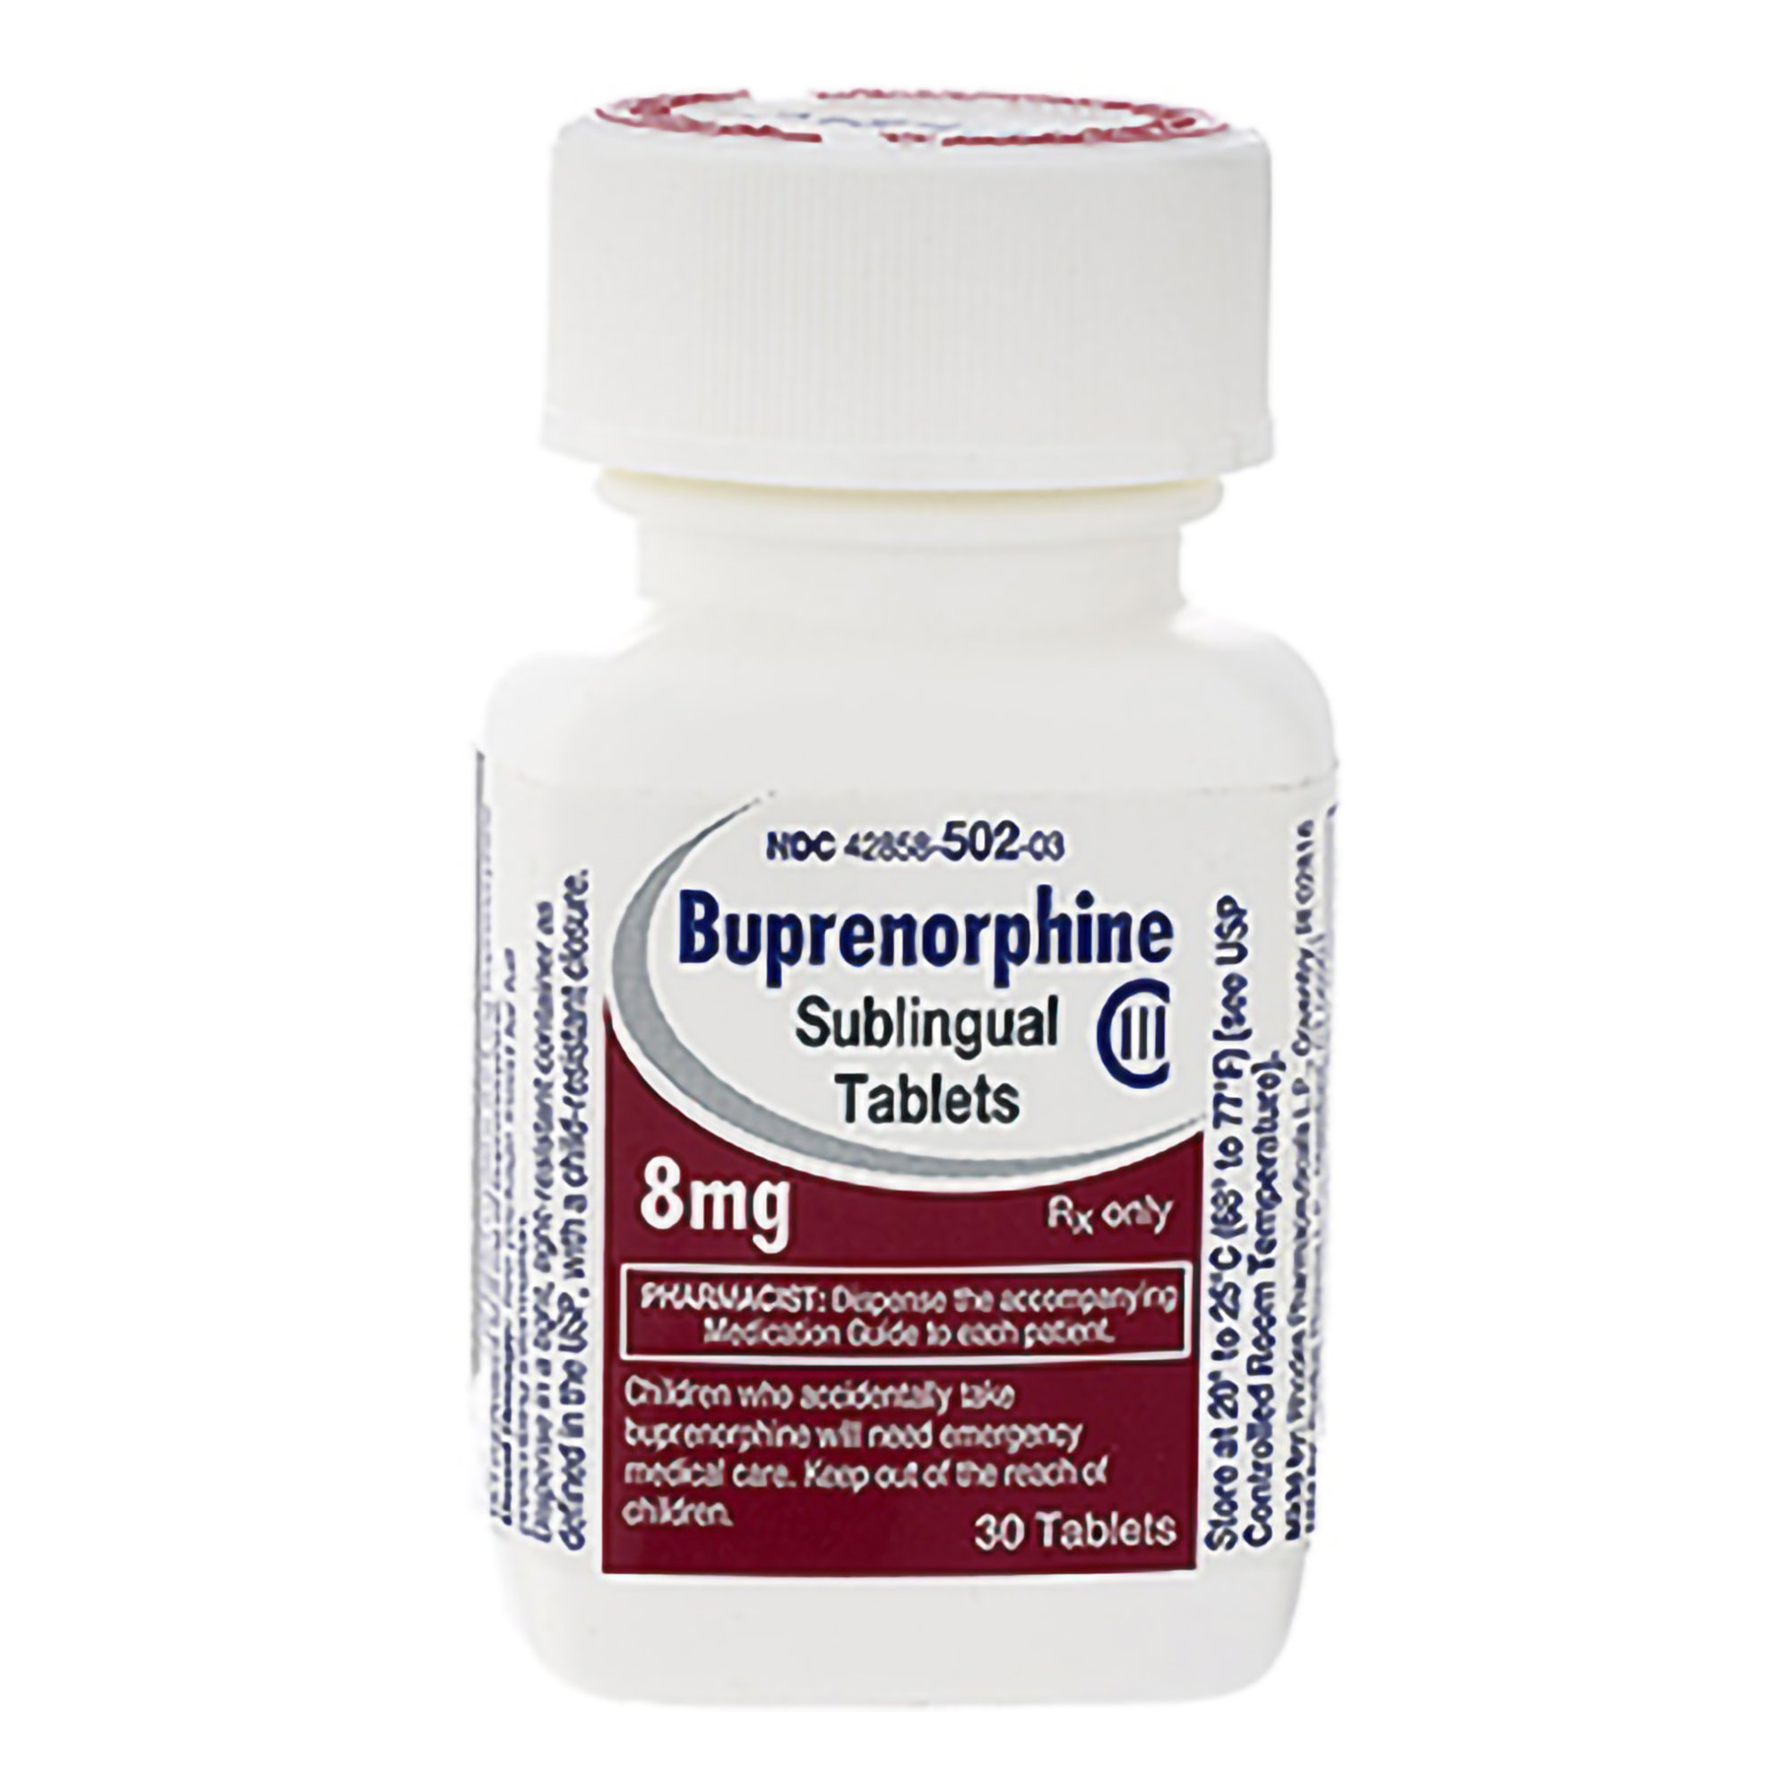
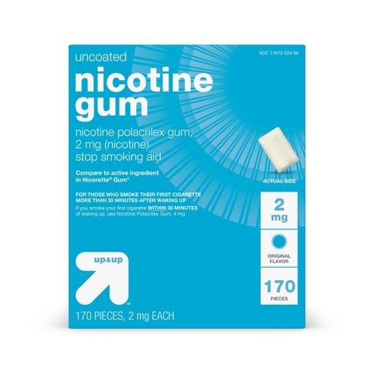
EMS Medication Assisted Therapy (MAT)
Sacramento County EMS is one of 7 counties that Paramedics can give MAT
Buprenorphine
Treats withdrawal Prevents overdose Helps people thrive

Slide 9
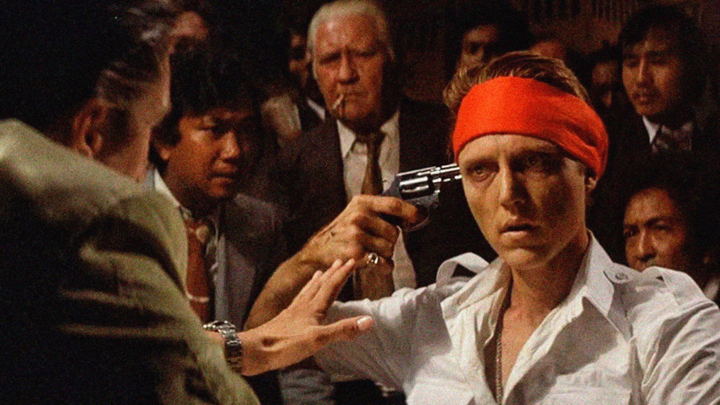
EMS Medication Assisted Therapy (MAT)
Sacramento County EMS is one of 7 counties that Paramedics can give MAT
Buprenorphine
Treats withdrawal Prevents overdose Helps people thrive

Slide 10
The Solution: MAT Medication Assisted Treatment for Opioid Use Disorder
ED Patients Randomized:
Referral
+ Brief Intervention
+ Buprenorphine
Use opiates 3x less than if they weren’t on treatment
More than 2x as likely to stay in treatment
Notes:
Keeps people sober
Keeps people alive
Prior version of “referral”: case manager hands patient a list of clinics in the area for them to call to get help
List not updated/clinics closed
Appointment times too far in the future
Clinic doesn’t take their insurance
Many phone calls – not hard, though annoying and time-consuming things for us to deal with, nearly impossible for someone with addiction to overcome
One RCT of many: randomized ED patients presenting with opioid withdrawal to one of three treatment arms: (1) referral to a treatment program, (2) a brief counseling intervention followed by referral, and (3) (in red) initiation of buprenorphine followed by counseling and referral.
Patient who were actually started on buprenorphine had a near doubling in their 30-day treatment retention and less than half the self-reported rate of opioid use.
Reference: Emergency Department-Initiated Buprenorphine/Naloxone Treatment for Opioid Dependence: A Randomized Clinical Trial. D'Onofrio G, O'Connor PG, Pantalon MV, Chawarski MC, Busch SH, Owens PH, Bernstein SL, Fiellin DA. JAMA. 2015 Apr 28;313(16):1636-1644

Slide 11
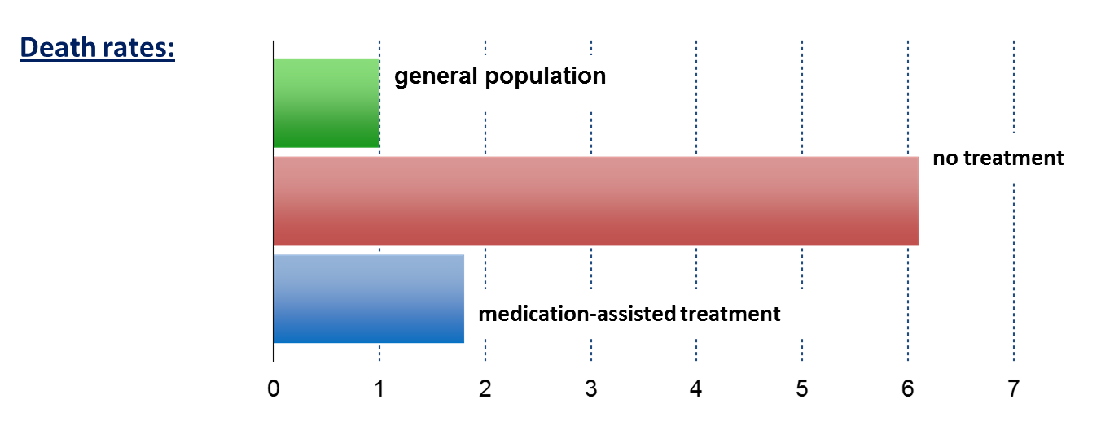
MAT: Decreased Mortality
Standardized Mortality Ratio
➔ MAT keeps people alive
Dupouy et al., 2017
Evans et al., 2015
Sordo et a., 2017
Notes:
It is very difficult to find statistically significant mortality benefits in many of the interventions we perform or medications we prescribe
OUD patients out of treatment died at about 6 times the rate of people in the general population, while medication-assisted treatment brought this to less than 2 times.
Now that we have a great treatment, it puts peoples lives together, families back together, etc
→ how do we use that in EMS

Slide 12
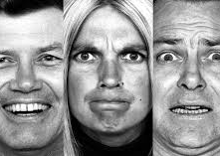
Impactful events
Emotional Intensity
Personal Relevance
Novelty and Uniqueness
Survival Mechanism
Notes:
Back and forth here
Scott: Lets try it. What did you have for dinner last Wednesday? But lets look at something where there was an emotional intensity, something unique, and personal. Where was your first kiss?
Alex: June Enich While playing hide and go seek Summer of 2002
Alex:
- Lets try that on you. Tell me about the birth of your first child.
List of events that people have that lead to change
Divorce
Moving to a new city
Death of a loved one
Birth of a child
➔ all things that shake people’s worlds ➔ cause people to change who they are and what they d
Every time someone calls EMS it’s an event that changes their life
Scott --> One day that is the highest impact is the day you almost die

Slide 13
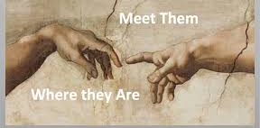
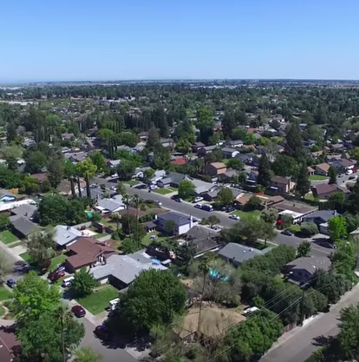
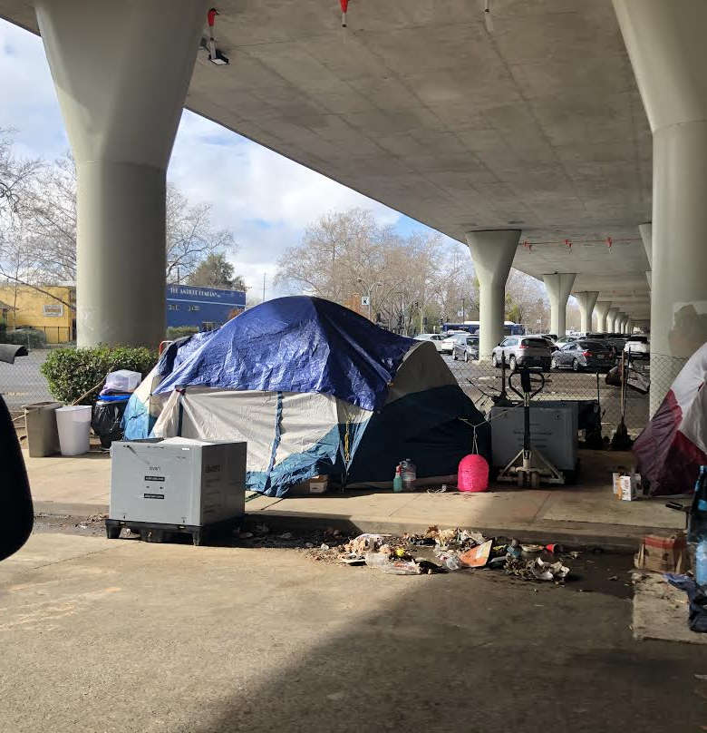
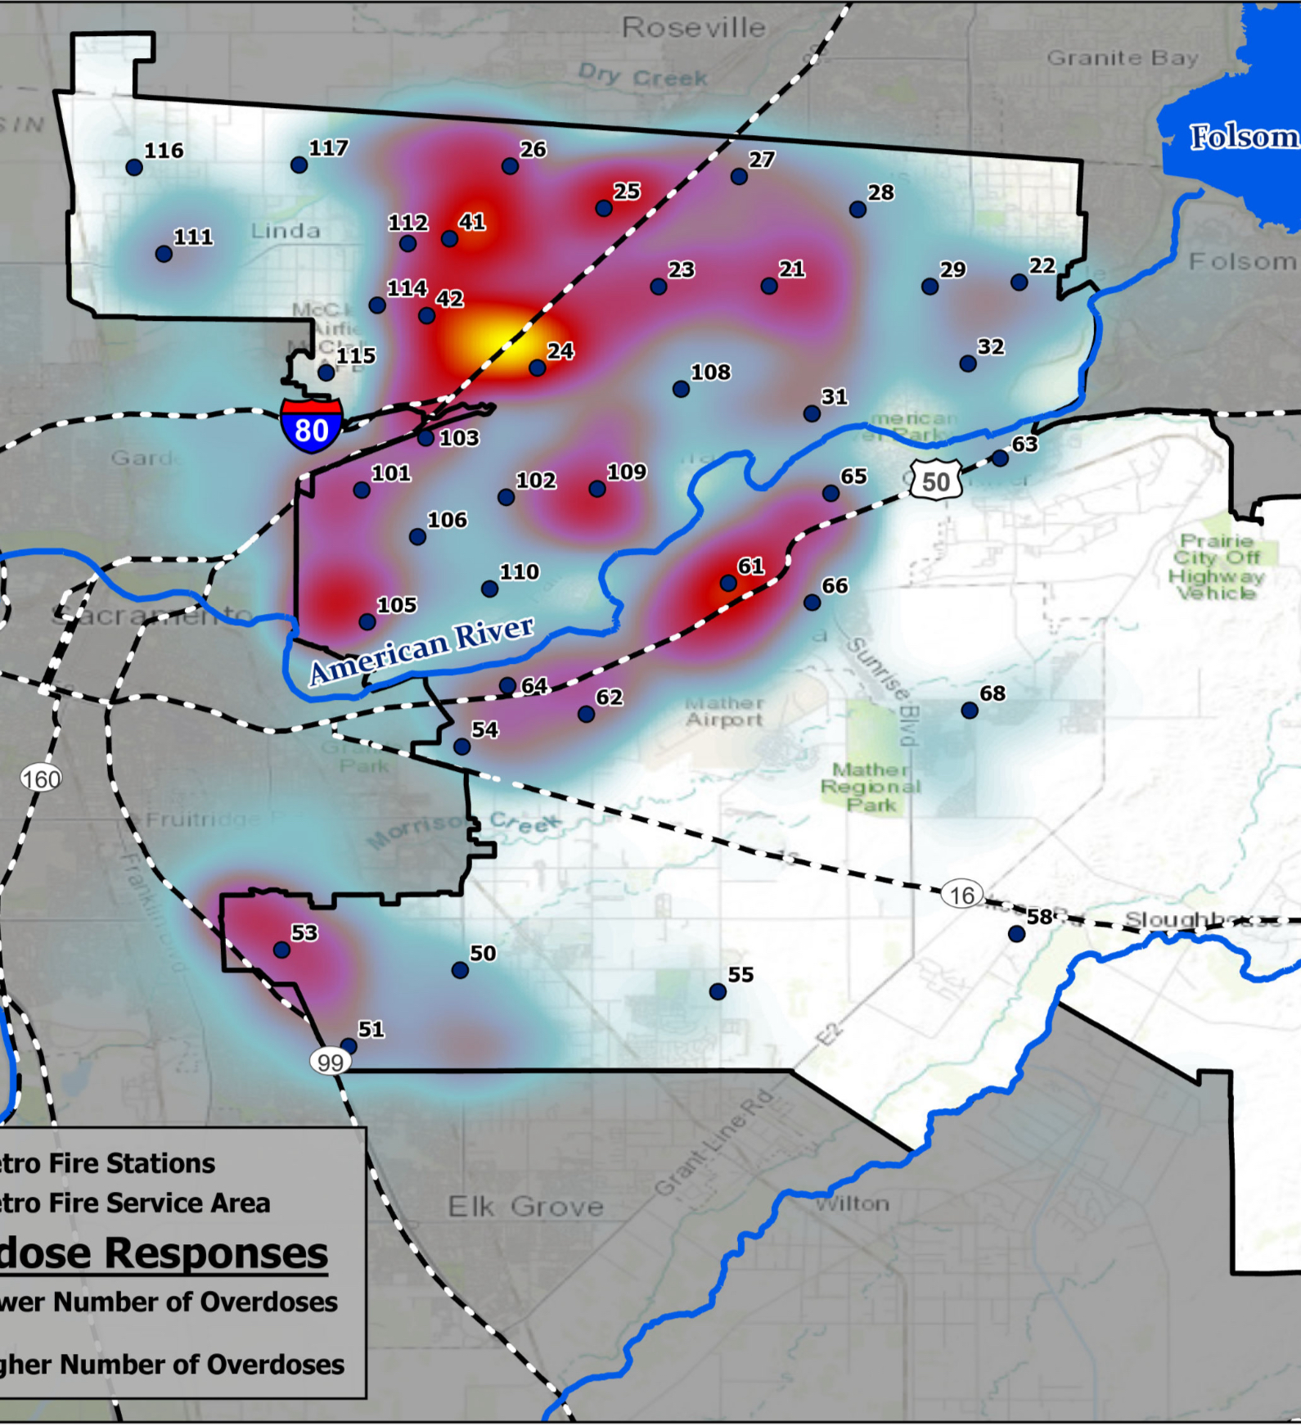
Positioned to make an impact
We are already responding to these incidents
Meet them where they are
The impactful moment has occurred and we can direct them
Heart attack vs Overdose
Notes:
https://www.ncbi.nlm.nih.gov/pmc/articles/PMC3711523/
https://www.ncbi.nlm.nih.gov/pmc/articles/PMC3664550/
Negative events lead to behavior changes
A definitely high impact moment is the day you almost die
Scott first 2 bullets
Alex takes 3rd.
Scott do you remember who was in the room when your kid was born? The loved ones? Doctor?
→ take that moment and lead to change
Normal EMS helps people survive by giving them Narcan and taking them to the ER
We’re hoping to take that a step further by helping people thrive by doing more
We believe this makes it so EMS has a unique opportunity to intervene and not just save someone’s life, but change the trajectory of their life and allow them to thrive
We can save their life in that moment by giving them Narcan or treating their heart attack or stroke
But we also believe we can change the trajectory of their life → spur change and help them thrive
The key to this is meeting patients where they are and connecting with them

Slide 14
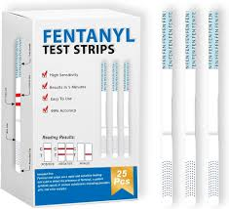
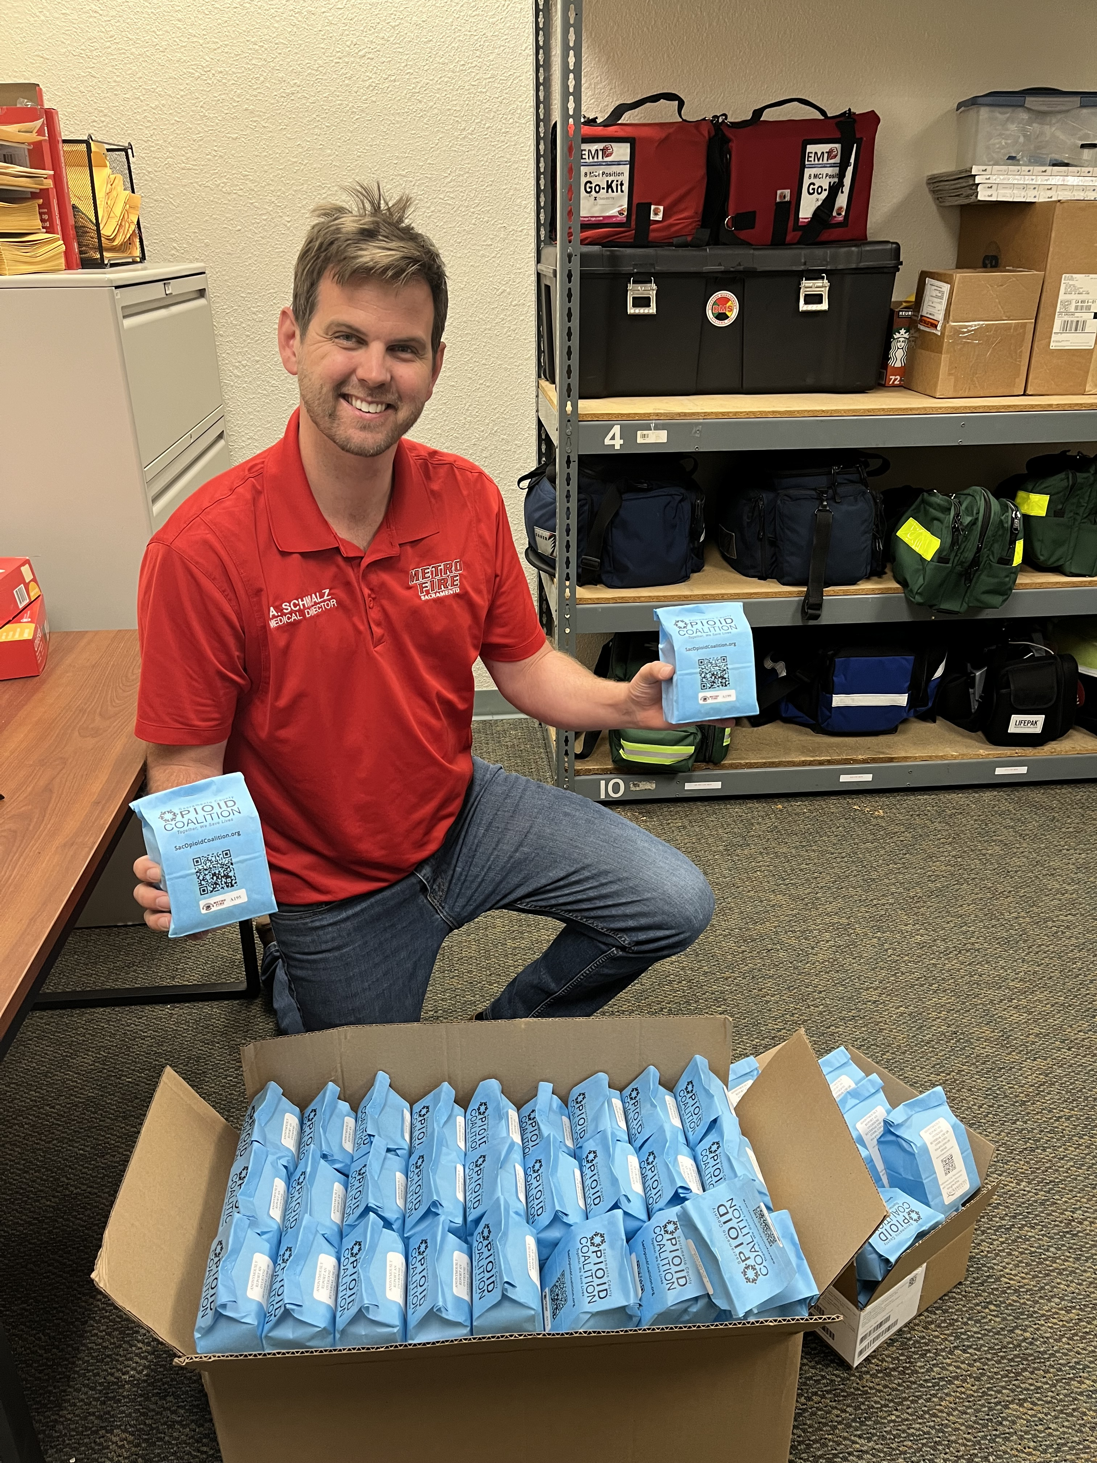
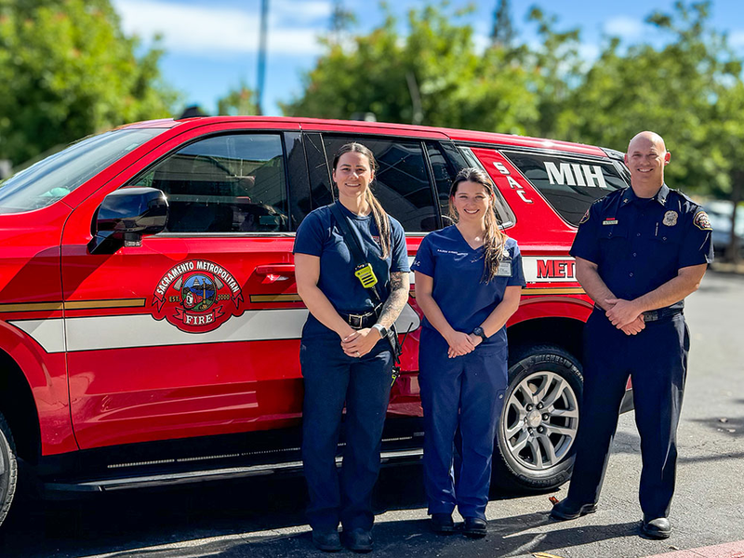
Amplifying the Impact of EMS
Harm Reduction
Leave behind Narcan
Fentanyl test strips
Street Overdose Response Team
EMS MAT (Buprenorphine)
Mobile Integrated Health
Notes:
Suggestion: Change “knowledge is power” to “amplifying the impact” or something like that

Slide 15
Leave Behind Narcan & Fentanyl Test Strips
Notes:
Leave behind Narcan
Piloted with MIH for the past year
Would follow up to patient’s lived environments and provide them education and Narcan
During that time, we’ve worked with county leadership to create a leave behind Narcan program
Several parts of this program
Patients get Narcan
Patients get connection to resources and clinics
Patient’s get wrap around care.
If patient indicates that they want connection to treatment the MIH will reach out to them to offer care

Slide 16
Mobile Integrated Health
Overview of MIH
Expanded MAT capacity
Month long prescriptions
Motivational interviewing
Overdose follow-ups
Leave behind Narcan
Additional Medical Care
Connecting patients to care
Notes:
Would really like to see this fleshed out more.
Structure / overview
A mobile unit of NP/Pas who can offer a higher level of care than a paramedic
Can write for rx
Can go ”off protocol”
2 units
50
109
Rapidly growing since 2022??
Fentanyl Awareness Initiatives
Leave behind Narcan
- MIH was the pilot program
MAT
Ask the crowd if they know anyone who smokes? Anyone who has used nicotine patches
Suboxone/ buprenorphine is like nicotine patches
Prevents withdrawals
Prevents cravings
Talk about how MAT decreases mortality and what it does
Decreases mortality
Allows people to stop using
Allows people to put their lives back together
MIH breaks down barriers to care → brings care to people in their lived environment treatment
Treating people in their lived environments and giving them prescriptions to bridge them until they can get into their care team
Referral to care
Connecting patients to county clinics
Overdose follow up
Harness the power of our EMS Data to provide longitudinal care
Metro fire administers about 1800-2000 doses of Narcan a year
→ Calling all of our people who overdose and offering them buprenorphine and MAT

Slide 17
Street Overdose Response Team
City of Sacramento

Slide 18
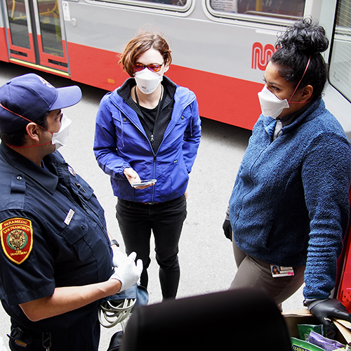
SORT Response
Respond in real time to overdose related incidents
Coordinated Response with Department of Community Response
Outreach to the community
Harm reduction kits
Leave Behind Narcan
Fentanyl testing strips
Follow-up/Case Management
Partnerships with Transitions, BAART, Hope Cooperative and SANE

Slide 19
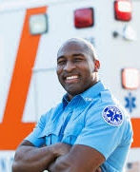
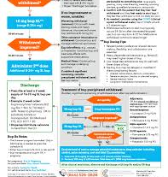
EMS Medication Assisted Therapy (MAT)
Sacramento County EMS is one of 7 counties that Paramedics can give Buprenorphine

