Slide 1
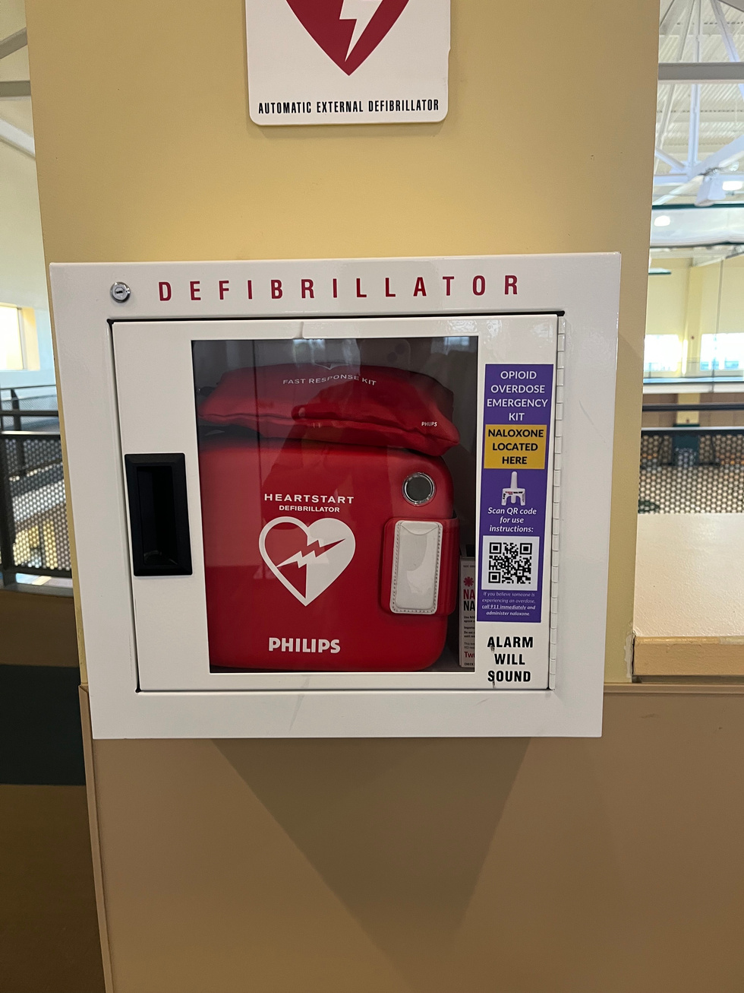

Campus Opioid Safety Act
(SB 367)
The Campus Opioid Safety Act aims to reduce opioid-related overdoses and deaths at public colleges through education and access to overdose reversal medication
Efforts at Sacramento State:
  Collaboration with campus partners to train front-facing students and staff
  In-person Narcan trainings for all campus members
  Asynchronous training option for individuals who prefer to learn on their own time
  Narcan units in AED boxes throughout campus for emergency use
Notes:
There is a link in the title in case people want to learn more about this act.

Slide 2

Student safety: fentanyl test strips
(AB 461)
  Required to provide information about the use and location of fentanyl test strips as part of established campus orientations and to notify students of the presence and location of fentanyl test strips.
  Each campus health center required to stock and distribute fentanyl test strips.
Efforts at Sacramento State:
  Collaboration with campus partners to train front-facing students and staff
  In-person Narcan trainings to include fentanyl test strip information and education for all campus members
  Asynchronous training option for individuals who prefer to learn on their own time
  Fentanyl test strips available for students and campus community in health center.
Notes:
There is a link in the title in case people want to learn more about this act.

Slide 3

  Discuss the Campus Opioid Safety Act (SB 367), Student safety: fentanyl test strips (AB 461) and Sac State's prevention efforts
  Learn about the opioid epidemic and the impact on our community
  Understand what opioids are and what they are used for
  Learn about naloxone/Narcan and how to administer it
  Learn about fentanyl test strips, the safety risks of use, how to use them properly for overdose prevention.
  Identify the signs and symptoms of opioid overdose
  Identify on- and off-campus resources to obtain free naloxone/Narcan and
fentanyl test strips.
Learning Objectives

Slide 4
Training Outcomes 2023-2024
Narcan Trainings begin in August 2023
In-person Trainings - 291
Virtual, Asynchronous Trainings – 457
Total = 748 people trained on campus to on how to administer Narcan
Feedback from participants:
77% of participants now understand what opioids are and what they are used for
85% of participants felt like they were aware of the Campus Safety Act (SB 367) and Sac State’s prevention
84% of participants said they know what naloxone/Narcan is and how to properly administer it

