Slide 1
Rosa A. Vega, MS, D-ABMDI
Sacramento County Coroner

Slide 2
Medicolegal Death Investigation Systems
CALIFORNIA- 58 Counties
Sheriff-Coroner- 48 Alameda, Contra Costa, Humboldt, Orange, Riverside, San Bernardino, Yolo, Kern, etc.
Coroner- 4 Sacramento, Calaveras, San Mateo
Inyo
Medical Examiner- 6 Santa Clara, San Diego, San Francisco, Los Angeles, Ventura, San Joaquin
The Sacramento County Coroner’s Office is independent from Law Enforcement, the District Attorney’s Office and County Crime Lab

Slide 3
Yea​r | Accident | Homicide | Natural | Suicide | Undetermined | To​tal
​​​​​Totals | 9,261 | 1,198 | 5,980 | 2,405 | 938 | 19,782
2010 | 542​ | 91 | 461 | 184 | 64 | 1,342
201​1 | 524 | 91 | 495 | 180 | 72 | 1,362
2012 | 592 | 102 | 473 | 189 | 71 | 1,427
2013 | 606 | 85 | 485 | 221 | 88 | 1,485
2014 | 656 | 101 | 451 | 218 | 72 | 1,498
2015 | 760 | 110 | 493 | 195 | 88 | 1,646
2016 | 751 | 108 | 437 | 191 | 94 | 1,581
2017 | 850 | 91 | 475 | 213 | 82 | 1,711
2018 | 794 | 91 | 480 | 216 | 65 | 1,646
2019 | 924 | 92 | 499 | 212 | 77 | 1,804
2020 | 1,077 | 123 | 564 | 187 | 65 | 2,016
2021 | 1,185 | 113 | 667 | 199 | 100 | 2,264​
In 2023 there were 6,409 reportable deaths of which 2,251 required field investigations

Slide 4
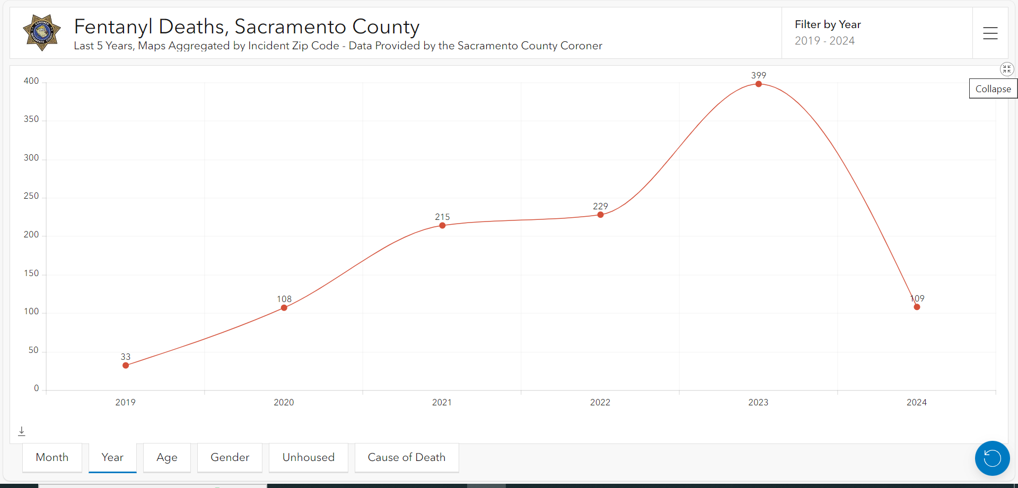
404

Slide 5
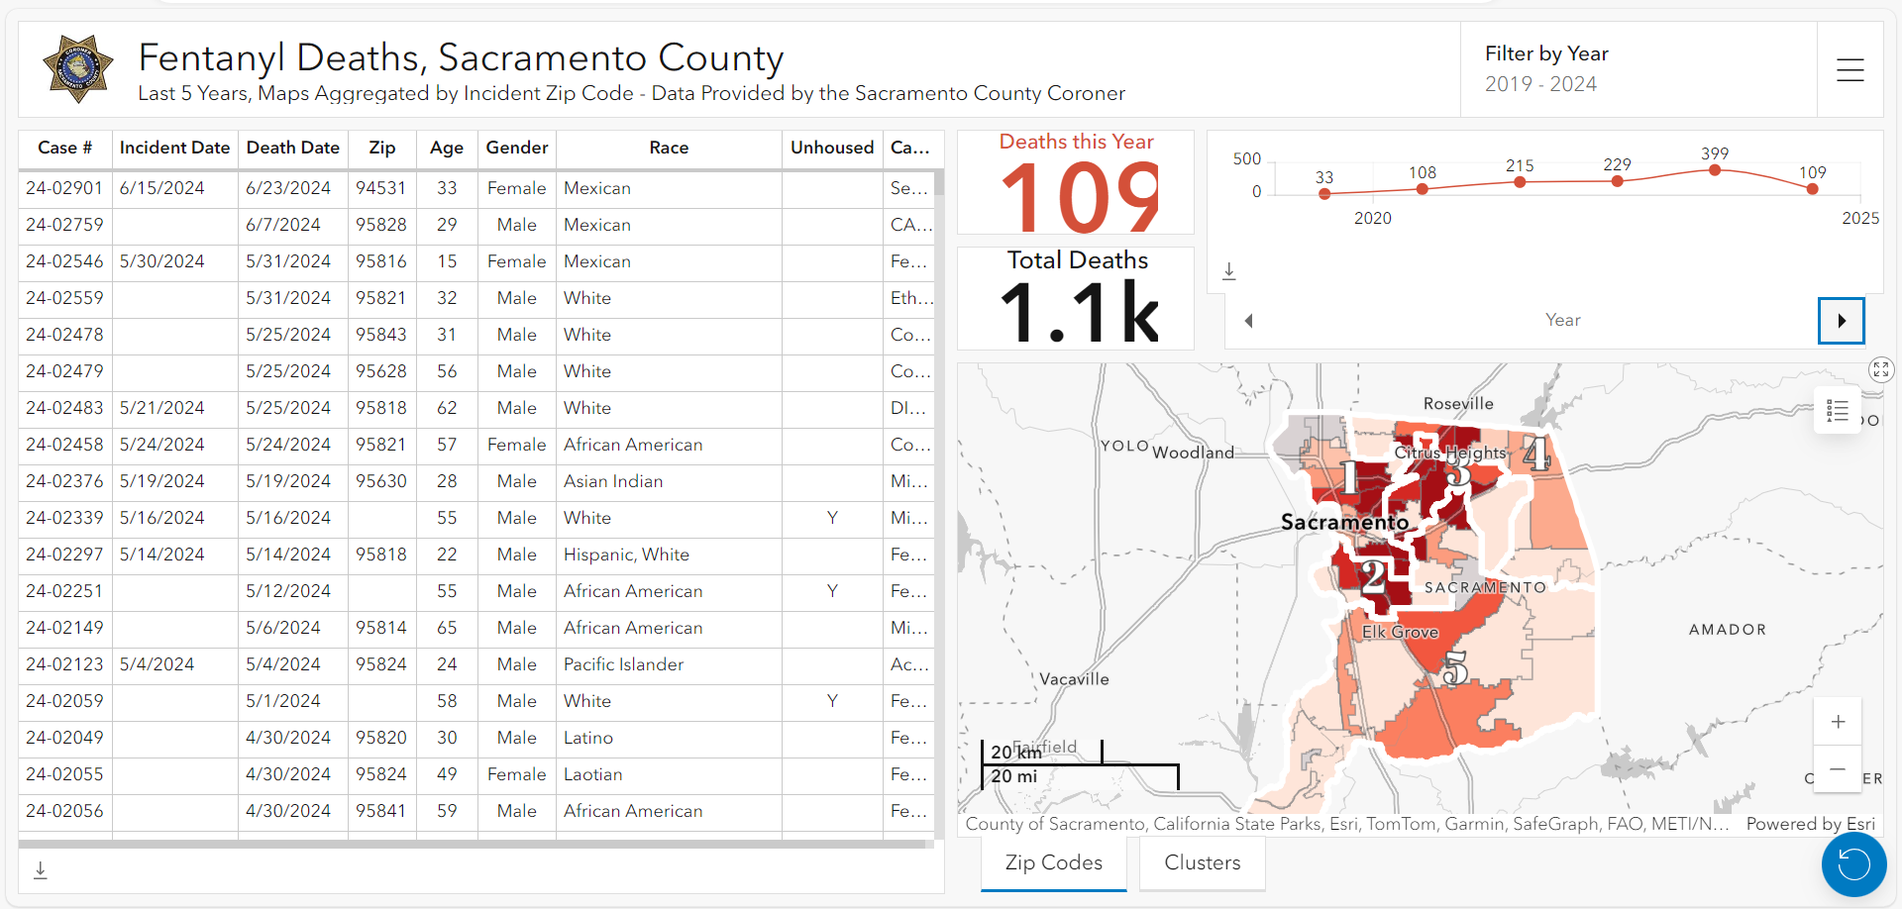
08/05/2024

Slide 6
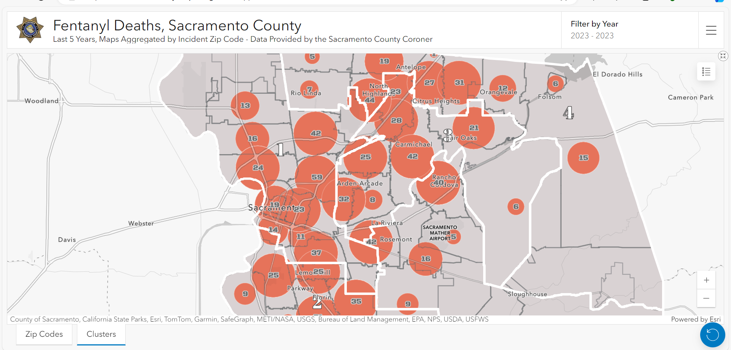

Slide 7
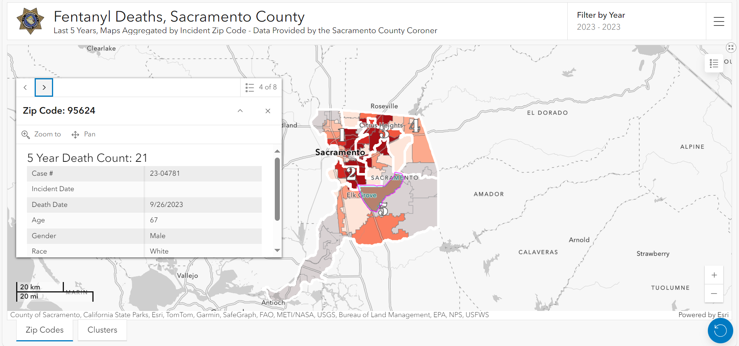

Slide 8
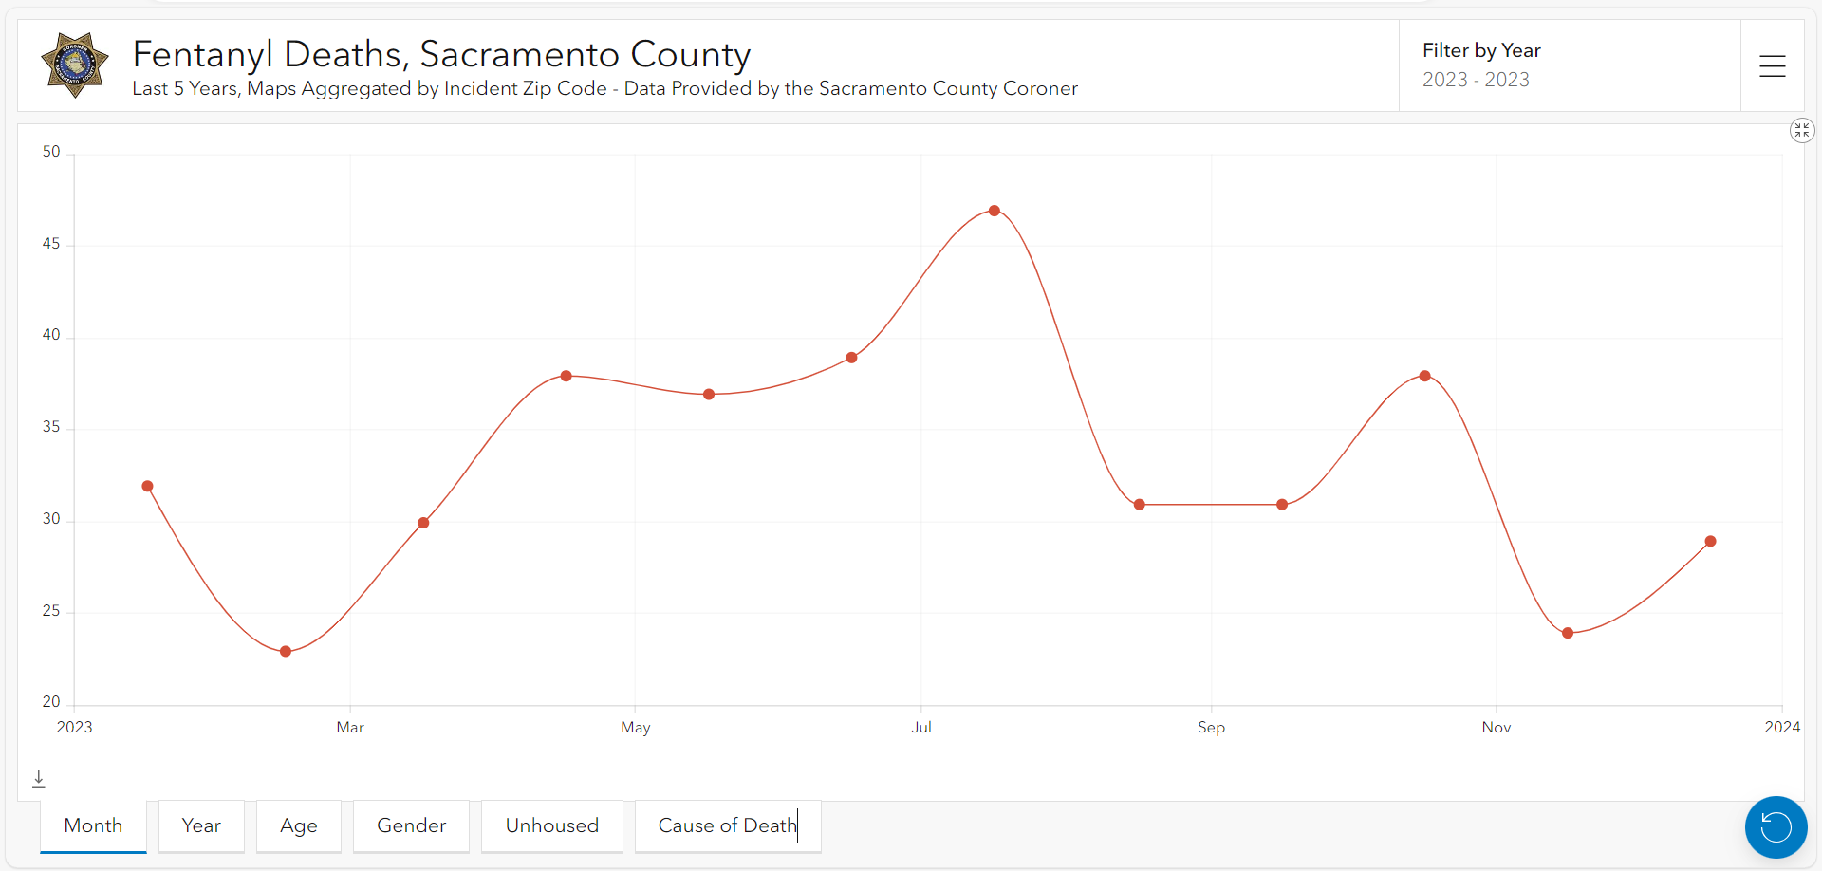

Slide 9
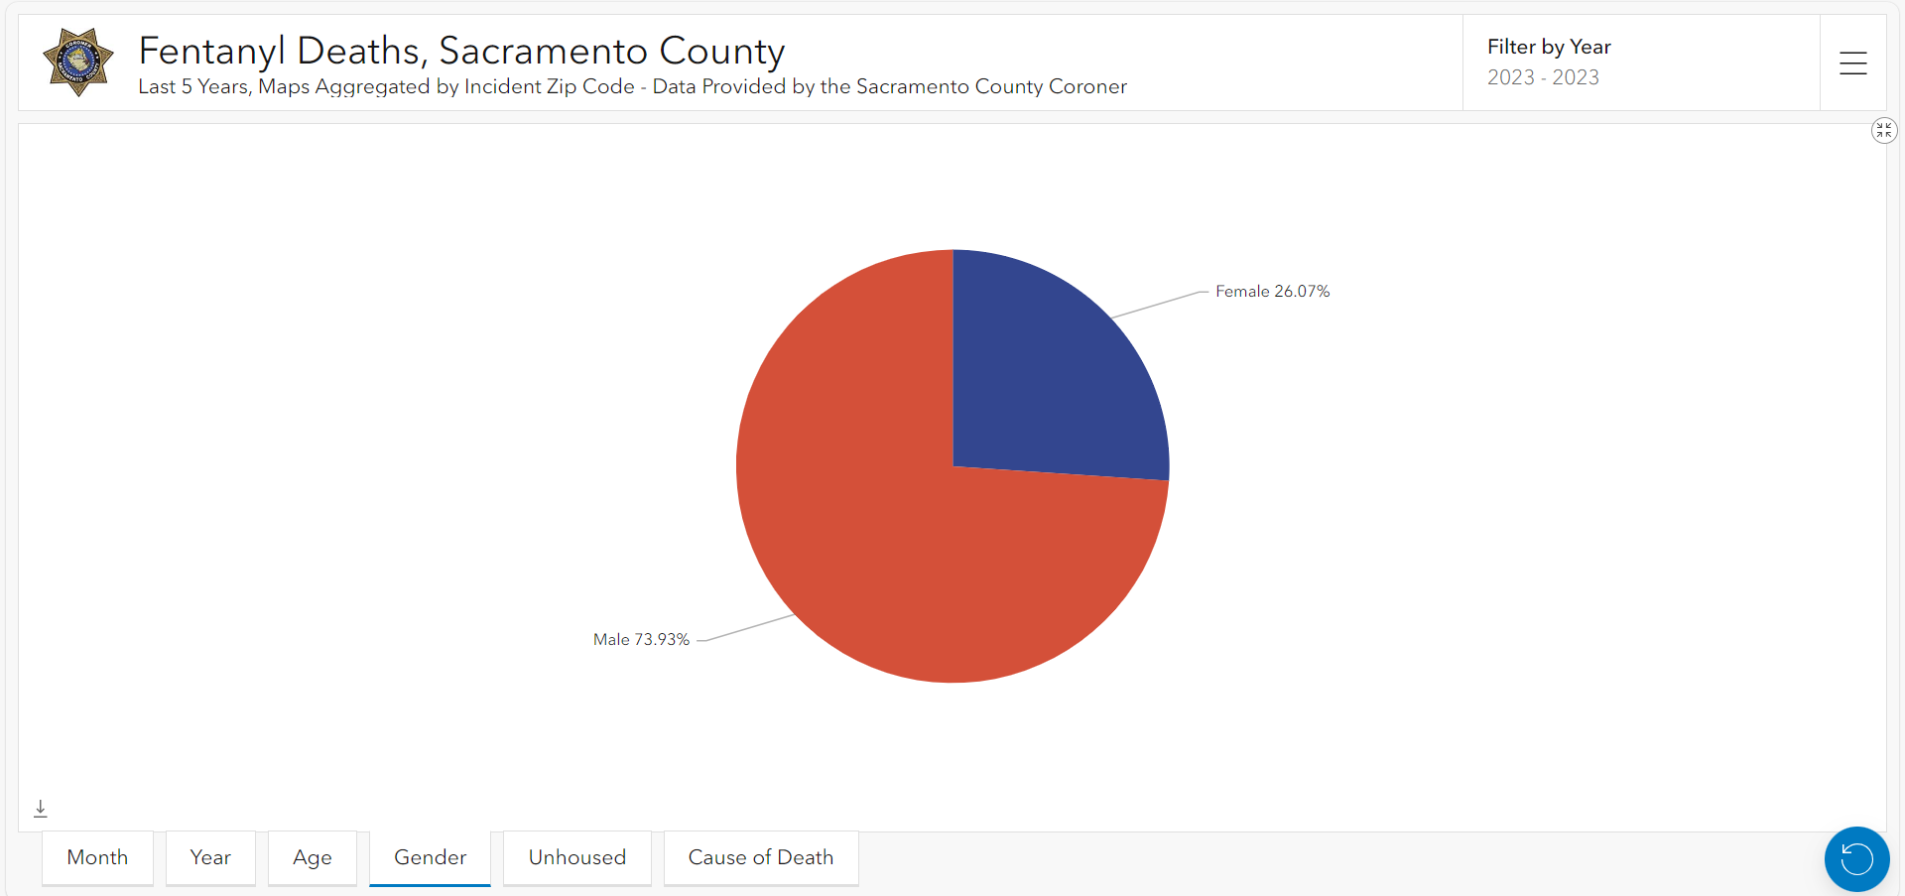

Slide 10
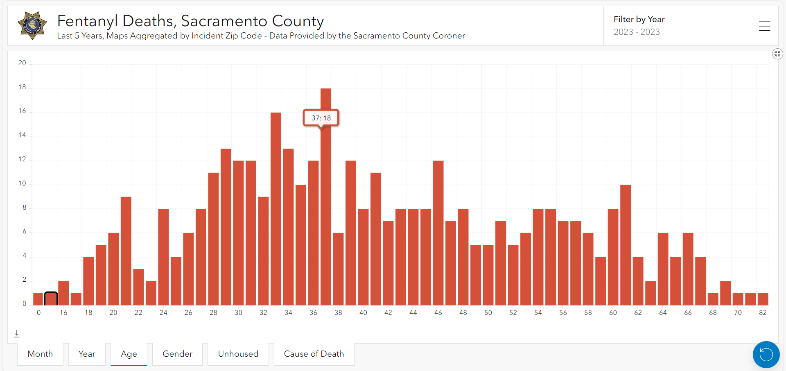

Slide 11
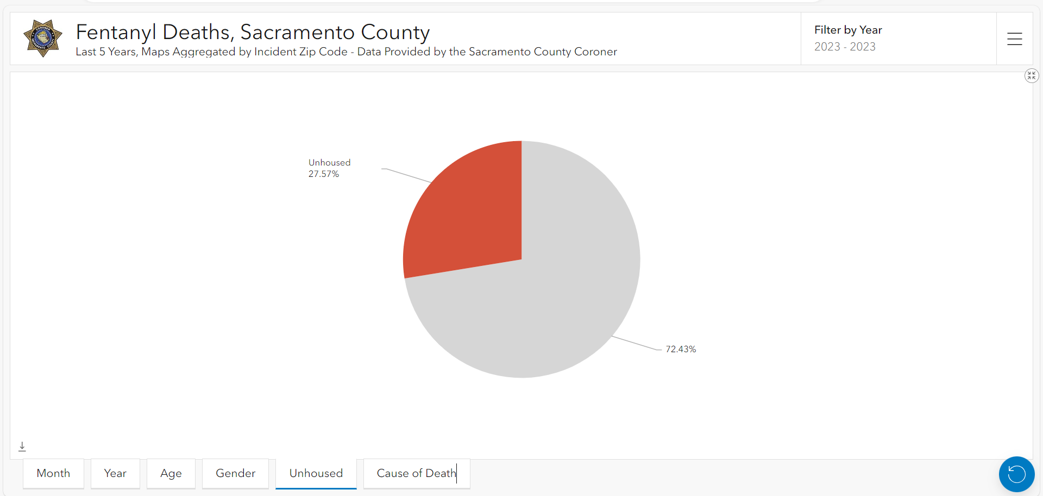

Slide 12
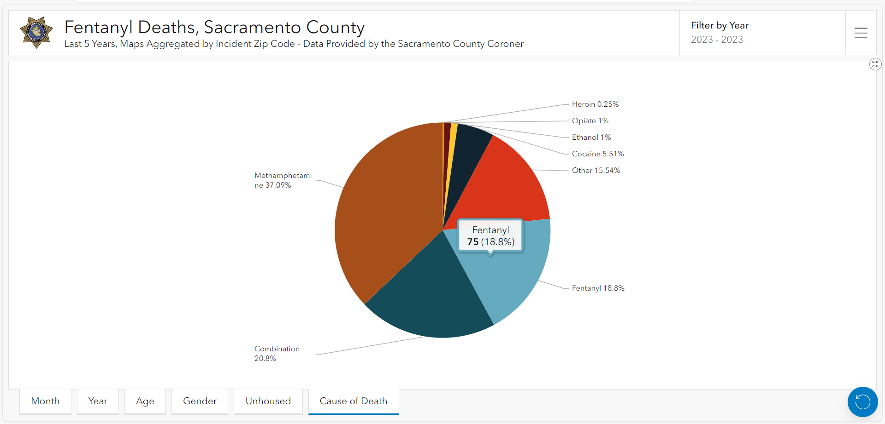

Slide 13
Questions?
Rosa A. Vega
vegarosa@saccounty.gov
Website: https://Coroner.saccounty.gov

