Slide 1
SAC-(Fentanyl Overdose Response Criminal Investigation Enforcement) SAC-FORCE
Response Need –Sacramento Coroner Report on Fentanyl Related Deaths
2019-Present/5-year Death Total (1.1K Deaths)
2022- Death total 223
2023- Death total 403
(26.9 % Unhoused –total 103)
Proposed – Mandatory On-Scene Response Factors:
Victim 35 or under
Recovery of working electronic device,
Cooperative family/witnesses,
Evidence of fentanyl/opioid found at scene, meets physical signs of opioid overdose or opinion by first responders or coroners' death is fentanyl related
Proposed Optional On Scene Response Factors: – Jurisdictional Discretion based on available resources and circumstances

Slide 2
SAC-FORCE GOALS & OBJECTIVES
Create a multi-agency collaborative partnership and approach to Fatal and Non-Fatal OD Investigations
Create a compressive checklist/protocol to guide law enforcements on the scene response and follow-up investigations
Improve the investigative response time to Fatal OD’s (first 24hours) to ensure the preservation and collection of critical evidence for a determination to be made if there is viable death investigation
Provide local agencies with investigative support, resources, guidance and leadership in Fatal OD investigations
Provide local agencies with agencies with investigative support, resources, guidance and leadership in non-Fatal OD investigations (DEA response team assistance for the purpose of potential investigations and collection of intel for regional drug investigations)
Provide patrol officers and first responders with a card with a QR code with a basic protocol on how to identify potential investigations, preliminarily secure an OD scene and contact number 1-800-XSECTOR for TASK-FORCE 24 hours roster with personal available to respond on scene.
Establishment of a District Attorney's Fentanyl Cold Case investigation Team
Facilitate fentanyl investigative training for all participating agencies (including but not limited to Homicide, Narcotics, POP)

Slide 3
SAC- FORCE TEAM Organizational Set-up
Federal Prosecution and Investigation Leads:
US Attorneys- Jason Hitt, James Connolly
DEA Task-Force Supervisor – Bob Ghanzanfari
14-person Multi-Agency Team (Comprised of DEA, CHP, HIS, Yuba County, CDCR,SSO,SPD)
State Prosecution and Investigation Leads:
Sacramento County District Attorney’s Office- Homicide Chief William Satchell, Major Narcotic Supervisor Leland Washington
Sacramento County Regional Overdose Response Team Leader – DA Investigator and TFO Brandon Olivera
Sacramento County Regional Overdose Response Team (Comprised of LE Officers from local agencies and TFO’s assigned to DEA Multi-Agency Team)

Slide 4
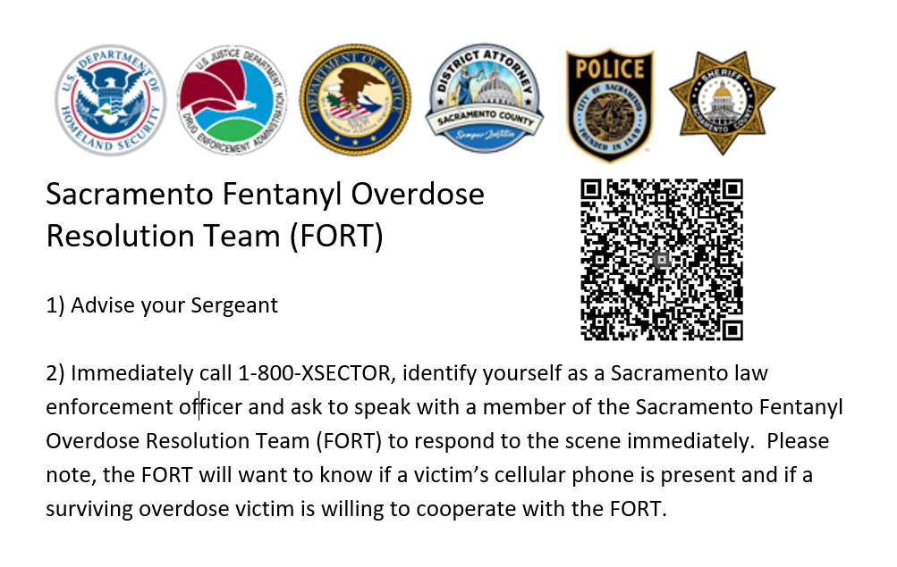
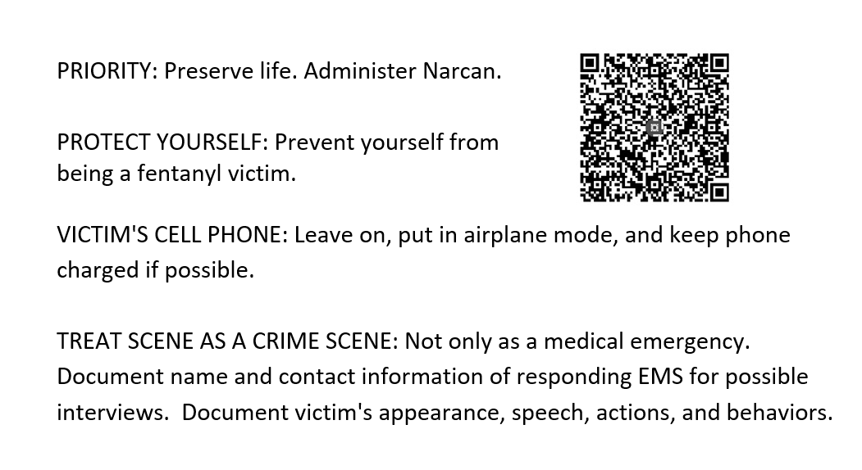
Contacting Support
Front
Back
Notes:
FRONT
Sacramento Fentanyl Overdose Resolution Team (FORT)
1) Advise your Sergeant
2) Immediately call 1-800-XSECTOR, identify yourself as a Sacramento law enforcement officer and ask to speak with a member of the Sacramento Fentanyl Overdose Resolution Team (FORT) to determine if they should respond to the scene immediately. Please note, the FORT will want to know if a victim’s cellular phone is present and if a surviving overdose victim is willing to cooperate with the FORT
BACK
PRIORITY: Preserve life. Administer Narcan.
PROTECT YOURSELF: Prevent yourself from being a fentanyl victim.
VICTIM'S CELL PHONE: Leave on, put in airplane mode, and keep phone charged if possible.
TREAT SCENE AS A CRIME SCENE: Not only as a medical emergency.
Document name and contact information of responding EMS for possible
interviews. Document victim's appearance, speech, actions, and behaviors.

Slide 5
Best Practices For Response Team Cases
Patrol Officers dispatched to potential OD investigations: preserve scene as if it was a homicide.
ID and document potential witnesses by photo ID
Attempt keep witnesses on the scene until the fentanyl response arrives or it is determined will not be responding
Confirm if other potential witnesses left the scene prior to your arrival
Ask witnesses and family not to post about the death on social media
Secure all cell phones and electronic devices connected to victim
Search the area for any video Re: CCTV, Ring camera, street cameras , etc

Slide 6
SAC-FORCE Filing Considerations
Malice must be established for PC 187
All possible intervening sources of other drug sales must be ruled out
Challenges of Mixed Toxicology Findings
Lab tests not preformed by Sacramento Crime Lab
Pathologist Opinion
Coroner Logistical Workload
Initial Filings or alternative filings as Sales cases
Potential for Federal Prosecution on undetermined Mix-tox cases

Slide 7
QUESTIONS?

